Slide 1
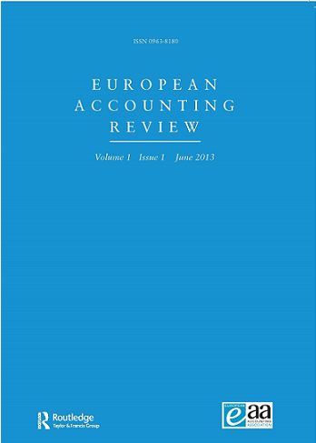
Annual Report European Accounting Review
Amir Amel-Zadeh
Saïd Business School,
University of Oxford, UK
Matias Laine
Tampere University, Finland
Editors European Accounting Review (2024-2027)
Report on the activity
EAR editorial statistics
Year 2024

Slide 2
EAR status & current issues
Year 2024:
First year of the new editorial team
H1: Transition & learning the trade
H2: settled in, processes become smoother
Solid year: submissions increased considerably, metrics remained strong across the board
More detailed report available on the EAA website in due course
EAR Annual Conference
2024: Castellón - 2025: Paris - 2026: Düsseldorf

Slide 3
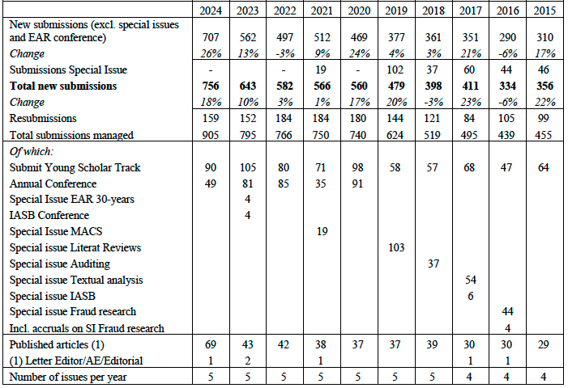
Submissions and Papers Published

Slide 4
Thank You
Comments / Suggestions

