Slide 1
EAA PhD Opportunities and Accounting Resources Centre
EAA PhD Forum
Bergen, 10 May 2022
Tami Dinh, Chair of the ARC

Slide 2
What is the ARC?
https://eaa-online.org/arc/

Slide 3
ARC – Background
Founded in 2016 under Salvador Carmona’s EAA presidency by Thorsten Sellhorn and Philip Joos
Support young scholars to enhance research and teaching productivity and help in building their academic careers
Support in extending academic network, manage teaching activities, link own work to policy-making institutions, the profession, and practitioners
Before: separate ARC website, now: integrated within the (new) EAA website
Before: “Accounting Research Centre”, now: “Accounting Resources Centre” (including education material, outreach & impact)

Slide 4
ARC – Activities
The goal of the Accounting Resources Centre (ARC) is to provide the EAA’s one-stop location for research resources and networking opportunities relevant for emerging scholars and others interested in accounting research.

Slide 5
PhD Mentoring Initiative (Senior Editors: Steven Young, Martin Walker)
The EAA PhD Mentoring Initiative (PMI) aims to help EAA PhD students refine their research proposals and enhance the overall quality of their work by accessing timely advice and feedback from some top accounting researchers. The PMI is a resource open to all European PhD students in accounting.
Journal-style peer review system (Taylor & Francis)
Editors select an expert reviewer to provide constructive feedback via a review report
Editors:
Beatriz Garcia Osma, Universidad Carlos III, Spain
Sven Modell, Manchester Business School, UK
Brendan O’Dwyer, University of Amsterdam, The Netherlands
Laurence van Lent, Tilburg University, The Netherlands
Ann Vanstraelen, Maastricht University, The Netherlands

Slide 6
ARC – Events (Senior Editor: Claudia Imperatore)
Don‘t miss out on any important accounting events, both EAA- and non-EAA-related!
Filter by topics, PhD events, types of events (virtual, association conferences, journal conferences etc.)

Slide 7
ARC – Repository
Under “Repository” we provide all research- and teaching-related material from both physical and online events
Members can share own material and insights with the community
Access for EAA members only
Videos
Codes
Data sources
Presentations
...

Slide 8
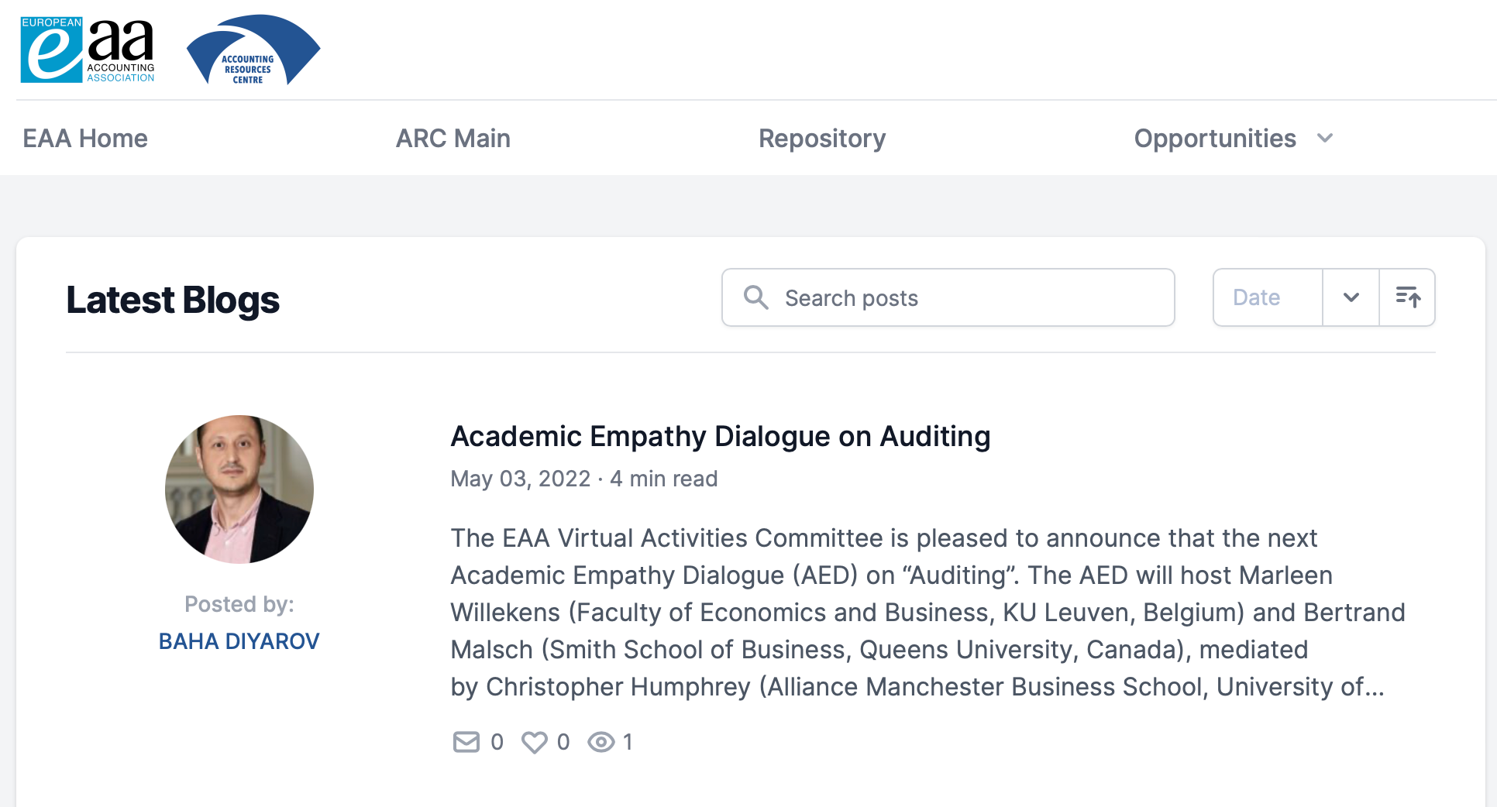
ARC – Blogs
Stay informed, inform others, express your views and learn about other opinions!

Slide 9
ARC – International PhD Visit Scheme
5 scholarships p.a. (EUR 1,000 each) to visit a partner host institution (workspace, access to IT and library, attend seminars and courses)
Cass Business School, City University, London
Erasmus University, Rotterdam
ESSEC Business School Paris
Humboldt-Universität zu Berlin
Lancaster University (subject to a visit fee)
Maastricht University
Norwich Business School UEA (may be subject to a visit fee)
Tilburg University
Universidad Carlos III de Madrid
University of Mannheim
WHU Otto Beisheim School of Management
University of Bern
Next deadline: 31 August 2022 for a visit in the spring term 2023

Slide 10
ARC – International PhD Visit Scheme
Testimonial Rodolfo Damiano, University of Palermo
visiting University of Bristol from October-December 2021:
“I’m extremely grateful to the EAA ARC Ph.D. Visit Scheme and to the University of Bristol for the opportunity they gave me. The atmosphere in the department was very friendly and cooperative. I also had the opportunity to participate in seminars held by prestigious scholars from all over the world and also present my work for which I received very valuable and encouraging comments. Overall, I am strongly satisfied by this experience. These two months have been beneficial to me in many ways. Visiting should expand the horizons of young researchers, and I think this period has had that effect on me.“

Slide 11
ARC – EAA VARS, Education, Outreach & Impact
The ARC provides all information on EAA-related events, which have increased heavily over the last few years:
Virtual Accounting Research Seminars (VARS)
Education Committee Workshops (e.g. Python sessions, experiential learning etc.)
Academic Empathy Dialogues
EAA Reporting Standards Workshops
EAA Junior Network (Meet the Editor)
...

Slide 12
Get involved!
Successful scholars are...:
... excellent researchers
... inspiring educators
... engaging service providers to the discipline
What is “Service to the discipline”?
As an academic you are not only “measured” by your research output and teaching experience but also by how much you contribute to serving your own discipline / community
Reviewer activities (conferences and journals), editorships, editorial board members
Acting as chair, discussant, organizing conferences
Committee work (EAA, AAA, national organizations and others)
ARC offers many opportunities to be involved also for young scholars! Reach out to us!

Slide 13
ARC – Team
We look forward to hearing from you!
Chair: Tami Dinh
Editor-in-Chief: Ana Marques
Editorial Team: Ties de Kok, Christoph Sextroh, Jochen Pierk, Elica Krasteva
PhD Mentoring Initiative: Martin Walker, Steven Young
Events: Claudia Imperatore, Michele Fabrizi, Vanessa Flagmeier, Fabio Motoki, Arthur Stenzel
Opportunities: Evisa Mitrou, Cristina Grande Herrera, Maria Assel, Arianna Pisciella
External Engagement and Funding: Catalin Albu
Social Media: Enrique Mesa Perez, Jamie Johnston, Aljoša Valentinčič

Slide 14
Announcement on the 8th EAA Talent Workshop in Madrid, Nov 2022
EAA Job Market for Accounting Academics, F2F
Madrid, 11-12 Nov 2022, IE University – IE Tower
Application deadline for PhD students: 1 October 2022
Job market paper
Resume
Brief research statement
Send to: eaa-jobmarket@ie.edu
Participation is free for accepted candidates (participation in scientific program, availability to hold interviews with recruiters, coffee breaks, lunches)
Accepted candidates will get access to vacancies posted by recruiting institutions
During the event, institutions and candidates will have the opportunity to meet both through public presentations and private interviews.

Slide 15
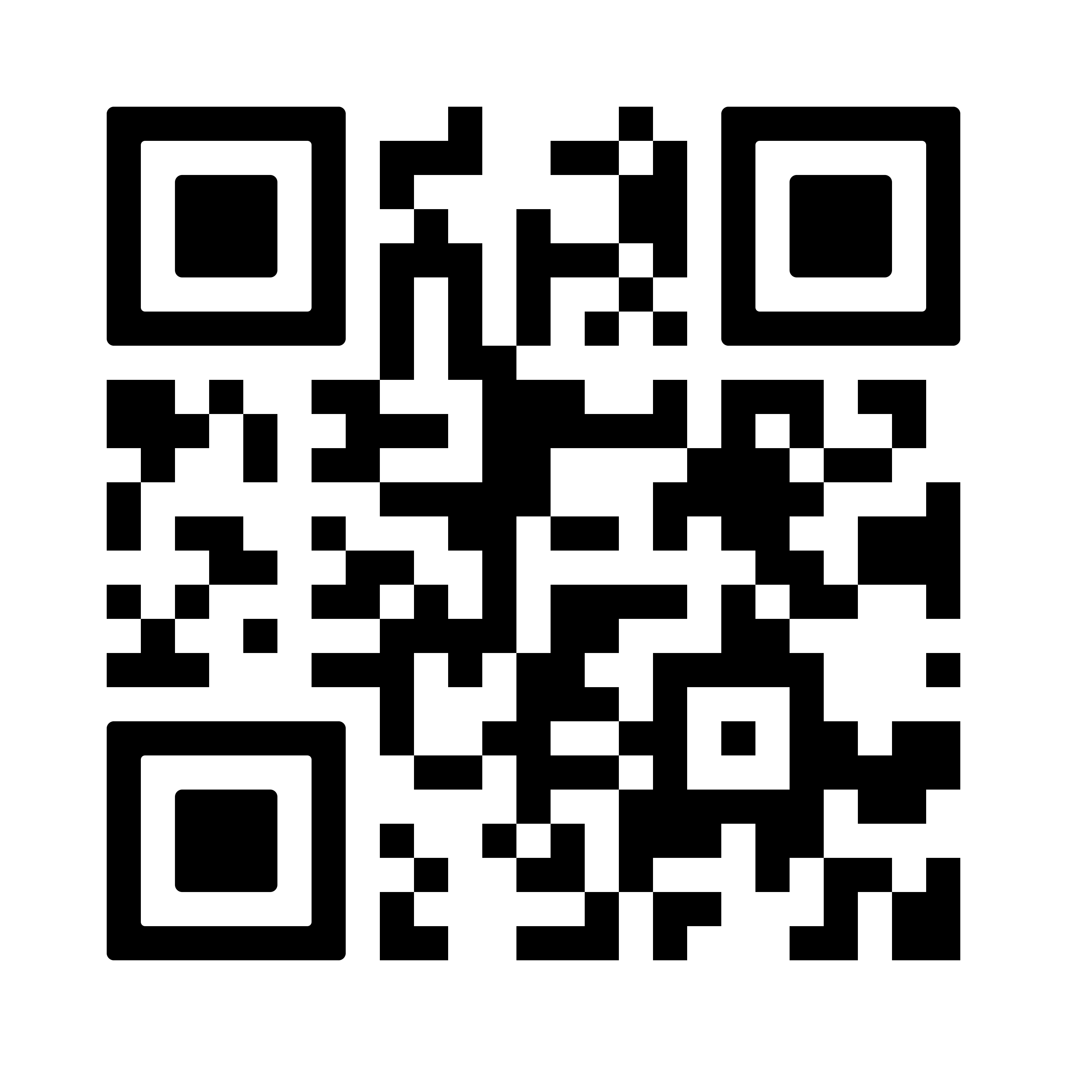
Announcement on the 8th EAA Talent Workshop in Madrid, Nov 2022
Testimonial: Cristina Grande (TW 2018, PhD from Universidad Carlos III de Madrid, at Cass Business School starting 2019)
“My experience at the 2018 Talent Workshop held at IE was very positive and key to finding a job. I had the opportunity of being interviewed by universities not only from Europe but also from other parts of the world. The TW was the perfect setting to meet great scholars and job market candidates and make myself known.”
More on the Talent Workshop here:
https://eaa-jobmarket.ie.edu

Slide 16
THANK YOU!
Q&A

Slide 17
Enjoy the EAA PhD Forum, Congress
and Bergen!

