Slide 1
Making Innovation Work
Organizing and Sensing the Environment
for Innovation Opportunities
Antonio Dávila

Slide 2
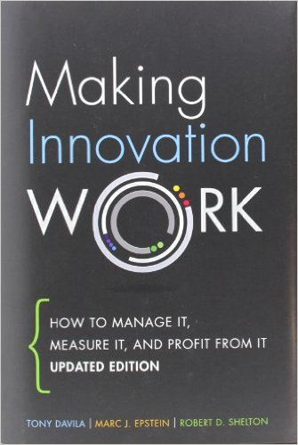
Lessons from Making Innovation Work
How you innovate determines what you innovate
Innovation is a team sport
Innovation is everywhere, it is up to you to take advantage of it

Slide 3
Innovation matrix
Semi-radical
innovation
Radical
innovation
Ignorance
management
New
Incremental
innovation
Semi-radical
innovation
Technology change
Close to existing
Knowldege
management
Close to existing
New
Business model change

Slide 4
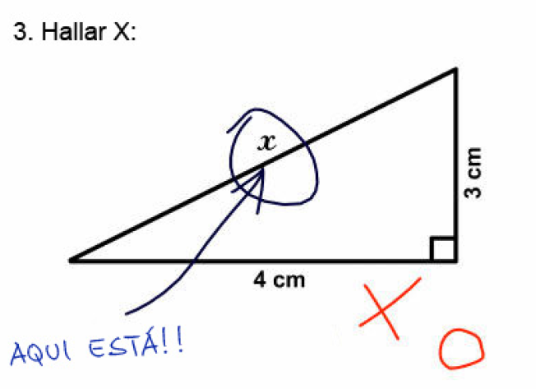
Find X:
Here it is!!!

Slide 5
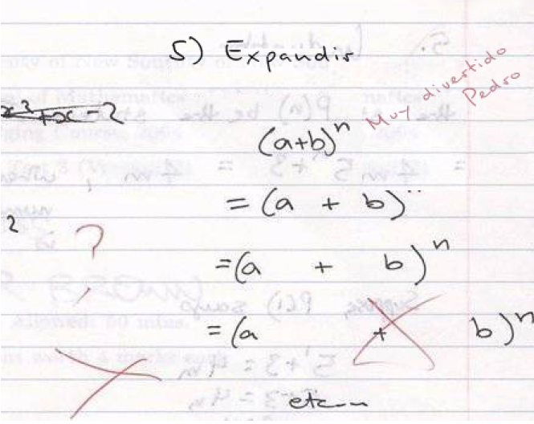
Expand
Very funny
Peter

Slide 6
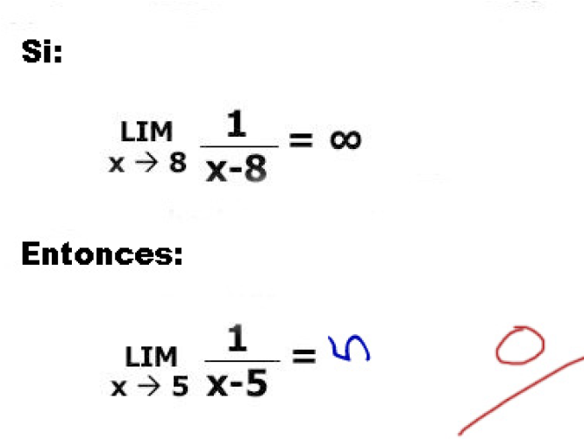
If:
Then:

Slide 7
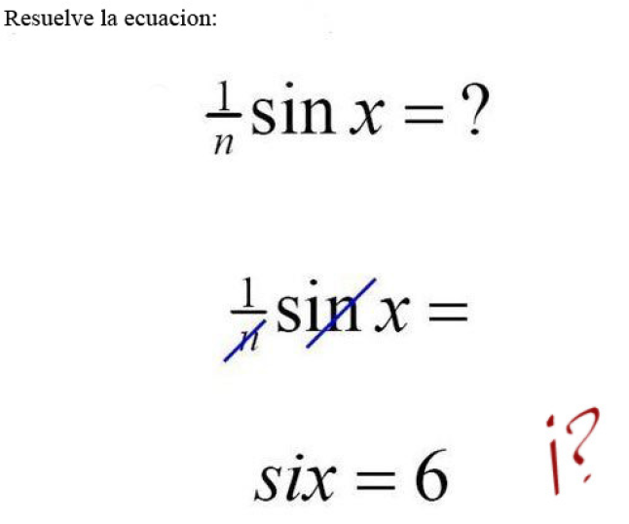
Solve the following equation:

Slide 8
Innovation sources
Strategic bets
Strategic
discoveries
Radical
Continuous
improvement
Emergent
improvement
Type of innovation
Incremental
Top management
Organization
Location

Slide 9
Innovation as a process
How You Innovate Determines What You Innovate.
Innovation Process
Create value
Intelligence-Gathering
Idea-Generation and Screening
Innovation
Platforms
Product Platforms
Corporate
Entrepreneurship
1
2
3
4
5
Stage Gate
Commercialization and Rollout
Value Capture
Capture value

Slide 10
What happened to MySpace?

Slide 11
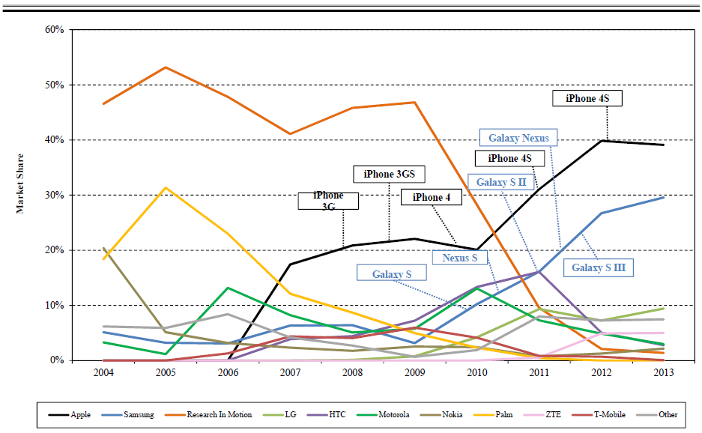
What happened to smartphones?

Slide 12
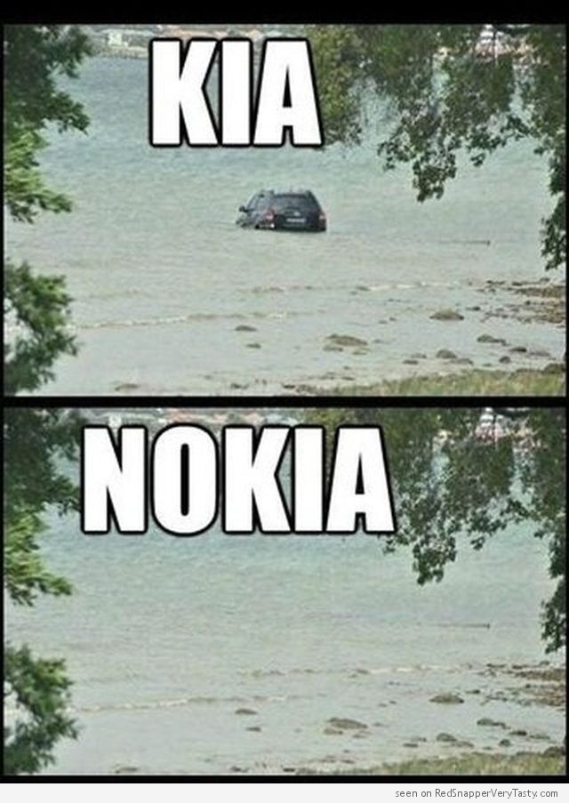

Slide 13
Are those the only ones?
Industries that have already experienced radical changes in their structures
Next?
Education
Healthcare
Energy
Transportation
Finance
News
Fotography
Airlines
Fashion

Slide 14
Opportunities and risks: where do they start?
In the company’s landscape
Competitors
Technology
Regulation
Partners
Social
Company
Demographics
Startups

Slide 15
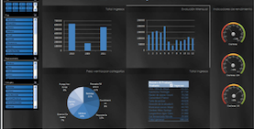
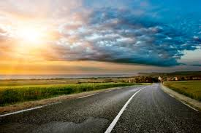
Challenge facing leading companies
Organizations have become excellent at execution
The next battle will be in becoming excellent at seeing change before anybody else does

Slide 16
Critical to constantly scan and assess the landscape
If opportunities and risks are outside then everybody should be scouting
And then discussing what the have seen

Slide 17
Landscape Monitor
Management system to sense the landscape - look and analyze events outside the organization - core as well as peripheral vision
Perceptual acuity: “the ability to see change coming before anyone else does”
Short term – tactical moves
Medium term – incremental strategy
Long term – radical opportunities

Slide 18
Landscape principles
Share a common view of the landscape: map it!
Use as many eyes as possible (crowdsource). Opportunities are outside
Use the talent not only to execute but also to create
Capture events both from public sources as well as individual experiences: visit to a client, observation in a trade show, a thought, or a rumor

Slide 19
Creating a Landscape Monitor
Draw a first map of your landscape characterizing core and peripheral actors
Collect information about actors through crowdsourcing through the organization and outside sources
Discuss the potential implications of events, rumors, and actions. Crowdanalyze the potential implications of them
Visualize the changes in the landscape through heat-maps, analyze patterns of events, and identify trends and weak signals
Analyze the outputs of the system to identify actionable insights

Slide 20
Final thoughts
Execution is not enough
Look outside for innovation opportunities
Think of technology and business model
Rely on the talent you so carefully hire
Make looking outside part of your competitive advantage

