Slide 1
Big Data and Accountants – a user perspective
Narayanan Vaidyanathan
12/05/2016

Slide 2
Developing professional accountants the world needs
178,000 members
181 countries
95 offices

Slide 4
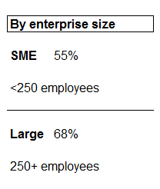
Extent to which developments in technology will transform the way
accountants and the finance function do business over the next 10 years
Expectation of Big Data having an impact on their business in the future
GLOBAL
62%
N = 2,074 professional accountants

Slide 5
What?
So what?
V
alue
V
olume
ariety
elocity

Slide 6
Despite upper single digit sales CAGR to 2025, limited margin leverage mutes earnings, but Intuitive still has high OM/GM ratio in devices
Willamette Vineyards shows low risk, based on our Exposure Scale Metric - metric drivers of volatility declined while leverage stayed level

Slide 7
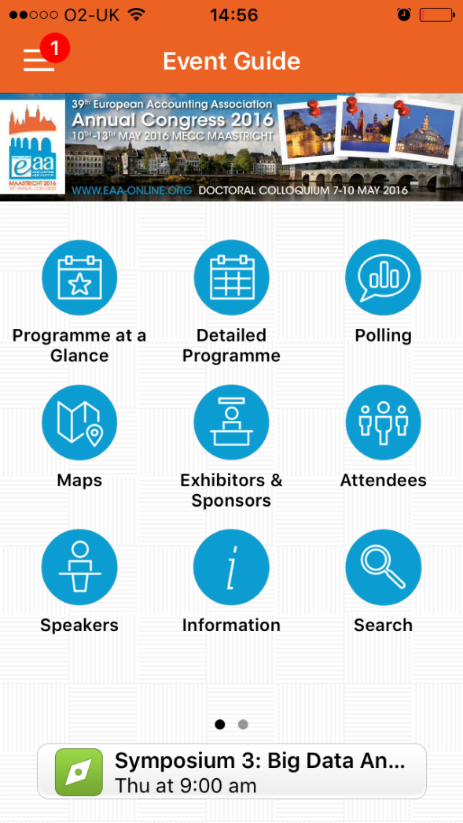
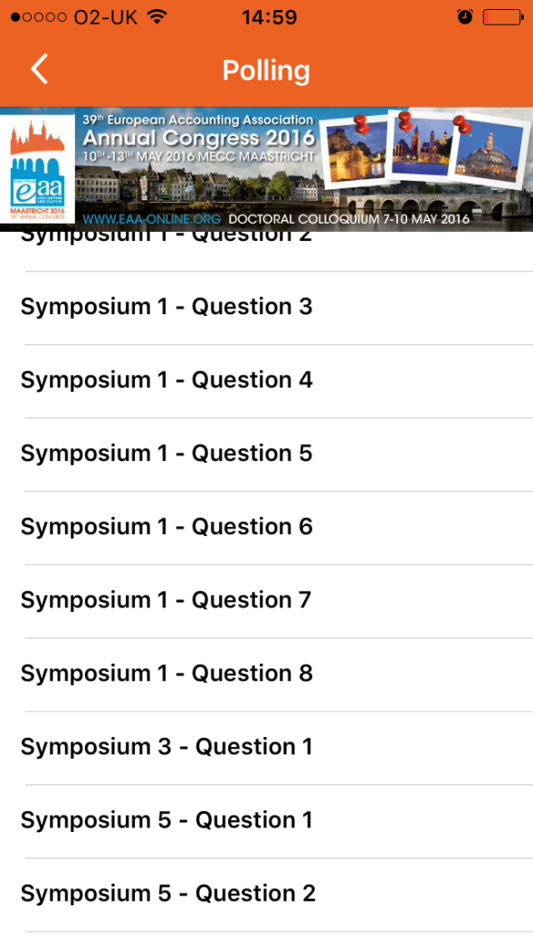
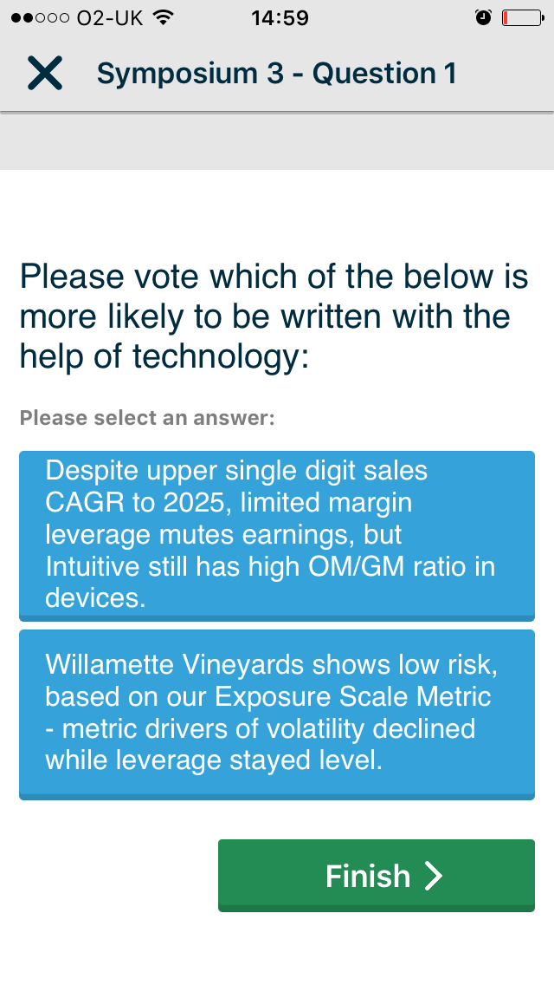
https://api.cvent.com/polling/v1/api/polls/spk87hux

Slide 8
Despite upper single digit sales CAGR to 2025, limited margin leverage mutes earnings, but Intuitive still has high OM/GM ratio in devices
Willamette Vineyards shows low risk, based on our Exposure Scale Metric - metric drivers of volatility declined while leverage stayed level

Slide 10
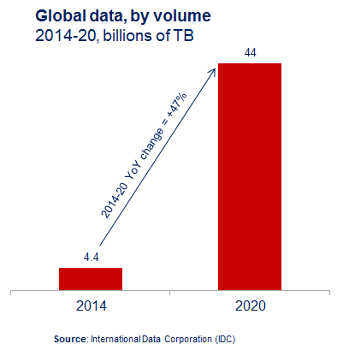
Open source
Distributed
Flash memory

Slide 11
Data lifecycle
Scope
Requirements
Planning
Creation
Collection
Cleansing
Sourcing & Extraction
Retrieval
Static pre-defined reports
Access rights
Audit trail
Physical safety
Storage & Security
Analysis & Discovery
Processing & Distribution
Modelling/BI
Visualisation
Predictive
Repurposing
Archiving & Disposal
Areas of particular interest to accountants and finance professionals

Slide 12
Fin
IT
HR
DATA
Legal
Bus. unit
Ops
SHareholder → STakeholder
Integrated Reporting
Non-financial disclosure
Focus on Future

Slide 13
“
When it comes to embracing technical innovation, finance professionals often tend to err on the side of caution...the Data Revolution is an excellent opportunity for accountants to make a real difference
”
Director, Global Audit and Consultancy Firm

Slide 14
Data as Asset/IP
Business/organisational strategy
E2E process
Leading change
Data Strategy
Data confidentiality, copyright
Ethical stewardship
Control mind-set and training
Data Governance
Data as Hygiene Factor
Data Management

Slide 16
SOURCE: designlenta

Slide 19
Thank You!

