Slide 1
European Union
Public Interest Entities (PIEs)
Databases
Featured Research May 2016

Slide 2
Databases
Who audits EU PIEs
EU Listed Companies
Credit Institutions
Insurance Undertakings
Other Member State Defined PIEs
Auditor Tenure (with most recent audit fees)
Auditor Fees
Auditor Changes
Transparency Reports
Subsidiaries
US SEC Audit Client Subs that are EU PIEs
EU PIE Subs that are US SEC Registrants & other EU PIEs
Expanded Audit Reports (EARs)
Audit Opinions with Issues Taxonomy
Lead Engagement Partners
EU Member State Laws and Regulatory Frameworks

Slide 3
Population – EU Public Interest Entities (PIEs)
All entities that are both governed by the law of a Member State and listed on a regulated market.
All credit institutions in the EU, irrespective of whether they are listed or not
All insurance undertakings in the EU, irrespective of whether they are listed or not and irrespective of whether they are life, non-life, insurance or reinsurance undertakings.
Entities designated by Member States as public-interest entities, for instance undertakings that are of significant public relevance because of the nature of their business, their size or the number of their employees.
Exchange-listed Entities (ELE) | EIOPA Insurance Undertakings (IU) | EBA Credit Institutions (CI) | Member State PIEs (TR PIEs That Are Not ELE, IU, or CI) | Total PIEs*
7,934 | 4,325 | 4,466 | 26,782 | 43,507
* Figures as of May 2016.

Slide 4
EU Audit Firm Market Share Listed PIEs

Slide 5
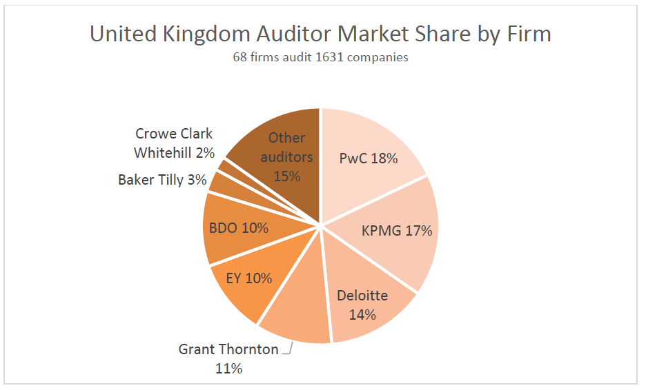
EU Auditor Market Share Listed PIEs
Note: Market share percentages are relative to the entire audit market of exchange-listed entities for the United Kingdom.

Slide 6
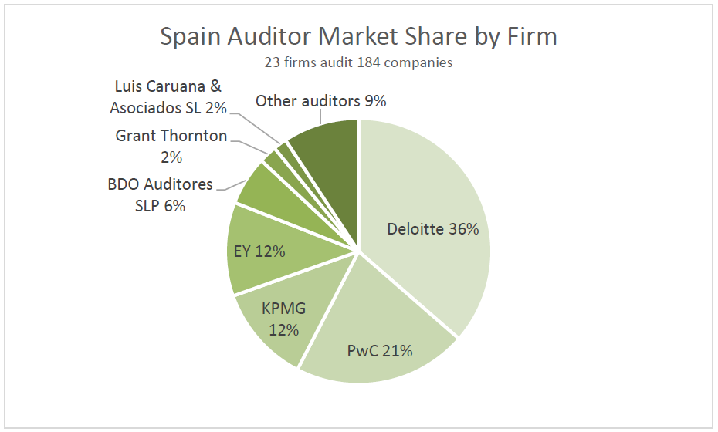
EU Auditor Market Share Listed PIEs
Note: Market share percentages are relative to the entire audit market for exchange-listed entities in Spain.

Slide 7
EU Audit Firm Rotation Projected Effect For Listed Companies

Slide 8
EU PIE Subsidiaries by Location (top 2,000 listed companies)
Asia
Middle East
Africa
USA
European

Slide 9
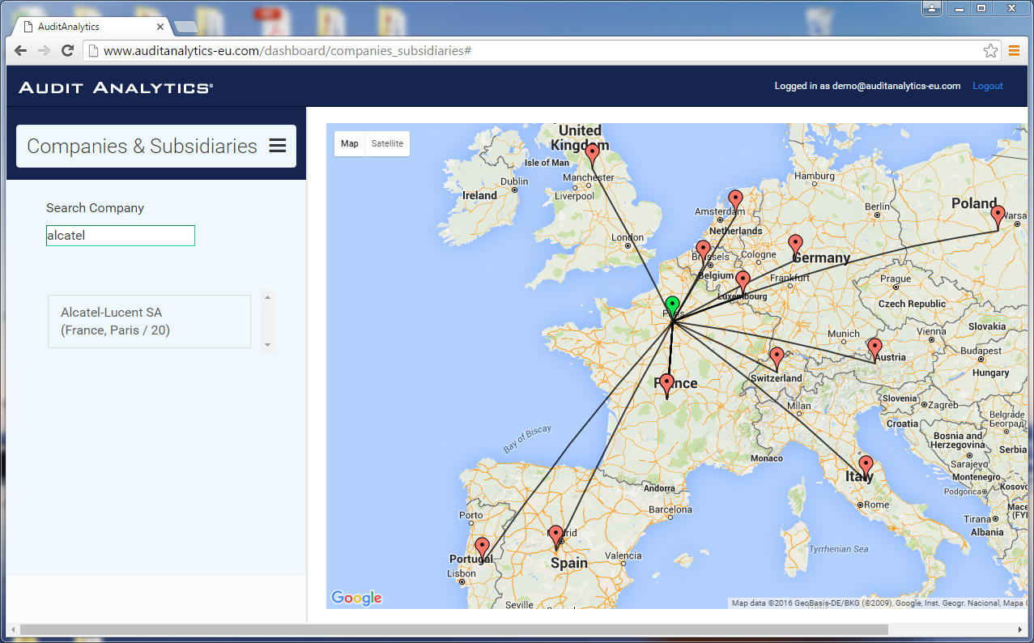

Slide 10
EU Subsidiaries of PIEs by Country (from top 2000 listed companies)

Slide 11
EU Exchange-listed PIEs: Disclosed Fees Paid to Audit Firms
2013 to 2014 : 5.06% increase in Audit Fees
2012 to 2013 : 2.22% increase in Audit Fees

Slide 12
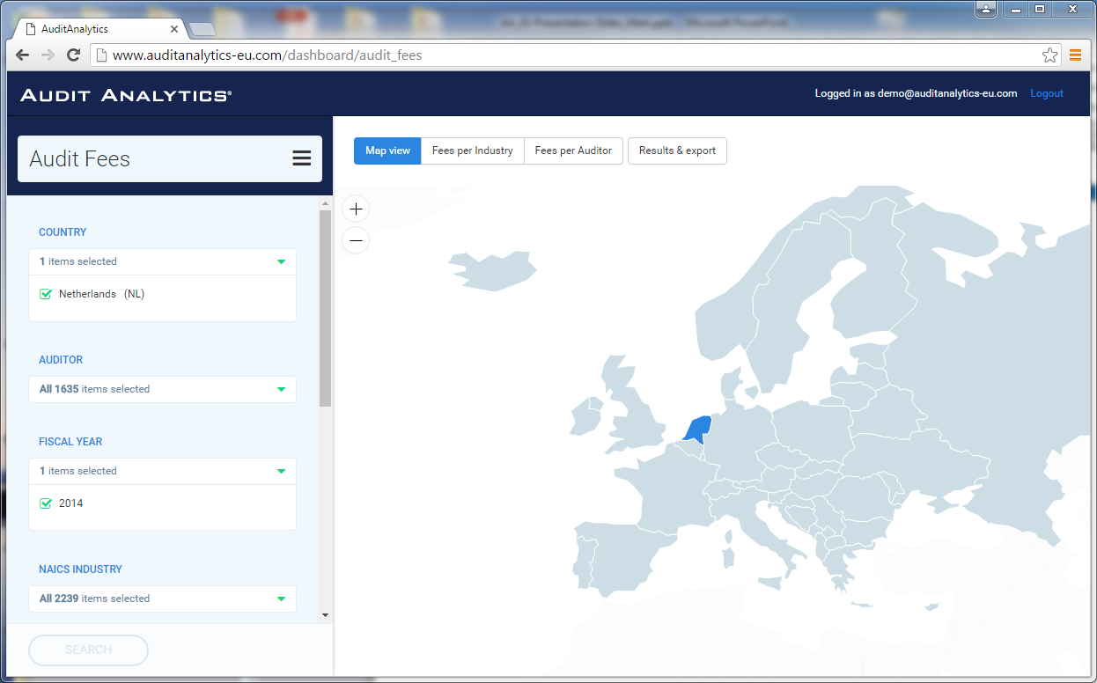
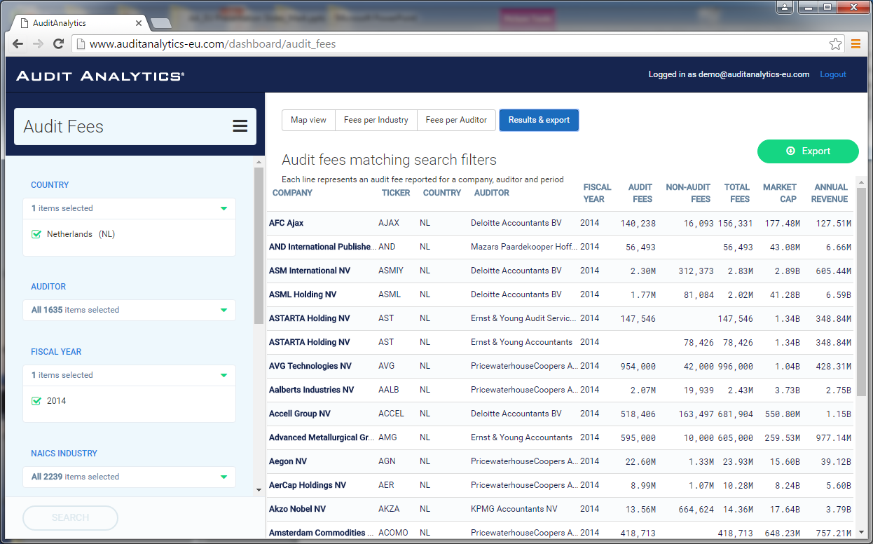

Slide 13
Contact Information
Mark Cheffers CPA, ABV
Audit Analytics
CEO and Founder
Office: (508) 476-7007 ext. 223
E-mail: mcheffers@auditanalytics.com

