Slide 1

About Us:
University of Wisconsin - Madison School of Business
Founded in 1900, the Wisconsin School of Business at the University of Wisconsin-Madison established one of the first five business programs in the nation. That entrepreneurial spirit remains strong.
Located within one of the world's leading public research universities, the Wisconsin School of Business is a vibrant community that honors our university's commitment to research and public service.
Together, we foster a passionate and diverse community of scholars, leaders and learners to address business challenges, inspire leadership, and improve lives.
Together Forward

Slide 2
Information Sharing During Auditors’ Fraud Brainstorming: Effects of Psychological Safety and Auditor Knowledge
Karla Johnstone, EY Professor (University of Wisconsin – Madison) with Jodi Gissel (Marquette University)

Slide 3
Definition of Psychological Safety
Psychological safety is a
  “sense of being able to show and employ self without fear of negative consequences to self-image, status, or career” (Kahn 1990, 705)”.
  “shared belief that the team is safe for interpersonal risk taking… (and is meant to suggest)… a sense of confidence that the team will not embarrass, reject, or punish someone for speaking up” (Edmondson 1999, 354).

Slide 4
Motivation
Less knowledgeable auditors likely possess valuable information that is known only to them from their daily interactions with client personnel (privately-known, fraud-relevant information).
Auditors may hesitate to share privately-known information because of team dynamics that highlight the risks of doing so.
Yet, such information contains cues that can assist the team in forming a problem representation about an existing, incomplete pattern of cues that, taken as a whole, are suggestive of fraud.

Slide 5
Purpose and Experimental Manipulation
We investigate the effects of psychological safety and auditor knowledge on subordinates’ willingness to share privately-known, fraud-relevant information.
We use a video of a simulated brainstorming session and alter how the audit partner leads the session (e.g., body-language behaviors) rather than the substantive content of the communications to manipulate psychological safety.

Slide 6
Literature Review and Hypotheses: Psych Safety
Psychological Safety and Information Sharing
  Psychologically safe settings display non-threatening group dynamics and a leadership style that encourages members to share ideas without fear of criticism (Kahn 1990).
  When members fear negative consequences from speaking up, they may choose “defensive silence”, i.e., self-protective behavior based on fear in which an individual intentionally withholds ideas, information, and/or opinions (Van Dyne et al. 2003).

Slide 7
Literature Review and Hypotheses: Task Knowledge
Auditor Knowledge and Information Sharing
  Less knowledgeable auditors likely possess less underlying ACCT/AUD knowledge and knowledge about the importance of sharing privately-known, fraud-relevant information.
  In addition, teams are comprised hierarchically, whereby partners possess greater power, status, and authority.
  “less experienced auditors are more likely to think that their inputs to group performance are dispensable”… in fraud hypothesis generation (Chen et al. 2015, 177).

Slide 8
Literature Review and Hypotheses: Task Knowledge
Auditor Knowledge and Information Sharing
H1: Less-knowledgeable subordinates’ willingness to share privately-known, fraud-relevant information is positively associated with perceived psychological safety, whereas more-knowledgeable subordinates’ willingness to share is insensitive to perceived psychological safety.

Slide 9
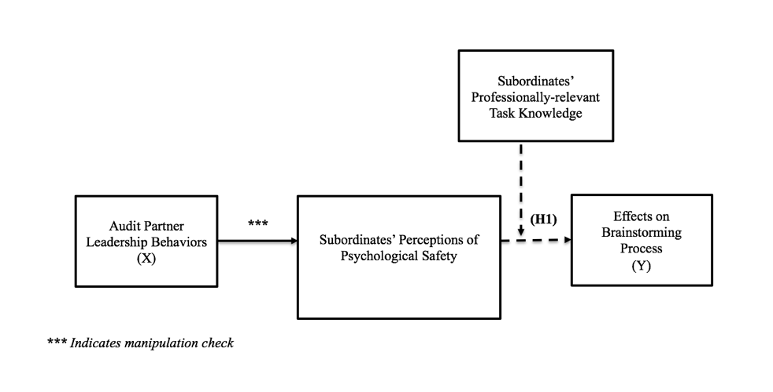
Conceptual Model

Slide 10
Methods: Subjects and Procedures
Participants are 37 staff and 32 senior auditors.
2X2 experimental design (knowledge X psychological safety)
Procedures:
  Review case materials.
  Rate willingness to share twelve qualitative fraud risks during brainstorming on a scale of zero (not at all) to ten (extremely comfortable).
    Of which, participants are aware that they alone possess four privately-known, fraud-relevant risks.
  View brainstorming video (hi vs. low psych. safety).
  Rate willingness to add the same twelve qualitative risks.
  Respond to manipulation checks and demographics.

Slide 11
Methods: Case
The case is based on an SEC enforcement action that documents fraud relating to an executive compensation plan and franchise reacquisitions (for specific case details, see SEC 2009 Krispy Kreme doughnuts).
More safe: http://youtu.be/AF1uwH9o_l0.
Less safe: http://youtu.be/l0AAZRZ9cvc.

Slide 12
Methods
Dependent variable
  Main analysis: participants’ mean change in willingness to share the four privately-known, fraud-relevant information before and after viewing the brainstorming session, ∆SHARE_PRIVATE.

Slide 13
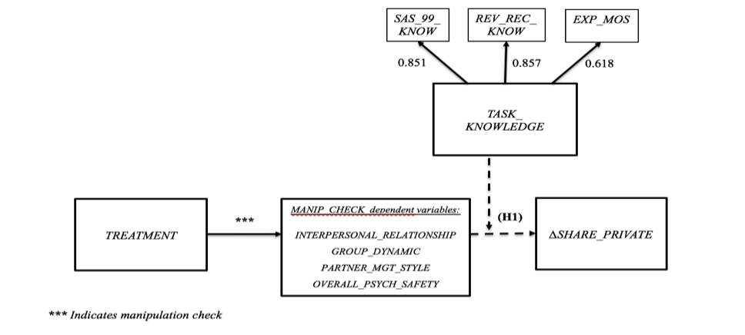
Depiction of Operational Model

Slide 14
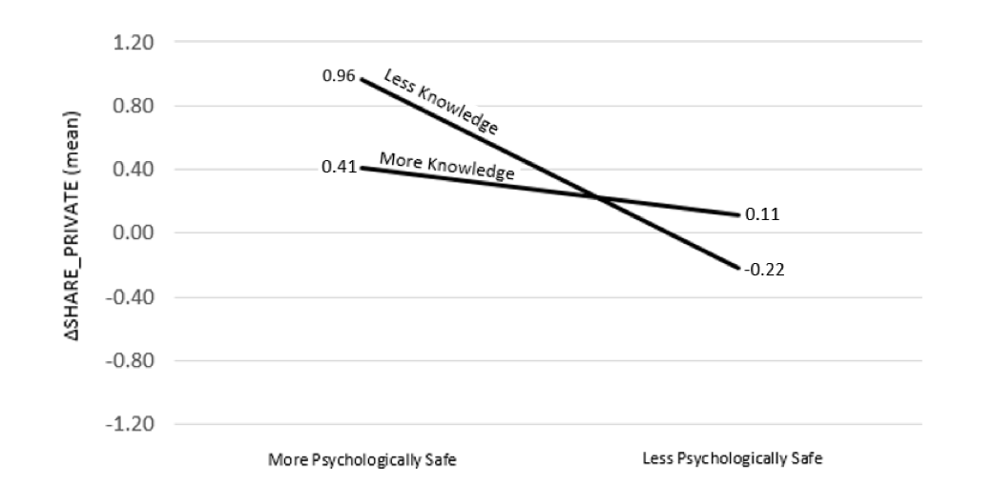
Results: Main Analysis

Slide 15
Conclusions
Higher psychological safety encourages sharing of privately-known, fraud-relevant cues
  This effect is more pronounced for less-knowledgeable subordinates.
  Making partners aware of this may aid effectiveness of brainstorming sessions in practice.
  And may help understand one possible source of process loss in brainstorming teams.
Researchers can manipulate perceptions of psychological safety
  Measuring auditors’ perceptions of superiors’ psychological safety in the field (as is done in the psychology literature) would yield interesting implications for audit quality.

Slide 16
Thank you!

Slide 17
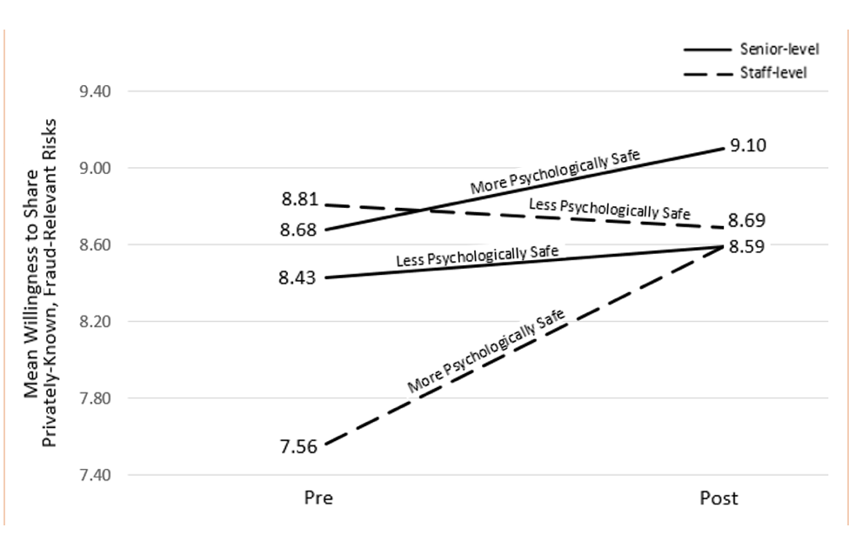
Alternative Levels Analysis Using Rank

Slide 18
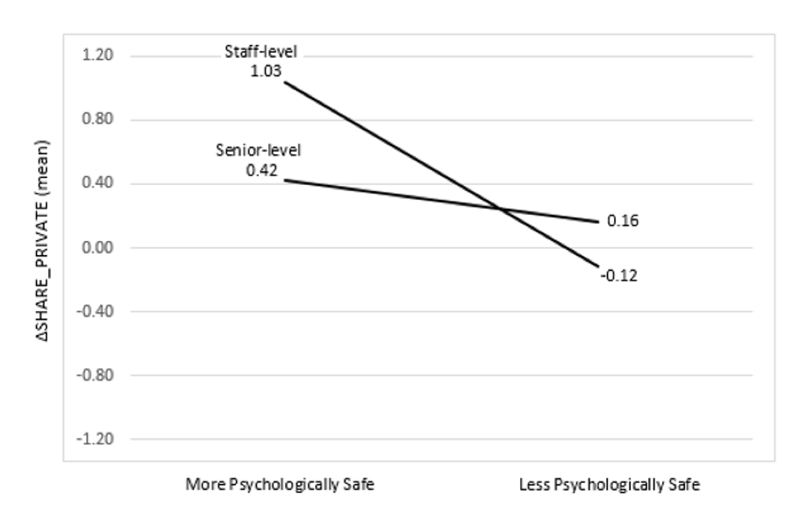
Using Rank the Inferences are the same

