Slide 1
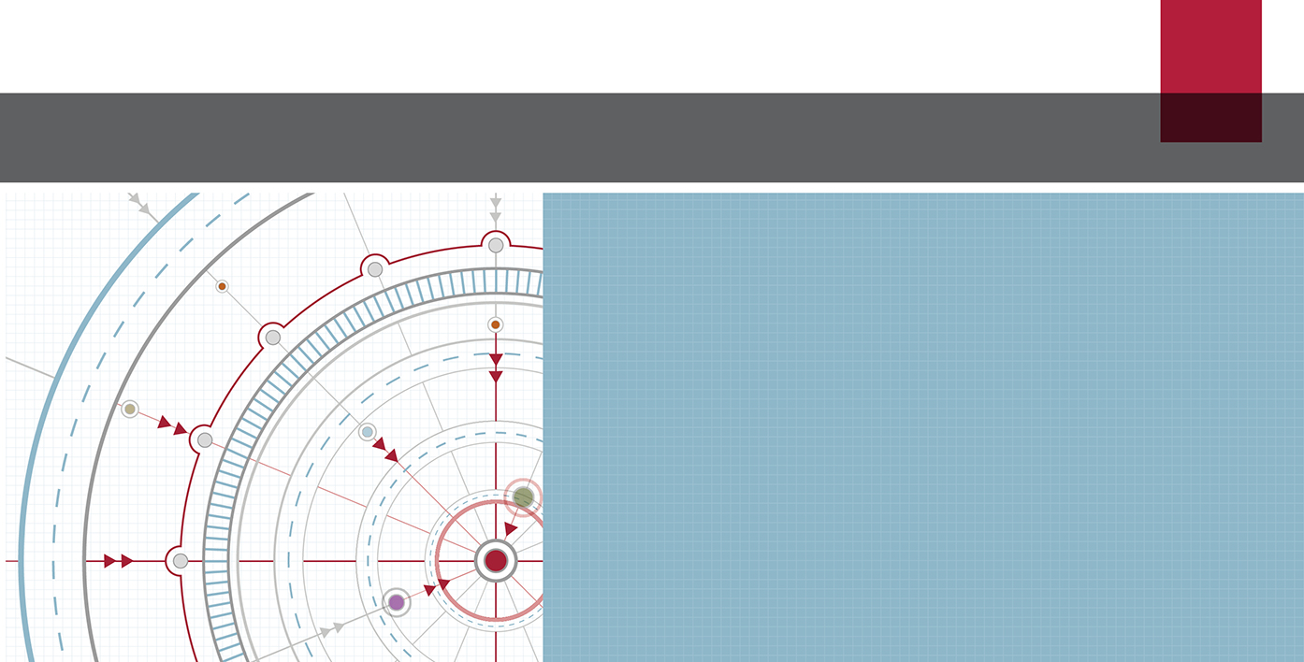
Conceptual Framework for Financial Reporting Part II EAA Congress IFRS workshop
IFRS® Foundation
May 2018
The views expressed in this presentation are those of the presenter, not necessarily those of the International Accounting Standards Board (Board) or IFRS Foundation.
Copyright © IFRS Foundation. All rights reserved

Slide 2
Elements of financial statements and recognition criteria
2

Slide 3
Elements of financial statements— assets, liabilities and equity
Relate to financial position
A present economic resource controlled by the entity as a result of past events
An economic resource is a right that has the potential to produce economic benefits
Asset
A present obligation of the entity to transfer an economic resource as a result of past events
An obligation is a duty or responsibility that the entity has no practical ability to avoid
Liability
The residual interest in the assets of the entity after deducting all its liabilities
Financial Instruments with Characteristics of Equity research project further explores how to distinguish liabilities from equity
Equity

Slide 4
Elements of financial statements— income and expenses
Relate to financial performance
Income
Increases in assets, or decreases in liabilities, that result in increases in equity, other than those relating to contributions from holders of equity claims
Expenses
Decreases in assets, or increases in liabilities, that result in decreases in equity, other than those relating to distributions to holders of equity claims
Information about income and expenses is just as important as information about assets and liabilities

Slide 5
Recognition
Recognition criteria
Relevance
Faithful representation
Whether recognition of an item results in relevant information may be affected by, for example:
low probability of a flow of economic benefits
existence uncertainty
Whether recognition of an item results in a faithful representation may be affected by, for example:
measurement uncertainty
recognition inconsistency
presentation and disclosure of resulting income, expenses and changes in equity
Cost constraint

Slide 6
Example 1 Purchase option
An entity has entered into a contract that gives it an option to purchase a commodity for a fixed price of cu10,000. The entity can exercise the option at any time in the next year. The current price of the commodity is cu9,000.
The entity paid cu100 for the option.
The option cannot be traded.
Does the entity have an asset?

Slide 7
Example 1 Purchase option
Criterion | Met?
Right
Potential to produce economic benefits
Controlled by the entity
As a result of past events
Does the entity have an asset?
✓
✓
✓
✓
⇩
✓

Slide 8
Example 2 Production process
An entity has developed an efficient process for producing a new material. The entity has not yet patented the process, but has successfully kept it secret. The process has the potential to produce significant economic benefits for the entity.
The material is not yet in commercial production, so economic benefits are highly uncertain—the range of possible outcomes is extremely wide and the likelihood of each outcome is exceptionally difficult to estimate.
Does the entity have an asset?

Slide 9
Example 2 Production process
Criterion | Met?
Right
Potential to produce economic benefits
Controlled by the entity
As a result of past events
Does the entity have an asset?
✓
✓
✓
✓
⇩
✓
Decide at Standards level if the asset is recognised

Slide 10
Example 3 Long service leave
Employees have a statutory entitlement to two months’ paid long service leave if they work for the same employer for 10 years. If an employer terminates an employee’s services after five years (for any reason other than serious misconduct), the employee is entitled to a pro-rata payment.
An entity has employed one group of employees for nine years; and a second group of employees for two years.
Does the entity have a liability?

Slide 11
Example 3 Long service leave
Criterion | Met?
Potential to require transfer of an economic resource
No practical ability to avoid
As a result of past events
 | ⇩
Does the entity have a liability?
✓
Standards level
✓
Standards level

Slide 12
Example 4 Product warranties
A manufacturer gives warranties at the time of sale to purchasers of its product. Under the terms of the contract for sale the manufacturer undertakes to make good, by repair or replacement, manufacturing defects that become apparent within three years from the date of sale.
The manufacturer has sold a batch of products. No defects have yet been reported to it.
Does the entity have a liability?
Example 1 in Section C of the guidance accompanying IAS 37 Provisions, Contingent Liabilities and Contingent Assets

Slide 13
Example 4 Product warranties
Criterion | Met?
Potential to require transfer of an economic resource
No practical ability to avoid
As a result of past events
 | ⇩
Does the entity have a liability?
✓
✓
✓
✓

Slide 14
Example 5 Contaminated land constructive obligation
An entity in the oil industry causes contamination and operates in a country where there is no environmental legislation. However, the entity has a widely published environmental policy in which it undertakes to clean up all contamination that it causes. The entity has a record of honouring this published policy.
Does the entity have a liability?

Slide 15
Example 5 Contaminated land constructive obligation
Criterion | Met?
Potential to require transfer of an economic resource
No practical ability to avoid
As a result of past events
 | ⇩
Does the entity have a liability?
✓
Depends
(but likely to be ✓)
✓
Depends
(but likely to be ✓)

Slide 16
Example 6 A court case
After a wedding, ten people died, possibly as a result of food poisoning from products sold by the entity. Legal proceedings are started seeking damages from the entity. The entity disputes that its products were the cause of the deaths.
Does the entity have a liability?
Example 10 in Section C of the guidance accompanying IAS 37 Provisions, Contingent Liabilities and Contingent Assets

Slide 17
Example 6 A court case
Criterion | Met?
Potential to require transfer of an economic resource
No practical ability to avoid
As a result of past events
 | ⇩
Does the entity have a liability?
Uncertain
✓
✓
Existence Uncertainty
Decide at Standards level if the liability is recognised

Slide 18
Derecognition
Aims to faithfully represent both:
Any assets and liabilities retained after the transaction that led to the derecognition
The change in the entity’s assets and liabilities as a result of that transaction
Derecognition normally occurs
when the entity loses control of all or part or the recognised asset | when the entity no longer has a present obligation for all or part of the recognised liability
for an asset
for a liability

Slide 19
Q&A
19

