Slide 1


The work of the IASB
IFRS® Foundation
IFRS Academic Workshop
EAA Annual Congress
Milan 30 May 2018
Update on the work of the IASB - May 2018
Ann Tarca
IASB Board Member
The views expressed in this presentation are those of the presenter,
not necessarily those of the International Accounting Standards Board (the Board) or IFRS Foundation.
Copyright © IFRS Foundation. All rights reserved

Slide 2
Contents
Better Communication
Management Commentary
The Research programme
  Financial Instruments with Characteristics of Equity
  Business Combinations under Common Control
  Dynamic Risk Management
  Goodwill and Impairment
Post Implementation Reviews
Implementation Support Activities
Resources and communications

Slide 3

Better Communication
IFRS Foundation
Copyright © IFRS Foundation. All rights reserved

Slide 4
Central theme of the Board’s work
4
Better Communication in Financial Reporting
Primary Financial Statements
Disclosure Initiative
IFRS Taxonomy™
Content and its organisation
Content delivery

Slide 5

Better Communication Report
Purpose
Demonstrate that better communication is possible
Content
Focuses on the seven principles of effective communication from the Principles of Disclosure Discussion Paper
Inspire others to improve communication
Shows how entities disclosed information before and after enhancing communication in their financial statements
Describes how entities improved the way they communicate (the process)

Slide 6
Disclosure Initiative projects
Disclosure Initiative
Completed
projects
Research project
Maintenance
projects
Amendments to IAS 1 to remove barriers to application of judgement
Amendments to IAS 7 to improve disclosure of liabilities from financing activities
Materiality Practice Statement
Principles of Disclosure
Targeted Standards-level Review of Disclosures
Definition of Material

Slide 7
Materiality Practice Statement
 | IFRS Practice Statement 2 Making Materiality Judgements
 | ◻ |  | Gathers in one place all the requirements on materiality from IFRS Standards and adds practical guidance and examples
 | Objective
 |  |  | Provides reporting entities with guidance on making materiality judgements when preparing financial statements in accordance with IFRS Standards
 | Form of the guidance
 |  |  | The Practice Statement does not change any existing requirements nor introduce any new requirements; it is a non-mandatory document developed by the Board

Slide 8
Primary Financial Statements
IFRS Foundation
Copyright © IFRS Foundation. All rights reserved

Slide 9
Primary Financial Statements—project scope
9
Statement(s) of financial performance
Statement of cash flows
EBIT subtotal
Eliminating classification options (interest/dividends)
‘income/expenses from investments’ category
Guidance on presentation of management performance measure and alternative EPS
(Not) aligning the operating section between statement of cash flows and statement(s) of financial performance
Considering better ways to communicate OCI
removing options for presentation of income and expenses eg presentation of profit of associates/JVs
Specifying the starting point for the indirect method
Developing templates for the Primary Financial Statements
Achieving greater disaggregation including minimum line items

Slide 10
Primary Financial Statements—project scope
Not in the Scope of this project:
Statement of financial position
No planned change, except for templates and greater disaggregation
Statement of changes in equity
Financial Instruments with Characteristics of Equity project looks at some issues

Slide 11
Principles of Disclosure
IFRS Foundation
Copyright © IFRS Foundation. All rights reserved

Slide 12
Principles of Disclosure— the disclosure problem
The Board has identified three main concerns about disclosures in financial statements:
  not enough relevant information
  too much irrelevant information
  ineffective communication
Enabling preparer judgement
Improved disclosure requirements
Improved disclosures & better communication

Slide 13
Principles of Disclosure—next steps
The Board:
  added a project to review disclosures in specific Standards
  will perform further research and analysis on:
Topics specifically considered in the Discussion Paper
Accounting policies to disclose
Location of information
IFRS information outside the financial statements
Non-IFRS information inside the financial statements
Other topics highlighted by respondents
Effect of technology and digital reporting
Materiality
Consider the practical effect of recent publications such as the Materiality Practice Statement

Slide 14
Principles of Disclosure
The Board decided:
The Primary Financial Statements project should consider
The following topics unlikely to contribute significantly to addressing the disclosure problem
  roles of the primary financial statements and the notes
  presentation of EBIT and EBITDA
  presentation of unusual or infrequently occurring items
  fair presentation of performance measures
  use of formatting in the financial statements
  location of accounting policy disclosures
  location of disclosure objectives and requirements in IFRS Standards
  use of ‘present’ and ‘disclose’ in IFRS Standards

Slide 15
Targeted Standards-level Review of Disclosures
Develop guidance for the Board itself to use when developing and drafting disclosure requirements
Improve guidance for the Board
Prepare an Exposure Draft of amendments to the disclosure requirements of the test Standard(s)
Identify one or two IFRS Standards on which to test the guidance for the Board
Test the guidance for the Board by applying it to the test Standard(s)

Slide 16
Targeted Standards-level Review of Disclosures
Guidance for the Board
Test the guidance for the Board
Will be developed as a set of Board decisions
Formal stakeholder feedback will be obtained when subsequently used as part of standard-setting
The objective of the targeted standards-level review will be to improve the disclosure requirements and hence, the usefulness of the disclosures provided to the primary users of financial statements
The objective will not be to change the volume of disclosure requirements, although this may be a consequence

Slide 17
IFRS Taxonomy
IFRS Foundation
Copyright © IFRS Foundation. All rights reserved

Slide 18
The IFRS Taxonomy
Reflects the presentation and disclosure requirements of IFRS Standards (including IFRS for SMEs Standard) and related common reporting practice in a timely and accurate manner
Facilitates communication between preparers and users
Consists of ‘elements’ that are used by preparers to tag the information in IFRS financial statements
Makes IFRS disclosures more accessible to users of structured electronic data

Slide 19
The IFRS Taxonomy—areas of focus
Common reporting practice
IFRS 13, Fair Value Measurement
Implementation support
Research XBRL fillings to identify additional common practice elements
Update to materials, such as Using the IFRS Taxonomy—A preparer’s guide
Implementation guidance for specific elements
Entity-specific disclosures
Working with XBRL International to improve accessibility of entity-specific disclosures in a structured report
The impact of new or amended IFRS Standards on the IFRS Taxonomy in the next 12 months is expected to be limited

Slide 20
Management Commentary
IFRS Foundation
Copyright © IFRS Foundation. All rights reserved

Slide 21
Scope of the Board’s interest
Wider Corporate Reporting
Financial
Reporting
‘Other financial’:
information outside the financial statements that assists in the interpretation of a complete set of financial statements or improves users' ability to make better economic decisions.
Public Policy Reporting⁽¹⁾
Other Financial Reporting
⁽³⁾
Financial
Statements
Other Stakeholder Reporting⁽²⁾
Management commentary:
a narrative report that provides financial and non-financial information useful to users of financial reports
⁽¹⁾ Reporting to support public policy objectives
⁽²⁾ Other frameworks (eg GRI Sustainability Reporting Standards) and regulation address the needs of a wider community of report users
⁽³⁾ International Integrated Reporting Framework and national narrative reporting frameworks, along with a number of subject matter (e.g. Carbon Disclosure Standards Board) and sector based (e.g. Sustainability Accounting Standards Board) frameworks, also target this space

Slide 22
Reasons for updating the MCPS
Proliferation of requirements with diverse objectives
Growing importance of intangible business resources & relationships
MCPS update
Incorporate relevant developments from other frameworks
Complementary information to support longer-term decision making
Close gaps in
existing practice
Better support for the interpretation of the
financial statements
In November 2017 the Board added to its agenda a project
to update the Management Commentary Practice Statement.

Slide 23
Staff’s proposed approach to an update
The current Management Commentary Practice Statement:
A principles based non-binding framework for presenting investor-relevant narrative content based on the specific circumstances of the business
This is not expected to change, but the update could support a more rigorous approach to determining which matters to address and the information to provide in the management commentary
Recent developments:
Innovations from International Integrated Reporting Framework and national narrative reporting frameworks build on MCPS
Acknowledged gaps in practice, including:
  inconsistent business model reporting
  short-term strategic focus
  continuing challenges in reporting pre-financial indicators
Growing frustration with investment and management short-termism
+
Key concepts expected to drive the update:
Value creation puts more emphasis on long term prospects
Business model and strategy provide a focus for building the report
Integration and linkage ensure key issues are followed across the report
Key resources and intangibles further support a long-term focus
Materiality—when to report a matter and the information to provide
It is not envisaged that the update will prescribe detailed industry or subject-matter specific measures

Slide 24
What could a revised MCPS cover?
Management commentary
Information relevant to understanding the future development of the financial statements
+ Linkage to governance and remuneration disclosures
Business model, risk, strategy and operating environment
Qualitative and quantitative information on:
the operational position of the business
the factors affecting its future development
Current year financial analysis
Explanation of current year financial performance and position
Additional / non-GAAP financial analysis
Non-financial Information
Pre-financial information and explanations that provide insight into:
business progress
implications for future financial performance
Covers resources and relationships key to value creation
foundation for a performance discussion focused on long-term business success
Forward-looking statements
Explaining statements of forecast and target financial and non-financial expectations (where made)
Insight into the company’s strategy for creating shareholder value over time, its progress in implementing it, and the potential impact on future financial performance not yet captured by the financial statements

Slide 25
Research programme
IFRS Foundation
Copyright © IFRS Foundation. All rights reserved

Slide 26
Research programme
Research pipeline
Future research projects
2017-2021: 8 projects in pipeline
Active research
Gather evidence: is there a problem?
Can it be solved?
Standard setting?
Use evidence:
Is it a significant financial reporting problem?
Start standard-setting?
If yes, set scope
6 active research projects

Slide 27
Active research projects*
Project | Target
Financial instruments with characteristics of equity | DP Q2 2018
Business combinations under common control | DP H2 2018
Dynamic risk management | Outreach H1 2019
Goodwill and impairment | DP H2 2018
* Also see slides on Better Communication. Primary Financial Statements and Principles of Disclosure are research projects.

Slide 28
FICE: challenges and response
The Board identified financial reporting challenges with financial instruments containing features of both liability and equity, and developed responses to those challenges.
Challenges identified with respect to IAS 32
The Board’s response
IAS 32 works well for most financial instruments but it does not provide a clear rationale for its classification requirements. The lack of clarity leads to:
Articulate the classification principle with a clear rationale, without fundamentally changing the existing classification outcomes of IAS 32
questions about whether some classification outcomes of IAS 32 provide useful information
difficulty in applying IAS 32 to complex financial instruments resulting in diversity in practice
develop the underlying rationale based on the information needs of users of financial statements
improve the consistency, completeness and clarity of the requirements for classification
Classification as liabilities or equity applying IAS 32 only provides some information about a wide variety of financial instruments
Provide information about the wide variety of financial instruments through presentation and disclosure in addition to classification

Slide 29
Overview of the proposed approach
Timing \ Amount
“Independent”
“Dependent”
Prior to liquidation
Liability*
Liability*^
Separate presentation
Only at liquidation
Liability*
Equity
Priority/Dilution
Disclosure
*IAS 1 requires presentation of assets and liabilities in the statement of financial position using current/non-current distinction or in the order of liquidity.
IFRS 7 requires disclosure of contractual maturity, which provides information about timing of the required transfer of economic resources.
^Puttables exception in IAS 32 would be retained.

Slide 30
Business Combinations under Common Control—the issue
30
Business combinations under common control (BCUCC) are excluded from the scope of IFRS 3 Business Combinations
In practice entities account for BCUCC using:
acquisition method as set out in IFRS 3 | predecessor method but there is diversity in practice in how the method is applied
Concerns about the diversity in practice raised by various interested parties, notably security regulators

Slide 31
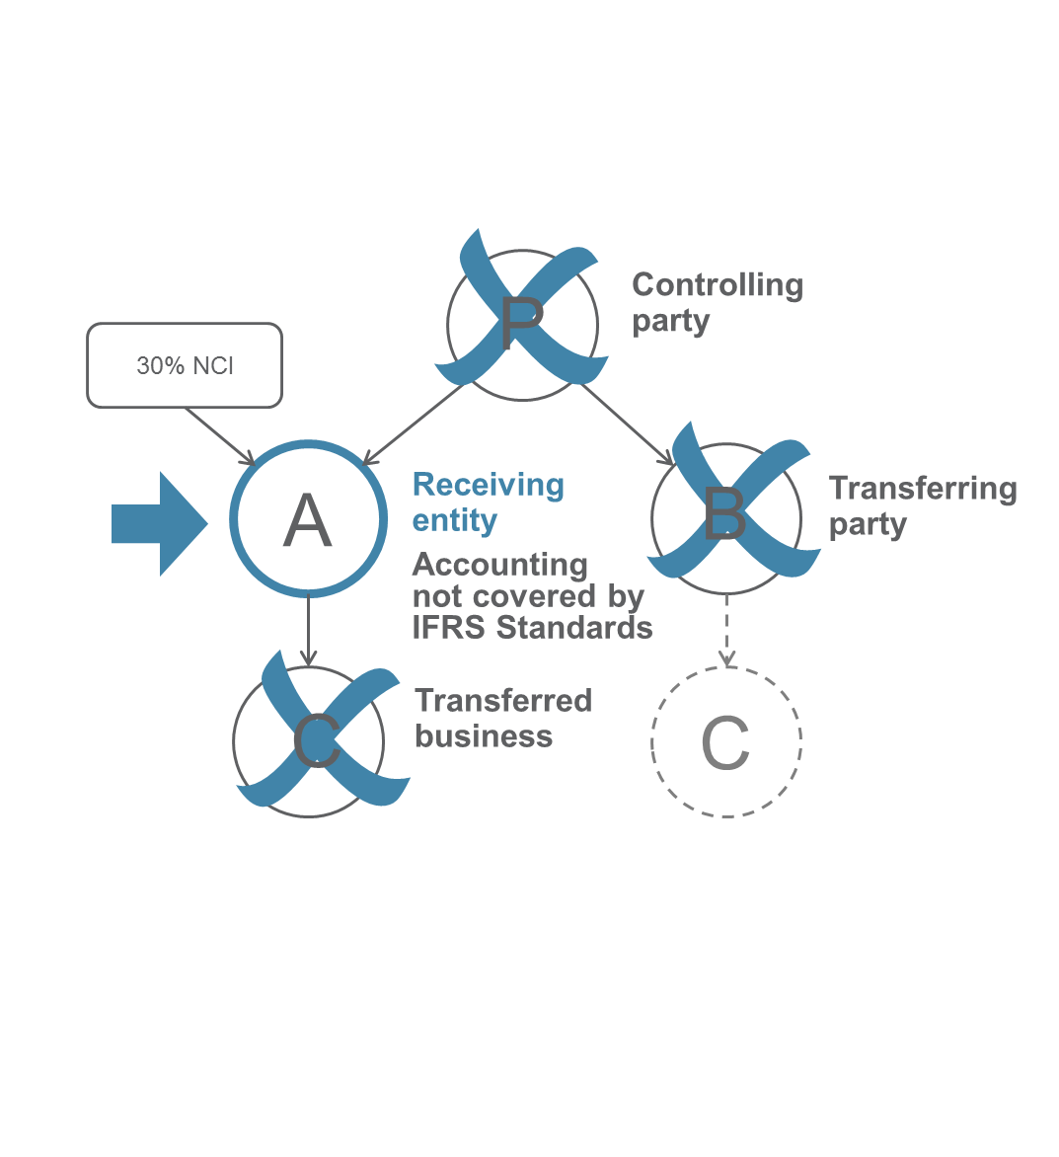
Business Combinations under Common Control—the scope
31
Accounting for transactions under common control that involve a transfer of one or more businesses from the perspective of the receiving entity, regardless of whether:
Example:
  the receiving entity can be identified as the ‘acquirer’, if IFRS 3 were applied to the transaction;
  the transaction is conditional on a loss of control over the combining parties, for example as a result of a future sale or an IPO;
  the transaction is either preceded by an external acquisition or followed by an external sale of one or more of the combining parties, or both.
Entity A acquires Entity C from Entity B.

Slide 32
Business Combinations under Common Control—methods of accounting
32
Decision process
Alternatives to explore
Acquisition method, as in IFRS 3?
Predecessor method? If yes, how to apply it?
Other methods?
single method
for all transactions within the scope?
different methods for different transactions?
which
method?
which
methods?
how to chose which method to apply to which transactions?

Slide 33

Business Combinations under
Common Control—methods of accounting
33
In February 2018, the Board decided to start its analysis from …
the acquisition method set in IFRS 3
Using the acquisition method as a starting point does NOT mean that:
  the Board will propose applying that method to all or many transactions within the scope of the project. That method will just provide a starting point for discussions at future meetings; or
  that method will be treated as the ‘default’ method of accounting for transactions within the scope of the project.

Slide 34
Dynamic risk management
34
Discussion Paper: Portfolio Revaluation Approach to Macro Hedging
IFRS 9 Financial Instruments becomes effective*
Dynamic Risk Management: Core Model
Dynamic Risk Management: Discussion Paper
2014
1 Jan 2018
H1 2019
In December, the Board tentatively decided to focus on developing the most important areas of the DRM accounting model and then seek external feedback.
* Entities can use IFRS 9 hedging requirements or continue to use existing hedge accounting requirements
in IAS 39 Financial Instruments: Recognition and Measurement

Slide 35
Dynamic risk management
Objective
Improve information regarding risk management and how risk management activities affect the entity’s current and future economic resources.
Guiding principles
Transparency
Capacity
Dynamic Nature
Performance Measurement
Focused on solutions involving both measurement and disclosure

Slide 36
Dynamic risk management
Proposal
If an entity perfectly aligns the asset profile with the target profile by using derivatives, the change in fair value of the associated derivatives should be deferred in Other Comprehensive Income and recycled to the statement of profit or loss such that it reflects the target profile.
Summarised tentative decisions to date:
Designated financial assets and financial liabilities must be measured at amortised cost;
Future transactions can be designated but their occurrence must be highly probable; and
Formal designation and documentation are required and must be consistent with the entity’s risk management policies and procedures.

Slide 37
Goodwill and Impairment: project timeline
IFRS 3 Business Combinations (revised) effective
2009
Feedback Statement to PIR, leading to new research project(s)
2015
Decide next stage of research project
2018
2013
Post-implementation Review of IFRS 3 (PIR)
2017
Tentative decisions on:
Improving effectiveness of impairment testing
Simplify impairment testing without reducing its robustness
Improving disclosures about goodwill and impairment

Slide 38
Goodwill and Impairment: Board’s tentative decisions
Feedback received | Topic for research | Board’s tentative decisions
There are delays in recognition of impairments of goodwill. | Topic 1—Improving effectiveness of impairment testing | Use the unrecognised headroom as an additional input in the impairment testing of goodwill.¹
Impairment testing of goodwill is a costly process. | Topic 2—Simplify impairment testing without reducing its robustness | Consider simplifying the value in use calculation.²
Financial statements do not include information to assess performance of an acquired business. | Topic 3—Improving disclosures about goodwill and impairment | Consider requiring entities to disclose: the unrecognised headroom; goodwill by past acquisition; and value creation from new acquisitions.¹
1. Members may refer to Agenda Papers 18C and 18F for the December 2017 Board meeting for more information.
2. Members may refer to Agenda Papers 18–18B for the January 2018 Board meeting for more information.

Slide 39
Goodwill and Impairment: Board’s tentative decisions
Issue identified | Topic for research | Board’s tentative decisions
Testing goodwill only for impairment without amortising it is not appropriate. | Topic 4—Any new conceptual arguments or new information in support of amortising goodwill? | Not to consider reintroducing amortisation of goodwill.³
Valuing some intangible assets on an acquisition is a costly process and does not provide useful information to investors. | Topic 5—Allow inclusion of some acquired identifiable intangible assets within goodwill arising on an acquisition? | No decisions made, discussion scheduled April 2018
Next Step:
In its April 2018 meeting, the Board will be asked whether the next stage is to publish a Discussion paper or an Exposure Draft.
3. Members may refer to Agenda Paper 18B for the December 2017 Board meeting for more information.

Slide 40
Post-implementation reviews
IFRS Foundation
Copyright © IFRS Foundation. All rights reserved

Slide 41
Post-implementation reviews (PIRs)
Completed PIRs
In progress
Future PIRs
IFRS 8 Operating Segments
Improvements to IFRS 8 ED—Feedback Statement expected H2 2018
IFRS 13
Fair Value Measurement
Request for Information—Feedback Statement expected H2 2018
IFRSs 10-12
consolidation
joint arrangements
disclosures
IFRS 3 Business Combination
Definition of a business ED, finalise June 2018
Research project: Goodwill and Impairment
IFRS 5
discontinued operations

Slide 42
IFRS Foundation Implementation Support Activities
IFRS Foundation
Copyright © IFRS Foundation. All rights reserved

Slide 43
The Board’s work
Standard-setting
Research
Maintenance
Implementation

Slide 44
Why we support implementation
Objective in supporting the Standards
We…
support consistent application of IFRS Standards
protects IFRS Standards as a single set of global Standards
help stakeholders understand the intent of the requirements - ie what they are aiming for
In order to…
Because it…

Slide 45
The challenge
In supporting implementation and application of the Standards, the challenge for a standard-setter is to balance:
Helpful
Not undermine principle-based nature of IFRS Standards
Responsive
Not disrupt practice (preparers, auditors, regulators)

Slide 46
Support for new Standards
Educational Webinars
(eg IFRS 17, IFRS16, IFRS 9)
Transition Resource Group
(eg IFRS 17, IFRS15, IFRS 9 – impairment)
Board and Committee public discussions
(eg IFRS 15, IFRS 9)
New Standards
Education for regulators, NSS and investors
Conferences
Informal technical discussions with regulators, NSS and audit firms
Narrow-scope standard setting
(eg annual improvements)

Slide 47
Support for Standards already effective
Interpretations process
Narrow scope standard-setting
Agenda decisions
Standards already effective
Working with other organisations such as regulators and NSS
Education materials

Slide 48
Resources and communications
IFRS Foundation
Copyright © IFRS Foundation. All rights reserved

Slide 49
Improving visibility and accessibility
Supporting materials sorted by Standard
✗
New website
IFRS Standards
IFRIC Interpretations
News and events

Video
For example, for IFRS 9 Financial Instruments

Webinars

Articles

Leaflet
Supporting IFRS Standards

Transition Resource Group

Agenda decisions

Slide 50

Recruitment

Slide 51


Contact Us
Keep up to date
@IFRSFoundation @tarca_ann #ifrsresearch
IFRS Foundation
www.ifrs.org
IFRS Foundation
Comment on our work
go.ifrs.org/comment

