Slide 1
EAA PhD Opportunities and Accounting Resources Centre
EAA PhD Forum
Espoo/Helsinki, 24 May 2023
Tami Dinh, Chair of the ARC

Slide 2
What is the ARC?
https://eaa-online.org/arc/

Slide 3
ARC – Background
Founded in 2016 under Salvador Carmona’s EAA presidency by Thorsten Sellhorn and Philip Joos
Support young scholars to enhance research and teaching productivity and help in building their academic careers
Support in extending academic network, manage teaching activities, link own work to policy-making institutions, the profession, and practitioners
Before: separate ARC website, now: integrated within the (new) EAA website
Before: “Accounting Research Centre”, now: “Accounting Resources Centre” (including education material, outreach & impact)

Slide 4
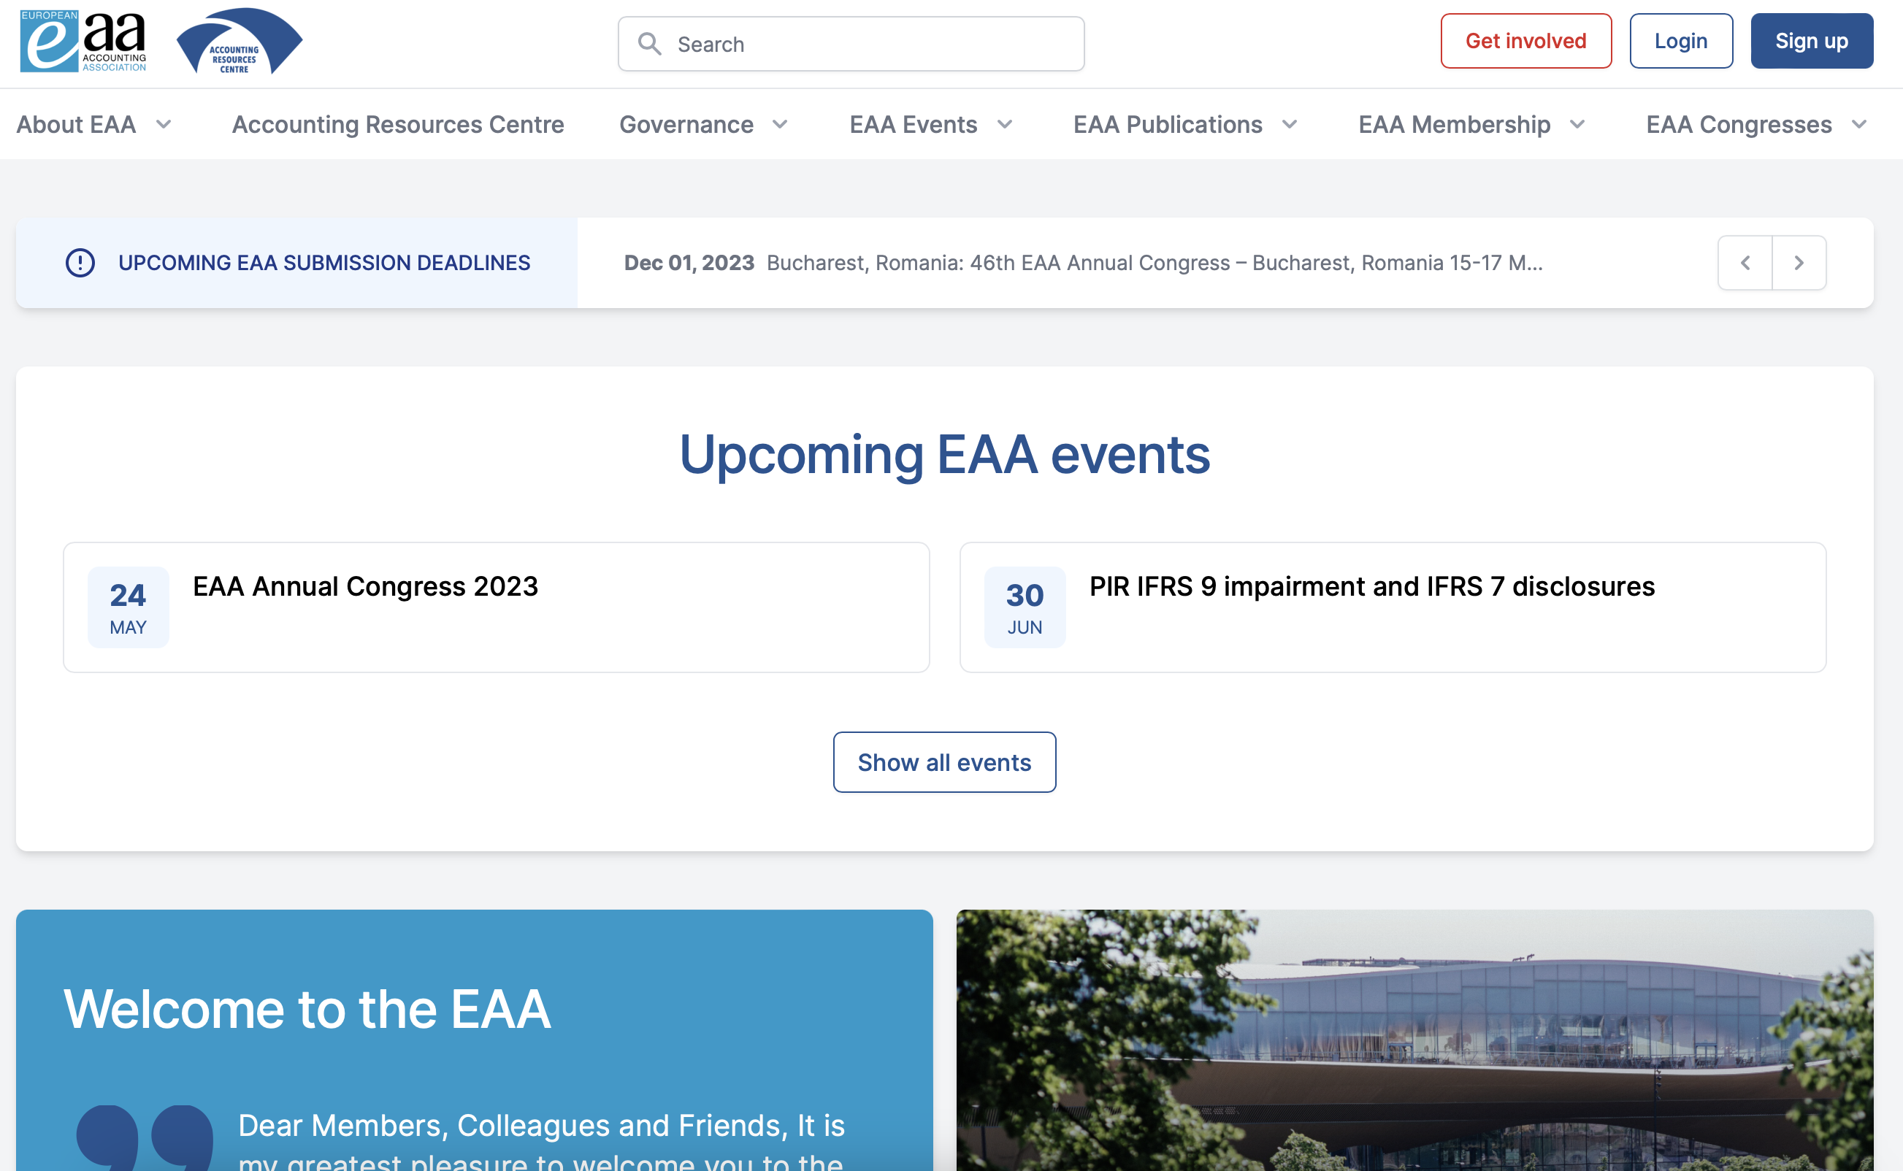
ARC – Activities
The goal of the Accounting Resources Centre (ARC) is to provide the EAA’s one-stop location for research resources and networking opportunities relevant for emerging scholars and others interested in accounting research.

Slide 5
PhD Mentoring Initiative (Senior Editors: Steven Young, Martin Walker)
The EAA PhD Mentoring Initiative (PMI) aims to help EAA PhD students refine their research proposals and enhance the overall quality of their work by accessing timely advice and feedback from some top accounting researchers. The PMI is a resource open to all European PhD students in accounting.
Journal-style peer review system (Taylor & Francis)
Editors select an expert reviewer to provide constructive feedback via a review report
Editors:
Beatriz Garcia Osma, Universidad Carlos III, Spain
Sven Modell, Manchester Business School, UK
Brendan O’Dwyer, University of Amsterdam, The Netherlands
Laurence van Lent, Tilburg University, The Netherlands
Ann Vanstraelen, Maastricht University, The Netherlands

Slide 6
ARC – Events (Senior Editor: Claudia Imperatore)
Don‘t miss out on any important accounting events, both EAA- and non-EAA-related!
Filter by topics, PhD events, types of events (virtual, association conferences, journal conferences etc.)

Slide 7
ARC – Repository
Under “Repository” we provide all research- and teaching-related material from both physical and online events
Members can share own material and insights with the community
Access for EAA members only
Videos
Codes
Data sources
Presentations
...

Slide 8
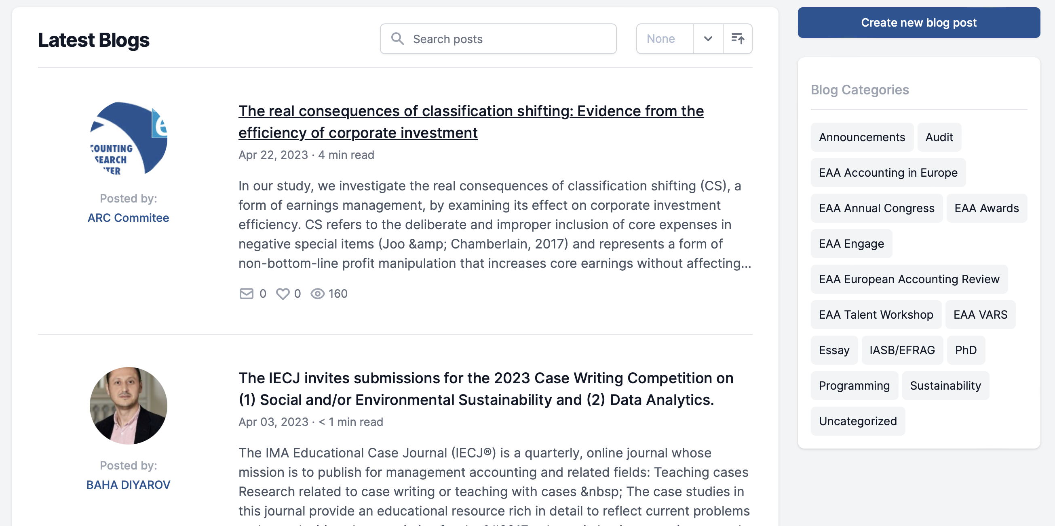
ARC – Blogs
Stay informed, inform others, express your views and learn about other opinions!

Slide 9
ARC – International PhD Visit Scheme
5 scholarships p.a. (EUR 1,000 each) to visit a partner host institution (workspace, access to IT and library, attend seminars and courses)
Bocconi University (subject to a visit fee)
Cass Business School, City University, London
Erasmus University, Rotterdam
ESSEC Business School Paris (subject to a visit fee)
Frankfurt School of Finance and Management
Humboldt-Universität zu Berlin
IÉSEG School of Management
Lancaster University (subject to a visit fee)
Maastricht University
Norwich Business School UEA (may be subject to a visit fee)
Tilburg University
Universidad Carlos III de Madrid
University of Bern
University of Mannheim
WHU Otto Beisheim School of Management
Next deadline: 31 August 2023 for a visit in the spring term 2024

Slide 10
ARC – International PhD Visit Scheme
Testimonial Dimitrios Ntounis, PhD student at the Athens University of Economics and Business (AUEB) visiting Tilburg University during the fall semester of 2022:
“I regard my visit in a highly-ranked institution like Tilburg University as essential for my doctoral studies as it has enabled me to improve my research skills. During my visit, I had the opportunity to share my research ideas and receive useful comments and feedback from the faculty members of Tilburg University.
In this two-month visit scheme, I had also the opportunity to attend departmental courses and research seminars that enhanced my knowledge on contemporary research trends in accounting. The events provided me with the opportunity to exchange ideas with other Ph.D. candidates, who share similar interests, and to shape connections that could potentially lead to fruitful research collaborations in the future.
I received useful comments from the faculty members of the Department of Accountancy that strengthened the robustness of my work. It has provided me with the ability to target a high-quality peer-reviewed journal.”

Slide 11
ARC – EAA VARS, Education, Outreach & Impact
The ARC provides all information on EAA-related events, which have increased heavily over the last few years:
Virtual Accounting Research Seminars (VARS)
Education Committee Workshops (e.g. Data analytics workshops, gamification in accounting education)
Academic Empathy Dialogues
EAA Reporting Standards Workshops
EAA Junior Network (Meet the Editor)
...

Slide 12
Get involved!
Successful scholars are...:
... excellent researchers
... inspiring educators
... engaging service providers to the discipline
What is “Service to the discipline”?
As an academic you are not only “measured” by your research output and teaching experience but also by how much you are integrated into the own discipline / community
Reviewer activities (conferences and journals), editorships, editorial board members
Acting as chair, discussant, organizing conferences
Committee work (EAA, AAA, national organizations and others)
ARC offers many opportunities to be involved also for young scholars! Reach out to us!

Slide 13
ARC – Team
We look forward to hearing from you!
Chair: Tami Dinh
Editor-in-Chief: Ana Marques
Editorial Team: Ties de Kok, Christoph Sextroh, Jochen Pierk, Elica Krasteva
PhD Mentoring Initiative: Martin Walker, Steven Young
Events: Claudia Imperatore, Michele Fabrizi, Vanessa Flagmeier, Fabio Motoki, Arthur Stenzel
Opportunities: Evisa Mitrou, Cristina Grande Herrera, Maria Assel, Arianna Pisciella
External Engagement and Funding: Catalin Albu
Social Media: Enrique Mesa Perez, Jamie Johnston, Aljoša Valentinčič

Slide 14
THANK YOU!
Q&A

Slide 15
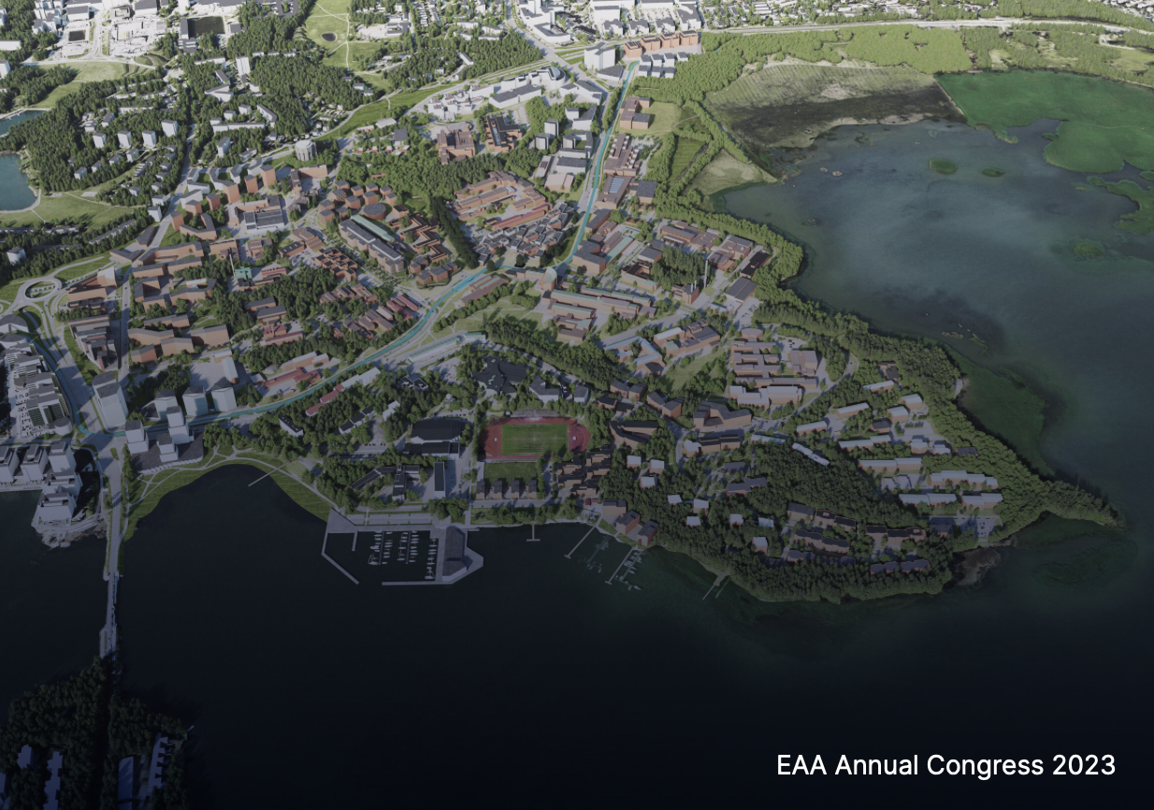
Enjoy the EAA PhD Forum, Congress
and Espoo/Helsinki!

