Slide 1
Digitalisation and Digital Reporting
EAA/EFRAG/IASB Financial Reporting Standards workshop
18 November 2022
The views expressed in this presentation are those of the presenter, not necessarily those of the IFRS Foundation, International Accounting Standards Board or the International Sustainability Standards Board. Copyright © 2022 IFRS Foundation. All rights reserved.

Slide 2
Overview
Introduction to digital financial reporting
Ann Tarca, IASB member
EFRAG’s initial observations
Saskia Slomp, EFRAG CEO
Didrik Thrane-Nielsen, EFRAG Project Director
Academic Commentary
Holger Daske, University of Mannheim
Nick Rowbottom, University of Birmingham
Q&A

Slide 3
Polling questions
Q1
The reason for your interest in this session on digital reporting is:
research
teaching
both research and teaching
practice
Q2
What is your level of knowledge about digital reporting?
none
some
significant

Slide 4
Introduction to digital financial reporting
Ann Tarca, IASB Member
18 November 2022
The views expressed in this presentation are those of the presenter, not necessarily those of the IFRS Foundation, International Accounting Standards Board or the International Sustainability Standards Board. Copyright © 2022 IFRS Foundation. All rights reserved.

Slide 5
Introduction

Slide 6
Digital financial reporting encompasses the digitalisation of both general purpose financial statements and sustainability-related financial information included in general purpose financial reports
Why digital financial reporting is important
By digitalising financial reports, information becomes machine-readable, allowing investors to access and analyse information efficiently
Digital financial reporting provides opportunities to improve capital market efficiency and reduce cost of capital
Investors are increasingly consuming information through digital means to make investment decisions
Over 90% of global market capitalisation now require some form of digital financial reporting (e.g. US, EU, UK, China, India, Japan).
However, the current global approach to digital financial reporting is fragmented and, in our view, does not realise the full benefits

Slide 7
Digital financial reporting and the IFRS Accounting Taxonomy

Slide 8
What is a digital financial report?
A digital financial report is a financial report that is machine-readable
More than a PDF version of a financial report
Reporting in a PDF format
I want to understand the details of company A’s share-based payment arrangements
✓
PDF
PDF
Company A
PDF
Company B
PDF
Company C
Company D
Digital financial reporting
I want to download 100 companies’ EPS into a spreadsheet to calculate & compare their P/E ratio
✓
XBRL
XBRL
…
XBRL
Company AA
Company AB
Company ZZ

Slide 9
How are financial statements digitalised?
£35,310
Who
Standard-setter
Companies
Investors
What
Standards
Digital taxonomy#
Financial reports
Use tagging software to tag disclosures in financial reports
Digital consumption
Why
Provides requirements for company disclosures in financial reports
Provides tags derived from the Standards to make disclosures machine-readable
Makes paper reports machine-readable
Digital comparison and analysis of financial reports for more efficient investment decision-making
# A classification system used to make financial reports machine-readable. Different from, for example, a green taxonomy used to classify environmentally sustainable economic activities

Slide 10
The need for a digital taxonomy
A digital taxonomy is a system for classifying and structuring data points in a manner which:
makes the data machine-readable, and
aids users in finding, understanding and comparing large amounts of information to facilitate efficient financial analysis
PDF
Taxonomy ‘Tag’
Co. A: Profit for the year xxx
Name | ifrs-full:ProfitLoss
Value | xxx,000,000
Units | CU
Period | 2021-01-01 to 2021-12-31
Decimals | -6
Co. B: Profit after tax xxx
Co. C: Net earnings xxx
Co. D: Loss for the period (xxx)
Co. E: 純利益 xxx
By using a common taxonomy to tag quantitative and qualitative disclosures, computers have the context needed to determine whether disclosures with different descriptions are comparable disclosures

Slide 11
The IFRS Accounting Taxonomy
❶ Identification
The IFRS Accounting Taxonomy lists the globally agreed computer codes (elements) that preparers can use to identify (tag) disclosures in IFRS financial statements
Consolidated statement of comprehensive income (extract)
Revenue | 30,650
Cost of sales | (26,000)
Gross profit | 4,650
ifrs-full:GrossProfit
References
The IFRS Accounting Taxonomy describes the accounting meaning of each element and provides references to the IFRS Accounting Standards
Label | Gross Profit
References | IAS 1.103 Example
Documentation | The amount of revenues less cost of sales. [Refer: Cost of sales; Revenue]
❸ Classification
The IFRS Accounting Taxonomy organises elements into groups and defines relationships between them to help preparers and users of tagged financial statements find elements more easily

Slide 12
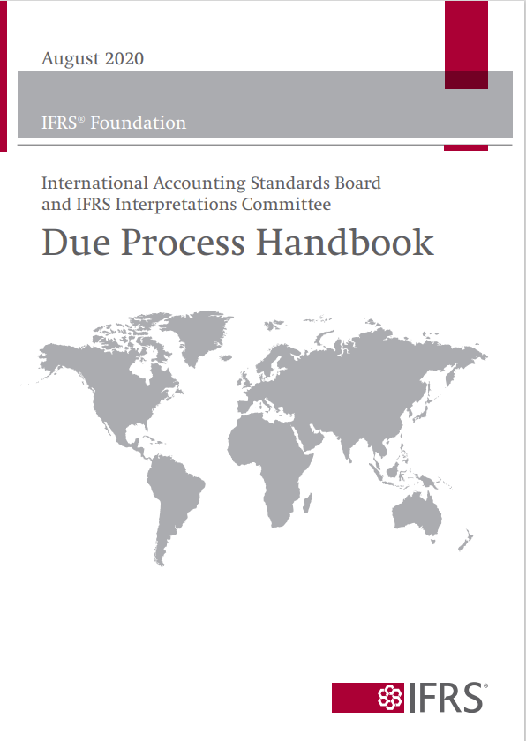
Subject to due process
The IFRS Accounting Taxonomy
Sources of the IFRS Accounting Taxonomy content
IFRS Accounting Standards
Common reporting practice
Presentation and disclosure requirements in IFRS Accounting Standards
Illustrative examples and implementation guidance
Commonly disclosed information not specifically mentioned in IFRS Accounting Standards
The Taxonomy reflects disclosure requirements in IFRS Accounting Standards
It does not introduce new requirements
It is not a disclosure checklist
It does not dictate how preparers should present their reports

Slide 13
Digital financial reporting and standard-setting

Slide 14
For a summary of academic evidence, see Troshani, I. and Rowbottom, N., 2021. Digital corporate reporting: research developments and implications. Australian Accounting Review, 31(3), pp.213-232
Additionally, the following speeches include citations to supporting research, see speech by US SEC Commissioner Caroline A. Crenshaw; speech by IASB member Ann Tarca
Benefits of digital financial reporting
Provides opportunities to improve capital market efficiency and reduce firms’ cost of capital
Reduced search costs
Increased analyst coverage
Increased access to capital
Level playing field for investors
Capital market transparency
Increased information processing efficiency
Reduced language barrier
Over 90% of global market capitalisation now require some form of digital financial reporting (e.g. US, EU, UK, China, India, Japan)
However, the current global approach to digital financial reporting is fragmented and, in our view, does not realise the full benefits

Slide 15
The IASB currently takes a ‘digital-neutral’ approach to standard-setting.
Opportunities to enhance financial reporting
Digitalisation offers new opportunities to enhance financial reporting. Possible opportunities include:
The ability for investors to tailor the presentation of financial reports to meet their decision-making needs
Interactive financial reports that allow investors to toggle between different measurement bases
Enhanced ability to reflect relationships between items/disclosures
Leveraging digital opportunities may require a ‘pro-digital’ standard-setting approach
There is a wide spectrum of what a ‘pro-digital’ approach might entail. Some examples are:
Re-thinking the cost/benefit analysis of disclosure requirements
Reporting more granular information may no longer be as costly
Consuming larger quantities of data may be easier
Re-thinking the balance between comparability and entity-specific information
Thinking beyond the constraints of a static paper-based format
Location of where information is presented/disclosed may be less of an issue
A pro-digital approach may involve challenges
Implications for materiality
Ensuring contextual information remains visible
Costs for preparers
Challenges for less sophisticated investors
May require changes to existing regulatory/legislative filing requirements

Slide 16
Myths about digital reporting persist
Myth #1: Artificial intelligence (AI) eliminates the need for the structure that taxonomies give to data
Our work indicates that AI benefits from the structure provided by taxonomies
Data providers that use AI need to create their own taxonomy
These data providers prefer a globally applied taxonomy, updated at the same time Standards change
AI provides only limited comparability across companies. A taxonomy facilitates the identification, by a company, of exactly which information it has provided to satisfy a particular requirement in the Standards. In contrast, AI, in effect, makes educated guesses about this
However, once tagged data is available and extracted, AI can aid analysis
Myth #2: Data aggregators already satisfy market needs for digital reports
Data aggregators play an important role in providing information to capital markets. However:
data from data aggregators can be costly for investors
the data may also be reformatted in a standardised way, but this presentation may differ from the underlying paper / PDF financial reports applying IFRS Accounting Standards
data aggregators often do not provide detailed information disclosed in the notes to the financial statements
Implication
Misinformation creates challenges in progressing towards global digital financial reporting

Slide 17
The vision has yet to be publicly discussed with the IASB or ISSB, but it is consistent with messaging in the IASB’s Feedback Statement on its Third Agenda Consultation (see Appendix A for relevant extracts)
Our vision: staff view
Vision
Decision-useful, high-quality, comparable and accessible global digital financial reports
How we get there (staff view)
IFRS Accounting Standards
IFRS Sustainability Disclosure Standards
Global adoption of IFRS Standards¹
Global adoption of IFRS digital taxonomies²
Connectivity
It’s all connected in a digital world
Connectivity
Connectivity
Assurance requirements and enforcer reviews
Accessibility, including platforms to access digital reports
IFRS Accounting Taxonomy
Connectivity
IFRS Sustainability Disclosure Taxonomy
Achieving this vision will require a coordinated effort by multiple players in the financial reporting ecosystem
¹ IFRS Standards refers to IFRS Accounting Standards and the forthcoming IFRS Sustainability Disclosure Standards
² IFRS digital taxonomies refers to the IFRS Accounting Taxonomy and forthcoming IFRS Sustainability Disclosure Taxonomy

Slide 18
Appendix A: 3AC
Feedback Statement extract: Digital Financial Reporting

Slide 19
3AC Feedback Statement extract: Digital Financial Reporting
The IASB’s response
The IASB agreed with the many respondents who said it should focus more on digital financial reporting. The IASB decided to increase slightly its current level of focus because: digital consumption of financial reporting continues to increase. the use of the IFRS Accounting Taxonomy is increasing but challenges, including inconsistent approaches to its adoption and data-quality issues, can undermine the usefulness, quality, accessibility and comparability of the reported information. some resources may be needed to support collaboration between the IASB and the ISSB on digital reporting. By slightly increasing its current level of focus, the IASB aims to improve the usefulness, quality, accessibility and comparability of digital financial information. To do so, the IASB plans: to consider the implications of increased consumption of digital financial information for Accounting Standards, which have historically been based on how much information can be presented and disclosed in a paper-based or PDF-based format. to continue to improve the IFRS Accounting Taxonomy by, for example: updating the IFRS Accounting Taxonomy to reflect new or amended requirements; updating the IFRS Accounting Taxonomy to reflect information (not referred to explicitly in Accounting Standards or the accompanying materials) that is commonly disclosed in practice by companies when applying Accounting Standards; publishing educational materials to help companies, regulators and others who use the IFRS Accounting Taxonomy; and identifying and resolving causes of errors and unnecessary extensions. to further engage with its partners in the digital ecosystem by, for example, working with regulators to support adoption of the IFRS Accounting Taxonomy and with preparers to support quality outcomes in applying the IFRS Accounting Taxonomy. to work with the ISSB, for example: to develop consistent approaches and concepts for the IFRS Accounting Taxonomy and the to-be-developed IFRS Sustainability Disclosure Taxonomy; to develop technological compatibility, so companies can seamlessly use both taxonomies; and to jointly engage with the digital reporting ecosystem to facilitate the consumption of digital reports.

Slide 20
Digitalisation and Digital Reporting
18 November 2022

Slide 21
DISCLAIMER
The views expressed in this presentation are those of the presenter, except where indicated otherwise. They are not approved by: the EFRAG Administrative Board, the EFRAG Financial Reporting Board (FRB), the EFRAG Financial Reporting TEG (FR TEG), the EFRAG Sustainability Reporting Board (SRB) and the EFRAG Sustainability Reporting TEG (SR TEG) or the European Lab Project Task Force on European sustainability reporting standards (PTF- ESRS)

Slide 22
The EU developments on digital reporting
Digital reporting to play a pivotal role and important initiatives are paving the way:
European Single Electronic Format (ESEF), has been mandatory applicable for the IFRS consolidated primary financial statements of listed entities since 2020. Block tagging of notes is mandatory as of 2022:
The tagging to be used is the ESEF taxonomy which is equal to the IFRS taxonomy with a small set of European Securities and Markets Authorities (ESMA) additions.
The ESEF taxonomy is developed by ESMA and is refreshed regularly to reflect changes in IFRS standards and ensure maximum comparability of reported data at the European and global level.

Slide 23
The EU requirements for digital reporting is making access to digital data easier
EC Capital Markets Action Plan 2020 – first action
EC Proposal for a Regulation November 2021
Digital corporate information will be accessible through the European single access point (ESAP) which is to be operational free of charge. In the Council June proposal it is envisaged that ESAP is available for users of financial reporting from 2026 and for users of sustainability reporting from 2027.
The EP is discussing the EC proposal.
Before these dates, digital corporate information will be accessible on entities web pages and in national repositories.

Slide 24
The EU requirements for digital reporting extended to sustainability reporting
In Sustainability Reporting, the Corporate Sustainability Reporting Directive (CSRD) requires undertakings to prepare their management report in electronic format.
EFRAG is requested to develop a ‘digital categorisation system’ for the EU sustainability reporting standards (ESRS- delegated acts).
EFRAG is required to deliver a draft ESRS XBRL taxonomy for each ESRS as well as the Illustrative Tagged Reports in the Inline XBRL format (iXBRL) to the European Commission no later than 30 September 2023.
EFRAG will set up a consultative forum of experts to help with the continuous development of the ESRS XBRL taxonomy.
Development of the XBRL taxonomy provides useful input for standard setting (learnings from the climate prototype in ED ESRS E1)

Slide 25
The EU requirements for digital reporting extended to sustainability reporting
EFRAG’s planned activities in 2022/2023
Activity | Period
Award of the contract to the selected contractor | Mid November 2022
Kick- off meeting with the selected contractor | Early November 2022
Development of the XBRL Taxonomy based on EFRAG’s draft ESRS | Mid-November 2022 – 10 April 2023 (about 5 months)
EFRAG’s review and approval process, | April 2023
Public consultation on EFRAG’s draft Taxonomy | May – June 2023 (2 months)
Revision of Taxonomy to reflect changes (if any) to final ESRS as approved by the EU and (2) changes (if any) arising from EFRAG’s public consultation. | July - August 2023 (2 months)
Final review and approval of changes by EFRAG | September 2023
Final Draft Taxonomy (Digital guidance) – submission to the EC | No later than 30 September 2023

Slide 26
Interoperability between European and international taxonomies
Interoperability between ESRS and IFRS sustainability reporting standards is important. Priority is to avoid double reporting.
Technical dialogue between EFRAG and ISSB ongoing for Sustainability Standards to promote interoperability.
Mapping table: On the area of intersection (investor relevant disclosures) the aim of this dialogue for interoperability is from European perspective that ESRS disclosures will also meet the requirement in IFRS sustainability reporting standards. A Mapping Table could facilitate the identification of the ESRS disclosures that serve as well IFRS Standards.
Role of tagging: Equally important is the interoperability for the ESRS XBRL taxonomy and IFRS Sustainability Disclosure Taxonomy EFRAG. Tagging is also a powerful tool to digitally implement the mapping for the area of intersection. The same information could be tagged both in XBRL ESRS and XBRL ISSB taxonomies.

Slide 27
Messages from Bergen EAA symposium (1)
Benefits expected from the tag-based digital reporting, including:
Alleviation of the perceived ‘disclosure overload’ problem
Reduced time required for consuming new data/numbers
Increased data comparability across companies
Increased accessibility of data
Users will be able to take and shuffle the information they want to analyse
Entities can present their reporting in the way they believe provide the most relevant information
Can entities still tell their own story? - extensions
Trade off between objective based standards and automated procedures and machine reading
Opportunities for academic research
Corporate reporting will be more relevant for users

Slide 28
Messages from EAA Bergen symposium (2)
Tagged data is only as good as the quality and consistence of the tagging
Extensions
Industry level consistency
Link between financial and sustainability taxonomies
External assurance
Corporate reporting (financial and sustainability) must convey a consistent message.

Slide 29
What are EFRAGs activities on digital reporting in the financial reporting pillar?
Due to resource constraints considerations, EFRAG doesn’t have an active project on digital reporting (in the financial reporting planning). However EFRAG is observing the environment.
In the financial reporting pillar EFRAG is looking at how the digitalisation of reported information (including the ESMA ESEF and other forms of digital reporting) can be incorporated into the cost-benefit analysis of IFRS requirements.
EFRAG constituents rank digitalisation as an important topic. In June EFRAG FR Board considered adding digital reporting to the EFRAG research agenda, but as this is not a topic that fits easily into the traditional research topics EFRAG FR Board decided considering the available resources not to initiate a formal proactive research project.

Slide 30
EFRAG receives financial support of the European Union - DG Financial Stability, Financial Services and Capital Markets Union. The content of this presentation is the sole responsibility of EFRAG and can under no circumstances be regarded as reflecting the position of the European Union.
Thank you for your attention!
EFRAG
Aisbl - ivzw
35 Square de Meeüs
B-1000 Brussel
Tel. +32 (0)2 207 93 00
www.efrag.org

Slide 31
Academic Commentary
Digitalization and Digital Reporting

Slide 32
What makes us qualified?
Holger Daske
20 years of experience with IFRS data
In “IFRS: Markets, Practice, and Politics”, Foundations and Trends® in Accounting, 2021, Chapter 4, we review the reporting practices under IFRS, including digital reporting
As past member of IFRS Advisory Council, I am aware of realities and obstacles the IFRS Foundation faces
Matthias Uckert
Doctoral candidate focusing on Unstructured Data Analysis and intersection of information environment & technology
Strong technical experience
Notes:
Idea of improving the accessibility, accuracy, and speed of data transmission through the tagging of financial statements is old: “barcode for financial reporting”.
Yet, still implemented only imperfectly so far!
What do we know and where do we stand?

Slide 33
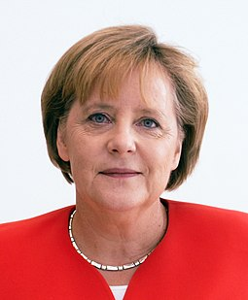
What motivates us?
Huge misbalance between resources spent to produce financial reports (e.g., Deutsche Bank Audit fees p.a. over 60 million EUR alone), and output provided (pdf-document)
To keep its relevance (Gen Z), our discipline must communicate like in the 21st century
The complexity and diversity in financial reports across and within firms, for many reasons, make it utopic that “AI” just solves the information processing problems
Digital reporting “Alternativelos”
Notes:
Idea of improving the accessibility, accuracy, and speed of data transmission through the tagging of financial statements is old: “barcode for financial reporting”.
Yet, still implemented only imperfectly so far!
What do we know and where do we stand?

Slide 34
Overview: Tagging IFRS Reports
Idea of “barcode for financial reporting” old. But where do we stand?
XBRL (eXtensible Business Reporting Language) as open, XML-based language designed to improve the disclosure of information by making financial data standardized, tagged, and machine-readable
XBRL can only be implemented using taxonomies
Provide clear definitions of financial reporting items & concise structure how items relate to each other, i.e.,
Dictionary containing financial reporting elements and concepts
Hierarchically groups the elements and defines the relationships between elements
Provided by regulator requiring information (such as IFRS Foundation)

Slide 35
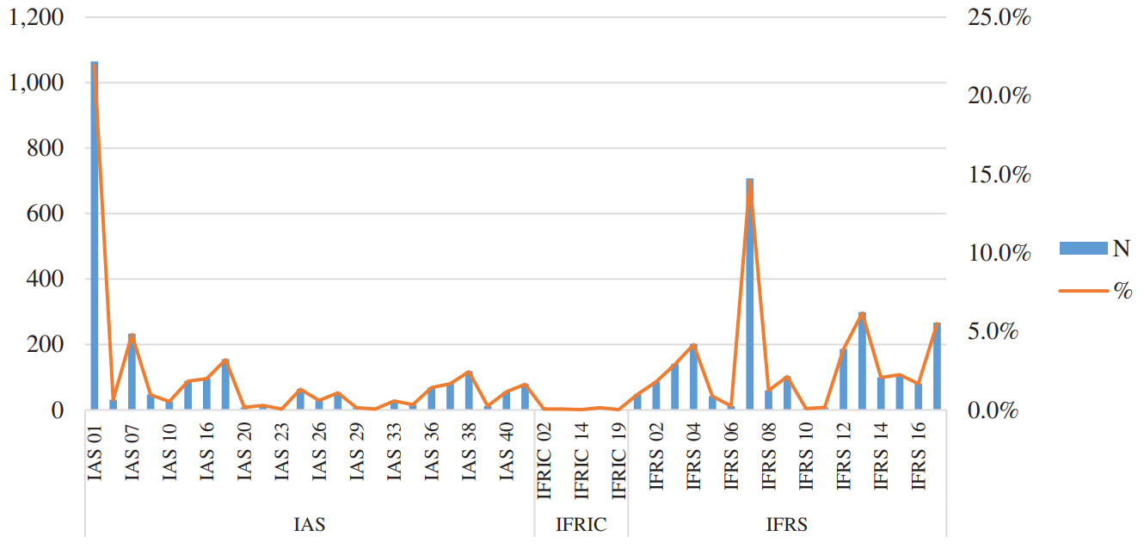
Overview: Taxonomy Stats
IFRS Taxonomy consists of around 5,300 unique elements (one-third of the U.S. GAAP taxonomy 15,000 elements)
Allows for “their own company-specific extension tags”, 1,300 common-practice
Regulators add their own taxonomies (e.g., ESMA, ~ 200 elements)
Compares to max. 1,000 elements in templates of data-providers (many missing)
Magnitude of disclosure requirements of standards (# unique tags)
Source: Becker, K., Bischof, J., & Daske, H. (2021)

Slide 36
Academic evidence (1): Complications with tagging of reports
Preparer’s Perspective:
Severe magnitudes of different types of tagging errors in XBRL-filings (Debreceny et al. 2010)
Missing tags (firm not assigning a tag to an appropriate section)
Wrong tags (firms assigning tags incorrectly or inconsistently)
Errors in the relationships implied by the taxonomy (25% of firms had errors such that reported monetary values did not add up as they were supposed to)
Tagging of text blocks is often not required and thus not employed
Unclear what is the best tagging solution. Many different providers offer software.
No clear market solution seems to be out
SAP Disclosure Management, Orcale Disclosure Management for Narrative Reporting, https://authoritysoftware.co.uk/,
https://www.workiva.com/, https://easyx.dk/, https://amana-esef.com/, …
Notes:
Idea of improving the accessibility, accuracy, and speed of data transmission through the tagging of financial statements is old: “barcode for financial reporting”.
Yet, still implemented only imperfectly so far!
What do we know and where do we stand?

Slide 37
Academic evidence (1): Complications with tagging of reports
User’s Perspective:
Tags tend to produce complex information, costlier to absorb than from standard databases
Unclear what is the best way to way to support information extraction:
https://www.workiva.com/ (featured by XBRL (Link))
https://amana-esef.com/
IFRS taxonomy uses highly technical and complex terms that are difficult to comprehend
Illustration: n-gram analysis of accounting terms: IFRS Taxonomy vs Compustat & Worldscope (see next slide)
Harris et al. (2020) establish in an experiment that “descriptor length” (i.e., the number of grams that refer to different descriptors of the same disclosure item) negatively affects information acquisition of participants
Notes:
Idea of improving the accessibility, accuracy, and speed of data transmission through the tagging of financial statements is old: “barcode for financial reporting”.
Yet, still implemented only imperfectly so far!
What do we know and where do we stand?

Slide 38
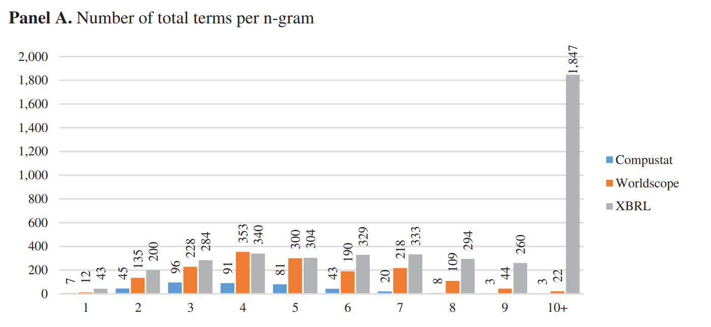
Academic evidence (1): Complications with tagging of reports
User’s Perspective (cont.):
Source: Becker, K., Bischof, J., & Daske, H. (2021)
Notes:
Idea of improving the accessibility, accuracy, and speed of data transmission through the tagging of financial statements is old: “barcode for financial reporting”.
Yet, still implemented only imperfectly so far!
What do we know and where do we stand?

Slide 39
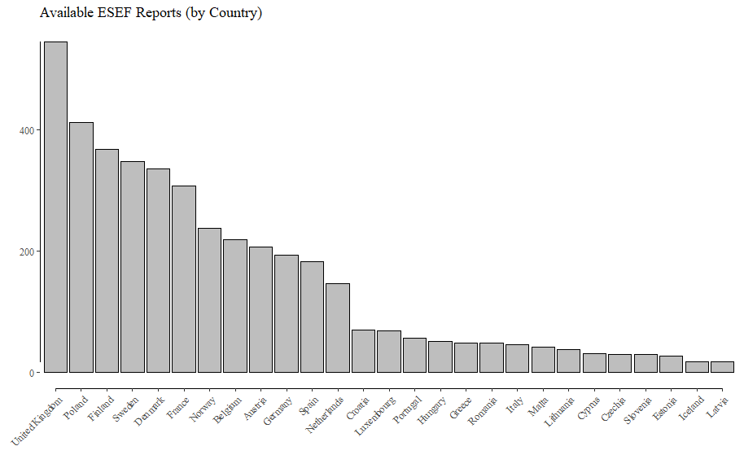
Illustration ESEF: Availability of Reports
(1) No single „Point-of-Truth“ for ESEF Reports available to this date. Attempts so far were not successful in providing an easy access:
European Single Access Point (ESAP)
European electronic access point (EEAP)
European financial transparency gateway (ETFG)
Only limited data available at: https://filings.xbrl.org/about.html

Slide 40
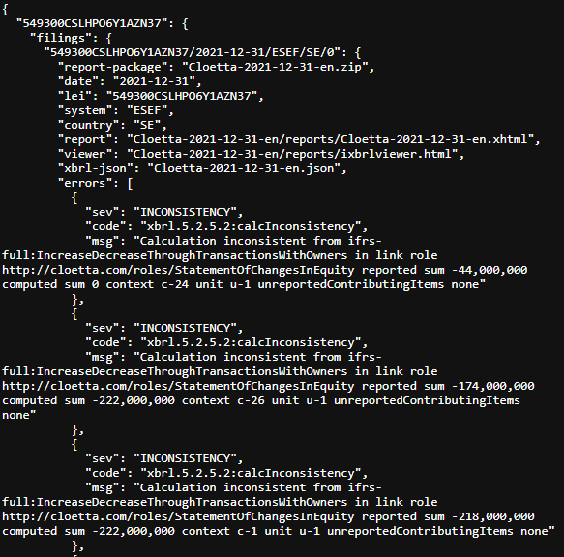
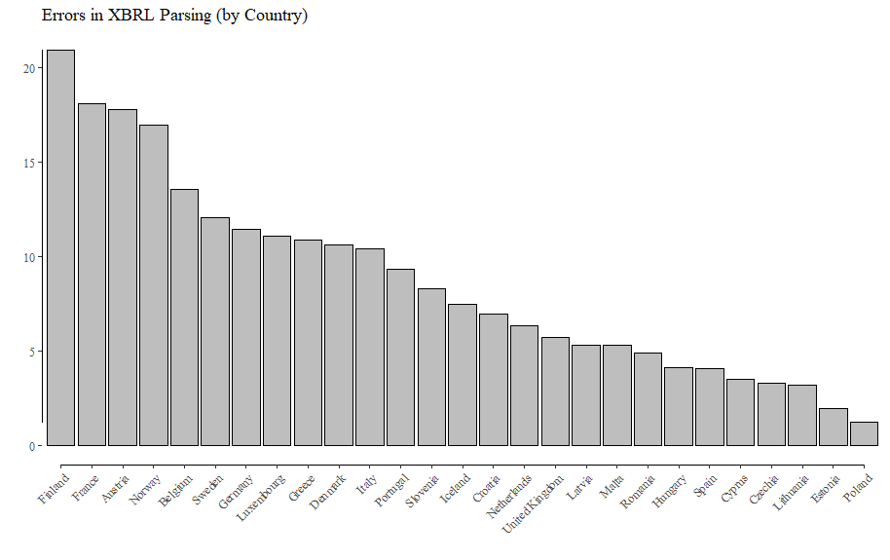
Illustration ESEF: Quality of Reports
(2) Way too high percentages of Errors in XBRL Parsing

Slide 41
Academic evidence: Learnings
Learning (1):
Auditing and Enforcement crucial (“Equal footing”): ESMA / IOSCO!
Learning (2):
IFRS Foundation / Regulators should help preparers and users
Notes:
Idea of improving the accessibility, accuracy, and speed of data transmission through the tagging of financial statements is old: “barcode for financial reporting”.
Yet, still implemented only imperfectly so far!
What do we know and where do we stand?

Slide 42
Academic evidence (2): Extensive & Unnecessary use of extensions
Firm’s use of customized and often idiosyncratic tags
Debreceny et al. (2011) classify firm-specific extensions of U.S. firms and find that 40% of extensions were unnecessary, because semantically equivalent elements were already available in U.S. GAAP taxonomy
Really novel concepts accounted only for 30% of the extensions, and many were just variants of existing elements
In IFRS Reports
IFRS reports include 40% of customized tags, twice the rate of U.S. firms (SEC, 2021)
The trade-off between a less comprehensive taxonomy and a greater magnitude of customized extensions under IFRS remains on open issue
Notes:
Idea of improving the accessibility, accuracy, and speed of data transmission through the tagging of financial statements is old: “barcode for financial reporting”.
Yet, still implemented only imperfectly so far!
What do we know and where do we stand?

Slide 43
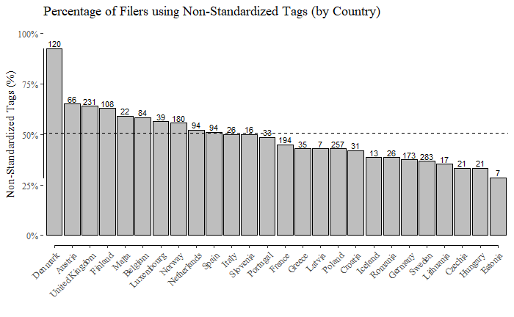
Illustration ESEF: Non-Standardized Tags
Large variation in the „perceived need“ by preparers for non-standardized Tags

Slide 44
Academic evidence: Learnings
Learning (3):
Collectively, we need to better understand the trade-offs of allowing extensions vs. more standardization
Learning (4):
Extensions are an issue. IFRS Foundation should help preparers “find” the information
Notes:
Idea of improving the accessibility, accuracy, and speed of data transmission through the tagging of financial statements is old: “barcode for financial reporting”.
Yet, still implemented only imperfectly so far!
What do we know and where do we stand?

Slide 45
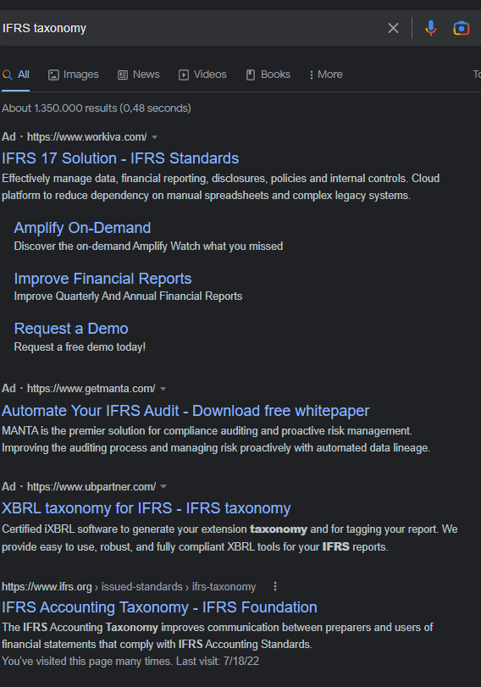
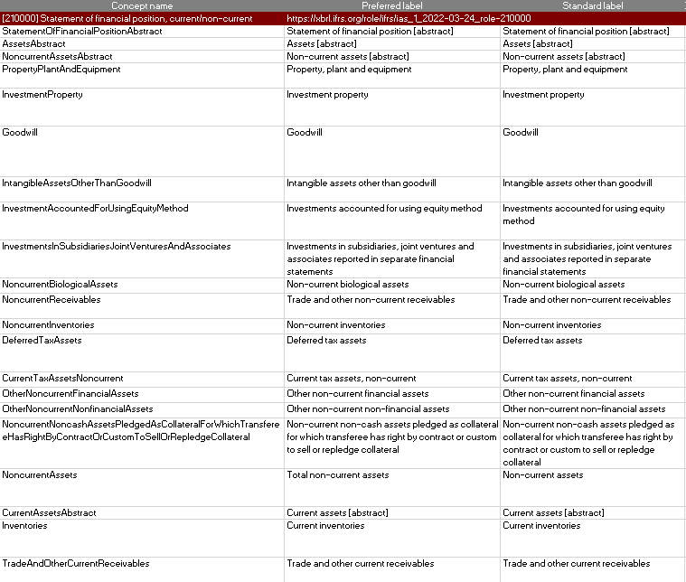
Illustration Taxonomy: Help Preparers & Users
(Source: Google)
(Source: https://www.ifrs.org/issued-standards/ifrs-taxonomy/)

Slide 46
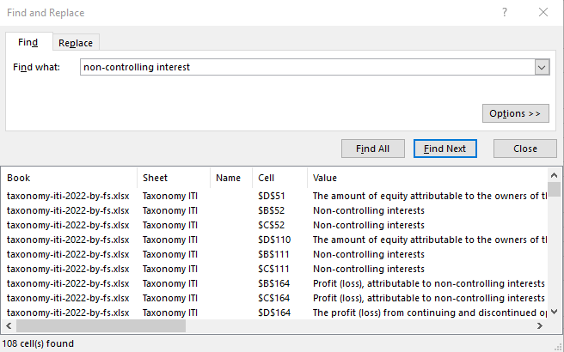
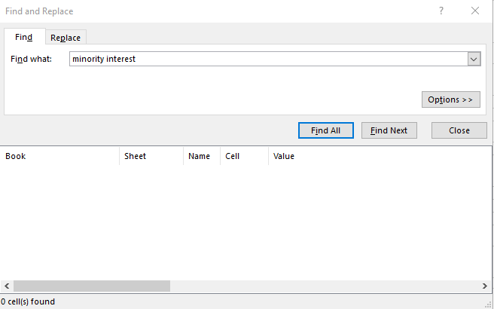
Illustration Taxonomy: Help Users & Preparers
Implementing IFRS taxonomy poses significant challenges for preparers
Example: Variation in Terminology (i.e., synonyms for the same accounting concept) poses additional hurdles (Daske, Seregni, Uckert 2022)
Non-controlling interest
Minority interest

Slide 47
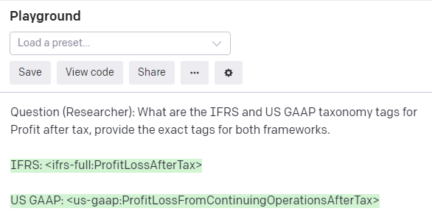
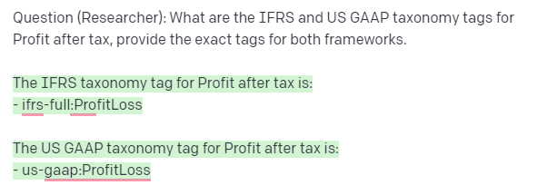
Help Users (Tools)
AI Large Language Models can aid in preparation, but results are not perfect yet. GPT-3 is a Generative Language Model, it is not trained on domain-specific text. But models can be fine-tuned on the Taxonomy and company reports
Question asked (by human)
Answer(s) given (by AI)
(Source: GPT-3 (OpenAI): https://beta.openai.com/playground)

Slide 48
Help Users (Tools)
Movement to Open-Source Programming Languages
So far XBRL parsing/preparation software is mostly proprietory. This poses a significant hurdle for new adopters (both preparers and users)
Well developed and maintained open-source solutions reduce entry barriers
Most Popular Programming Languages
Providing a free to use XBRL parsers to users is essential to ensure widespread adoption!
Examples:
R Language:
https://cran.r-project.org/web/packages/XBRL/XBRL.pdf
Python:
https://github.com/manusimidt/py-xbrl
https://github.com/greedo/python-xbrl
Maintained by individuals. Development cycle is an issue.
(Source: https://www.tiobe.com/tiobe-index/)

Slide 49
Academic evidence (3): Has XBRL Passed the Market Test?
Too early to judge: IFRS Foundation should NOT be discouraged by existing evidence …
Evidence on the usage of XBRL data comes from surveys, download statistics, and competition in the market for data provision
Capital market consequences in the U.S. mixed (for many reasons)
Blankespoor (2019) studies access logs for 10-K XBRL filings (“search traffic”) on EDGAR as a proxy for investor demand and finds a “dramatic increase” in the number of downloads over the years, from 240,000 in 2010 to 1.65 million in 2016, consistent with the XBRL technology being better understood, its data quality having improved, and more software providers available
New data providers (Calcbench or idaciti) have emerged in the U.S. and compete with Compustat by exploiting the power of XBRL disregarding traditional filings
Notes:
Idea of improving the accessibility, accuracy, and speed of data transmission through the tagging of financial statements is old: “barcode for financial reporting”.
Yet, still implemented only imperfectly so far!
What do we know and where do we stand?

Slide 50
Some final thoughts (1): For IFRS Foundation
Staff analysis: What can the IFRS Foundation learn from other settings-/jurisdictions that require business information to be transmitted via XBRL?
Examples of regulators (and the taxonomies they require firms to use) include the EBA (COREP and FINREP taxonomies), the EIOPA (Solvency II taxonomy), the Global Reporting Initiative (GRI Taxonomy), ...
Which support tools do they have for preparers (Excel-Sheet/Manual or more)?
Staff analysis: Analysis of extension tags (start with focus area)
Is the magnitude an issue? Are there overlaps with existing taxonomy?
Publication: Clarify the nature of “principle-based standards” in the context of forcing information into common formats that are machine-readable (Rowbottom et al., 2021)
In my opinion, the application of judgement does not prevent the consistent use of “IFRS-Full: …” tags
Notes:
Idea of improving the accessibility, accuracy, and speed of data transmission through the tagging of financial statements is old: “barcode for financial reporting”.
Yet, still implemented only imperfectly so far!
What do we know and where do we stand?

Slide 51
Some final thoughts (2): For Researchers
ESEF (and similar settings) will provide plenty of research opportunities. Much work is to be done, in particular for the academic community
Research Ideas:
Implementation issues?
Role of customized tags?
Impact on traditional data-providers / market-dynamics?
Feedback on information reported and standardization in general?
Impact on information processing costs, and information asymmetries?
Separate XBRL filings vs. integrated iXBRL?
Usefulness in PIR? (To study disclosures of individual standards)?
Do local taxonomies make “carve-outs”/“carve-ins” in the endorsement process visible?
…
Notes:
Idea of improving the accessibility, accuracy, and speed of data transmission through the tagging of financial statements is old: “barcode for financial reporting”.
Yet, still implemented only imperfectly so far!
What do we know and where do we stand?

Slide 52
Academic Commentary
Nick Rowbottom
(n.rowbottom@bham.ac.uk)

Slide 53
Technology & Corporate Reporting
Interdisciplinary Perspectives
‘The medium is the message’ i.e. how information is conveyed can change its meaning
Technology is enacted through both material and human ‘agency’
Whilst the IASB and EFRAG are developing policy and guidance, to some extent, how digitalisation influences corporate reporting will be affected by its usage in practice
53

Slide 54
Taxonomy & Standardisation
The taxonomy is needed to structure and codify accounting disclosures so they can be read by machines
Disclosures must be unambiguously defined – they must fit somewhere
This requires a process of translation from human concepts to machine rules (Locke et al., 2018)
We must play by the machine’s rules – it is limited in what it can understand, it requires precision
How does taxonomy design deal with a principles-based accounting model?
54

Slide 55
Taxonomy Development
Initially taxonomies were based solely on disclosures required by accounting standards
But preparers have to create many new taxonomy elements to capture their entity-specific disclosures
This reduces comparability between digital reports
Regulators discourage preparers from extending the taxonomy to suit their own disclosure requirements e.g. SEC
But they have to expand core taxonomies to include ‘common’ disclosure practices not specifically required by accounting standards
55

Slide 56
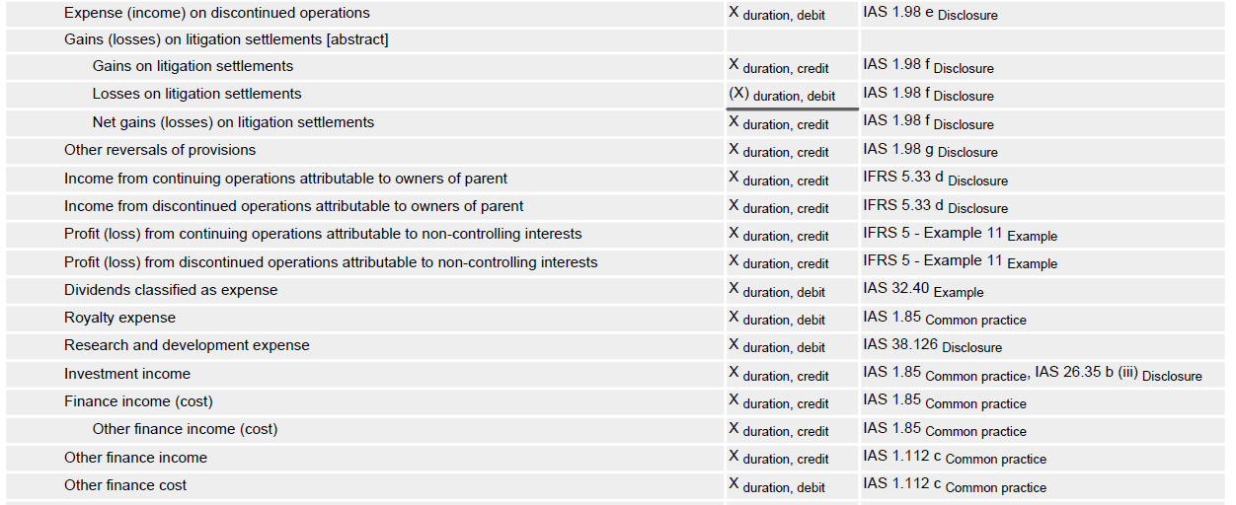
Taxonomies now include many disclosures not specifically required by reporting standards

Slide 57
Common Practices
What is Common?
IFRS 2011: 66/145 occurrences vs 3/145
By 2016, at least 10% of entities within the ‘sample’
112 elements in 2011 vs 1229 elements in 2021
The IASB assert that the taxonomy ‘does not introduce new requirements’
But given the taxonomy codifies disclosures not required by IFRS, is it a means of pseudo-standardisation?
Is the taxonomy a neutral device?
Depends on how the taxonomy is used...
57

Slide 58
Firms must either:
A) Conform: ‘tag’ a taxonomy element to each of their disclosures
B) Extend the taxonomy to create a new element for a disclosure

Slide 59
Taxonomy Usage - Context
Regulators seek to restrict (or ban) the use of extensions
SEC/FASB – ‘limited circumstances’
Other nations ban extensions to the base taxonomy (Troshani & Rowbottom, 2021)
ESEF uses ‘anchoring’ i.e. link an entity-specific disclosure to a core taxonomy element with the closest accounting meaning
All not all disclosures can be easily anchored this way
Uncertainty, Liability Risks
Studies of information overload & disclosure tell us that there are asymmetric risks i.e. risk of disclosure < risk of omission
Is the risk of conforming to the taxonomy < the risk of maintaining entity-specific disclosures?
59

Slide 60
Technology-in-use
The IASB & ESEF (and others) all assert that the taxonomy should ‘not dictate how preparers should present their reports’
But is it easier/less risky to conform to the taxonomy?
The IASB assert that the taxonomy ‘is not a disclosure checklist’
I agree, but will it be used as one?
Existing reporting templates are considered influential (big 4, IR, design consultants etc)
Does the taxonomy represent an authoritative version?
early evidence (Rowbottom et al., 2021)
60

Slide 61
Self-Referring Feedback Loops
Taxonomy considerations in standard setting
Common Practice Project
Taxonomy
Represented by
Pseudo-standards
Reporting Standards
Reporting Practices
Influences
Rowbottom et al., 2021

Slide 62
Digital Information Usage
Digital reporting information is (officially) atomised and decontextualised
But is this ability to tailor information always a ‘good’ thing?
Atomised information can be used out of context
e.g. Management Commentary, Corporate Governance, CSRD / ISSB (water usage unrelated to location (& level of water stress))
Some prior studies suggest placement and proximity matters (Bucaro et al., 2019)
62

Slide 63
..Digital Information Usage
Yet a large proportion of corporate reporting information has been conveyed in databases for years
Will Digital Reporting make a difference?
Digital reports are ‘more atomised’ (Hoitash & Hoitash, 2018; Hoitash et al., 2021)
Decontextualised analysis is more prevalent in an age of algorithms and natural language processing
And iXBRL maintains the ‘paper-based’ version of the ‘Report’
But will it be used in the future?
Given that information can be more easily decontextualised and atomised, will this affect how standards are constructed?
How can we ensure that ‘contextual information remains visible’?
63

Slide 64
Self-Referring Feedback Loops
Taxonomy considerations in standard setting
Common Practice Project
Taxonomy
Represented by
Pseudo-standards
Reporting Standards
Reporting Practices
Influences
Rowbottom et al., 2021
64

Slide 65
Challenges
Digital technology challenges principle-based accounting
Will it (unintentionally) make accounting more rules-based?
i.e. more comparable, conformant with the taxonomy but less informative about an entity’s individual circumstances? More boilerplate?
Does digital reporting valorise comparability over entity-specific communication?
Will we lose richness? Are different disclosures squeezed into a uniform taxonomy really comparable?
Poll Question: Can accounting standards be technologically neutral?
65

Slide 66
Other Key Issues
Usage
Users
Capital Market Consequences
Types of investors, types of firm, transparency
Supervision & Monitoring
RegTech and SupTech
Assurance
ESEF, India
Materiality, controls, data-level assurance
66

Slide 67
Research Opportunities
Call for Papers – AAAJ
https://bit.ly/3WQl2Tq
n.rowbottom@bham.ac.uk
Troshani, I. & Rowbottom, N. (2022). Digital Corporate Reporting: Global Experiences from the G20 and Implications for Policy Formulation. CPA Australia, Australia.
Troshani, I. & Rowbottom, N. (2021). ‘Digital Corporate Reporting: Research Developments and Implications’, Australian Accounting Review, 31/98, 213-232.
Rowbottom, N., Locke, J. & Troshani, I. (2021). ‘When The Tail Wags The Dog? Digitalisation And Corporate Reporting’, Accounting, Organizations & Society, 92, no. 101226.
Troshani, I., Locke, J. & Rowbottom, N. (2019) ‘Transformation of accounting through digital standardisation: tracing the construction of the IFRS Taxonomy’, Accounting, Auditing & Accountability Journal 32:1, 133-162.
Locke, J., Rowbottom, N. & Troshani, I. (2018) ‘Sites of translation in digital reporting’ Accounting, Auditing & Accountability Journal 31:7, 2006-2030.
67

Slide 68
Questions

Slide 69
Follow us online
ifrs.org/academics
IFRS Foundation
@IFRSFoundation
International Accounting Standards Board
IFRS Foundation
International Sustainability Standards Board

Slide 70
Thank you

