Slide 1
European Accounting Association – European Financial Reporting Advisory Group (EFRAG) – International Accounting Standards Board Research (IASB) Workshop
Financial Instruments with Characteristics of Equity (FICE)
March 2024

Slide 2


EAA, EFRAG and IASB participants
Sapna Heeralall, EFRAG Senior Technical Manager
Florian Esterer, IASB member
Riana Wiesner, IASB Technical Director
Angie Ah Kun, IASB Technical Staff
Tobias Bornemann, Vienna University of Economics and Business
Annelies Renders, BI Norwegian Business School

Slide 3

Objective of this workshop
Provide an overview of the Exposure Draft Financial Instruments with Characteristics of Equity–Proposed amendments to IAS 32 Financial Instruments: Presentation, IFRS 7 Financial Instruments: Disclosures, and IAS 1 Presentation of Financial Statements.
To highlight academic research that is relevant to the proposals in the Exposure Draft
To stimulate academic research in areas where there are gaps in the academic literature

Slide 4
Financial Instruments with Characteristics of Equity (FICE)
Riana Wiesner (rwiesner@ifrs.org)
Angie Ah Kun (aahkun@ifrs.org)

Slide 5
Purpose of this session
Provide an overview of:
  the FICE project;
  the presentation proposals with illustrative examples; and
  the disclosure proposals with additional explanation and illustrative examples.

Slide 6
Background information

Slide 7

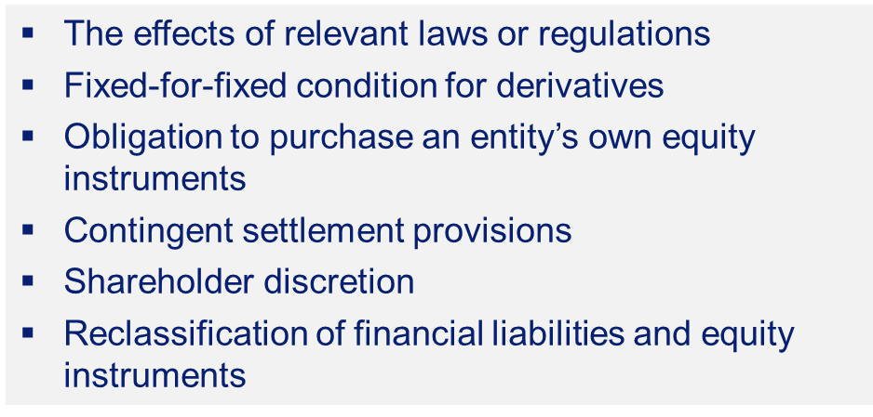
Overview of the project
Improve information entities provide in their financial statements about financial instruments that they have issued
Approach:
Improve presentation and disclosure
Address practice issues by clarifying underlying classification principles
Provide application guidance and illustrative examples
Address challenges in applying IAS 32:
A snapshot and webcast series is also available on our website.

Slide 8

Next steps
29 Nov 2023
29 Nov 2023–29 Mar 2024
Q2 2024 onwards
Exposure Draft published
Consultation period
Feedback analysis and redeliberations
Link to the consultation: https://www.ifrs.org/projects/work-plan/financial-instruments-with-characteristics-of-equity/exposure-draft-and-comment-letters/
Consultation closes
29 March 2024

Slide 9
Perpetual instruments
‘In good times, behaves like debt, in bad times, behaves like equity.’
Stated coupon
Issuer call option
Coupon and principal can be deferred
Subordinated/loss absorption
Regulatory Capital
Feedback from equity investors
Regulatory Environment
Restricted Tier 1 (RT1)
Additional Tier 1 (AT1)
A change in accounting classification is not expected to affect the regulatory capital classification
Most equity analysts preferred financial liability classification
If equity classification is retained, separate presentation and additional disclosures in the notes would provide useful information
Corporate Hybrids
Utilities
Telecommunication
Oil and Gas
Automobile
What is the IASB proposing?
No change in classification
Develop presentation and disclosure requirements

Slide 10
Presentation proposals

Slide 11
Presentation—Proposed amendments to IAS 1
To ensure amounts attributable to ordinary shareholders are clearly visible on an entity’s statement of financial position, statement(s) of financial performance and statement of changes in equity, an entity will be required to present:
Equity
Ordinary shareholders of parent
Other owners of the parent
Balance sheet
Line items on issued capital and reserves shown separately
Statement of financial performance
Results attributable shown separately
SOCIE
Each class of contributed
equity shown separately
Distributions shown separately

Slide 12
Illustrative presentation
Statement of profit or loss (extract) | 2020 CU million | 2019 CU million
Profit attributable to:
Ordinary shareholders of the parent | 82,000 | 39,400
Other owners of the parent | 15,000 | 13,000
Non-controlling interests | 24,250 | 13,100
Profit for the year | 121,250 | 65,500
Proposed improvements to presentation in the financial statements
Balance sheet (extract) | 2020 CU million | 2019 CU million
Share capital | 642,000 | 600,000
Retained earnings | 200,500 | 127,700
Other reserves | 10,200 | 21,200
Equity attributable to ordinary shareholders of the parent | 852,700 | 748,900
Equity attributable to other owners of the parent | 51,000 | 34,000
Non-controlling interests | 70,050 | 48,600
Total equity | 973,750 | 831,500

Slide 13
Proposed improvements to presentation in the financial statements
Illustrative presentation (continued)
Statement of changes in equity (extract) | Share capital | Retained earnings | Other reserves | Equity attributable to ordinary shareholders of the parent | Equity attributable to other owners of the parent | Non-controlling interests | Total equity
Balance at 1 January 20X6 | 600,000 | 97,500 | (400) | 697,100 | 21,000 | 29,900 | 748,000
Changes in equity for 20X6
Dividends | – | (10,000) | – | (10,000) | – | – | (10,000)
Total comprehensive income for the year | – | 40,200(a) | 21,600 | 61,800 | 13,000 | 18,700 | 93,500
Balance at 31 December 20X6 | 600,000 | 127,700 | 21,200 | 748,900 | 34,000 | 48,600 | 831,500
Changes in equity for 20X7
Issue of share capital | 42,000 | – | – | 42,000 | 8,000 | – | 50,000
Dividends | – | (9,000) | – | (9,000) | (6,000) | – | (15,000)
Total comprehensive income for the year | – | 81,600(b) | (10,800) | 70,800 | 15,000 | 21,450 | 107,250
Transfer to retained earnings | – | 200 | (200) | – | – | – | –
Balance at 31 December 20X7 | 642,000 | 200,500 | 10,200 | 852,700 | 51,000 | 70,050 | 973,750
The amount included in retained earnings for 20X6 of 40,200 represents profit attributable to ordinary shareholders of the parent of 39,400 plus remeasurements of defined benefit pension plans of 800.
The amount included in retained earnings for 20X7 of 81,600 represents profit attributable to ordinary shareholders of the parent of 82,000 plus remeasurements of defined benefit pension plans of 400.

Slide 14
Disclosure proposals

Slide 15
Disclosures—Proposed amendments to IFRS 7
Not applicable to stand-alone derivatives
Terms & Conditions
Debt-like characteristics
Priority on liquidation
Nature and priority of claims against an entity
Potential dilution
Equity-like characteristics
Characteristics that determine the classification
T&Cs about priority on liquidation for particular
instruments
Maximum number of additional ordinary shares
Reduced by minimum number of shares for repurchase
Other disclosures
Reclassifications
Remeasurement gains or losses on liabilities based on entity’s performance/net assets
Obligations to redeem own equity instruments
Significant judgements
Terms that become/stop being effective with passage of time
Compound instruments–initial allocation between components
Scope of IFRS 7
Equity instruments issued

Slide 16



Disclosures–terms and conditions
    Objective
    Help investors better understand the nature, amount, timing and uncertainty of cash flows arising from issued financial instruments
    Scope
    Financial instruments with characteristics of both debt and equity
    Includes compound instruments
    Excludes standalone derivatives
    Requirements
    Highlight:
    cash flow characteristics that are not ‘typical’ of the instrument's classification
    key features that determine classification
    the amounts allocated initially to the financial liability and equity components of compound financial instruments

Slide 17
Debt-like characteristics in equity instruments
Even though the entity has no contractual obligation to deliver cash, contractual terms:
  give rise to cash flows that have similar characteristics of nature, timing or amount to those of a financial liability; or
may cause an entity to deliver debt-like cash flows.
For example, preference shares not redeemable by the holder, classified as equity because the entity has the contractual right to avoid/defer payment until liquidation.
Debt-like characteristics—fixed cumulative coupon amounts, specified coupon payment dates and fixed principal amount.

Slide 18
Equity-like characteristics in financial liabilities
Contractual terms that give rise to cash flows that have similar characteristics of nature, timing or amount to those of ordinary shares.
Do not negate any contractual obligation on the issuer to deliver cash but may affect the amount or timing of the cash flows an entity has a contractual obligation to deliver.
May result in an entity delivering its own equity instruments to settle an obligation or not paying the full amount of the obligation.
For example, a financial liability that requires an entity to settle the instrument by delivering a variable number of own shares to the holder.

Slide 19
Terms and conditions illustrative disclosure
Perpetual subordinated notes
At 31 December 2020, the total perpetual subordinated notes outstanding amounted to CU3,986 million and are included in Company X’s equity. The table below includes the key terms of these financial instruments.
 | Notional amount | Initial call date | Coupon reset after initial call date | 2020 CU million | 2019 CU million
5.5% Fixed Rate Subordinated Notes | USD 1,000m | January 2025 | 10.5% | 690 | 714
4.5% Fixed Rate Subordinated Notes | EUR 750m | March 2028 | Market rate | 647 | 658
4% Fixed Rate Subordinated Notes | EUR 2,000m | October 2032 | Market rate | 1,724 | -
3% Fixed Rate Subordinated Notes | GBP 1,000m | January 2027 | Market rate | 925 | 910
 |  |  |  | 3,986 | 2,282

Slide 20
Terms and conditions illustrative disclosure (continued)
Coupon
These notes bear a fixed rate of coupon until their initial call dates. After the initial call dates, if they are not redeemed, the coupon on the notes reset. The coupon on the USD subordinated notes reset to 10.5%. The coupon on the other notes are fixed periodically in advance for five-year periods, based on prevailing market interest rates plus credit spreads of Company X, fixed at issuance.
Company X has discretion to defer coupons on these notes. The deferred coupons accumulate and become payable at the call date if the notes are called, or when Company X is liquidated, if the notes are not called.
Company X is prevented from paying dividends or other distributions in respect of its ordinary shares, or from repurchasing its ordinary shares, until the cumulative coupons on the perpetual subordinated notes have been paid in full.

Slide 21
Terms and conditions illustrative disclosure (continued)
Redemption option
These notes are redeemable at the option of Company X at the initial call date or any fifth anniversary after this date. The amount redeemable will be the notional amount plus accumulated coupons.
Classification
These notes are classified as equity instruments because Company X has the unconditional contractual right to defer coupons and principal repayments until liquidation of Company X.

Slide 22
Disclosures–Priority on liquidation: nature and priority of claims
    Objective
    Provide information about nature and priority of claims against the entity that arise from financial instruments
    Scope
    All financial liabilities and equity instruments within the scope of IAS 32
    Requirements
    Categorise financial instruments by differences in nature and priority, distinguishing between:
    secured and unsecured
    contractually subordinated and unsubordinated
    issued/owed by parent and issued/owed by subsidiaries

Slide 23
Priority on liquidation illustrative disclosure
Nature and priority of claims
As at 31 Dec 2020 (CU million)
 |  | Issued / owed by
 | Consolidated | Parent | Subsidiaries
Secured and unsubordinated
Senior secured debt (a) | 1,200 | – | 1,200
Lease liabilities (a) | 920 | 780 | 140
Unsecured and unsubordinated
Trade and other payables | 1,450 | 320 | 1,130
Senior unsecured debt (a) | 450 | – | 450
Unsecured and subordinated
Subordinated liabilities (see note 15) | 590 | 480 | 110
Classified as financial liabilities | 4,610 | 1,580 | 3,030
Unsecured and subordinated
Perpetual notes (see note 18) | 200 | 200 | –
Irredeemable preference shares (See note 19) | 400 | 400 | –
Non-controlling interest | 1,350 | – | 1,350
Other reserves | 15,000 | 10,000 | 5,000
Ordinary share capital | 8,500 | 8,500 | –
Classified as equity | 25,450 | 19,100 | 6,350
Total | 30,060 | 20,680 | 9,380
(a) Included in the “Borrowings” line item in the statement of financial position.

Slide 24
Disclosures–Priority on liquidation: contractual terms about priority
    Objective
    Provide information about the risks and returns of financial instruments on liquidation of the entity
    Scope
    Financial instruments with characteristics of both debt and equity
    Includes compound instruments
    Excludes standalone derivatives
    Requirements
    Disclose terms and conditions about priority of financial instruments on liquidation, including:
    terms that indicate priority
    terms that could lead to changes in priority
    details of intragroup arrangements such as guarantees

Slide 25
Priority on liquidation illustrative disclosure
Priority on liquidation—subordinated notes
In the event of the respective issuer’s liquidation, any amounts due in respect of the subordinated notes rank junior to all present and future unsubordinated claims of the respective issuer and rank senior to the respective issuer’s ordinary shares, and if any, preference shares. Subordinated notes do not rank pari passu with one another. Some subordinated notes are contractually subordinated to other subordinated notes.
 | 2020 CU million | 2019 CU million
USD 1,000m 5.5% Fixed Rate Subordinated Notes due January 2025 | 690 | 714
EUR 750m 4.5% Fixed Rate Subordinated Notes due March 2028 | 647 | 658
EUR 2,000m 4% Fixed Rate Subordinated Notes due October 2032 | 1,724 | -
GBP 1,000 3% Fixed Rate Subordinated Notes due January 2027 | 925 | 910
 | 3,986 | 2,282

Slide 26
Disclosures—maximum dilution of ordinary shares
    Objective
    Provide information about dilution that could arise from any potential increase in number of issued ordinary shares
    Not to replace IAS 33 Diluted EPS calculation
    Scope
    All instruments and transactions settled by delivering ordinary shares
    Includes IFRS 2 instruments and transactions (entities can leverage existing IFRS 2 disclosures)
    Requirements
    Underlying principle is for an entity to assume:
      maximum possible increase in number of shares for instruments that could be settled by delivering own shares
      minimum reduction in number of shares for instruments to repurchase own shares
    Disclosures include key terms and conditions relevant to understanding the likelihood of maximum dilution and the possibility for unknown dilution

Slide 27
Maximum dilution illustrative disclosure
Instruments | Maximum number of additional ordinary shares | Key terms and conditions relating to the instrument/transaction
Convertible bonds B | 250 | In the event of a change of control of Company X prior to the conversion date, the conversion ratio is adjusted downwards to a pre-determined strike price.
Convertible bonds D | 350 | Issuer holds an option to settle in shares or cash (equal to the value of the shares).
Convertible bonds (A and C) | 600 | Holder holds an option to convert the bond at a specified conversion date using a specified conversion ratio.

Slide 28
Maximum dilution illustrative disclosure (continued)
Instruments | Maximum number of additional ordinary shares | Key terms and conditions relating to the instrument/transaction
Mandatorily convertible note F | 100 | Subject to a cap of 100 shares and a floor of 10 shares.
Number of share options in the scope of IFRS 2 outstanding at reporting date | 100 | Refer to note x (IFRS 2 disclosures on share options).
Number of known unvested shares from share awards in the scope of IFRS 2 at reporting date | 100 | Refer to note y (IFRS 2 disclosures on share awards).

Slide 29
Maximum dilution illustrative disclosure (continued)
Instruments | Maximum number of additional ordinary shares | Key terms and conditions relating to the instrument/transaction
Maximum number of additional ordinary shares | 1,500
Unknown number of additional ordinary shares | unknown dilution from Share-settled bond E | The number of shares will depend on the share price at settlement date
Total maximum number of additional ordinary shares | 1,500 + unknown dilution from Share-settled Bond E
Less: minimum reduction in the number of ordinary shares
Share buy-back | (100) | Commitment to buy 100 –500 shares.
Net maximum number of additional ordinary shares | 1,400 + unknown dilution from Share-settled Bond E

Slide 30




Follow us online
ifrs.org
@IFRSFoundation
IFRS Foundation
International Accounting Standards Board

Slide 31

OVERVIEW ON FICE
FINANCIAL INSTRUMENTS WITH
CHARACTERISTICS OF EQUITY
EAA Virtual Research Workshop, 11 March 2024
Sapna Heeralall

Slide 32
DISCLAIMER
The views expressed in this presentation are those of the presenter, except where indicated otherwise. EFRAG positions, as approved by the EFRAG FRB, are published as comment letters, discussion or position papers, or in any other form considered appropriate in the circumstances

Slide 33
OVERVIEW
EFRAG’s draft comment letter
  Presentation proposals
  Disclosure proposals

Slide 34
EFRAG’s draft comment letter - Presentation

Slide 35
PRESENTATION PROPOSALS
EFRAG supports the IASB’s proposals to separately present the amounts attributable to ordinary shareholders from other owners of the parent in the primary financial statements
  Fundamental for the users of financial statements to have information about multiple equity providers and financial instruments not aggregated in a single line
  Will help users better understand how the proceeds will be distributed on the sale of a business and evaluate the ordinary shareholders’ value

Slide 36
IMPACT ON PRESENTATION – WRITTEN PUT OPTIONS ON NCI
What is a written put option over non-controlling interest (NCI put)
An instrument that obliges an entity in the consolidated group to purchase shares of its subsidiary that are held by a non-controlling-interest shareholders
Initial recognition
IASB proposals | NCI puts are presented on the Balance sheet as a financial liability and also presented as a debit to Parent Equity (gross presentation)
EFRAG’s draft comment letter | Disagree with the IASB’s proposals regarding presentation of NCI puts as a debit to Parent Equity EFRAG considers that NCI puts should be presented as a debit to Equity relating to NCI Also, the IASB should explore the alternative model to treat contracts meeting the definition of a derivative as stand-alone derivatives (net presentation) Results in no or limited financial liability and no or limited impact on Parent Equity or NCI equity

Slide 37
IMPACT ON PRESENTATION – WRITTEN PUT OPTIONS ON NCI
Subsequent measurement
IASB proposals | Changes in the financial liability are presented in the Statement of profit or loss
EFRAG’s draft comment letter | Many stakeholders disagree with the resulting presentation in the Statement of profit or loss Would be in conflict with the requirements to account in equity for transactions with owners in their capacity as owners Would be counterintuitive to have measurement changes being presented in profit or loss because performance decreases when the value of the shares subject to the put option increases, and vice versa

Slide 38
EFRAG’s draft comment letter - Disclosures

Slide 39
DISCLOSURE PROPOSALS
EFRAG welcomes the improvements to disclosures on issued instruments
Field-testing will be essential to ensure that these disclosures are:
Clear
Able to be implemented by entities
Balanced between the benefits to users and the costs for preparers
EFRAG has the following concerns and suggestions:
Disclosures on contractual nature and priority on liquidation.
  Entities may face challenges in determining whether priority on liquidation stems from contracts or law/regulation.
  Suggest to provide information on subgroups located in different jurisdictions and on how the group structure affects priority on liquidation
On terms and conditions of financial instruments with both financial liability and equity characteristics disclosures.
  Useful to provide disclosures on the effects of law on classification as financial liabilities or equity instruments.

Slide 40
DISCLOSURE PROPOSAL ON RECLASSIFICATION
IASB proposals | Disclosures on terms and conditions that become, or stop being, effective with the passage of time
EFRAG’s draft comment letter | EFRAG expresses concerns on the prohibition to reclassify ‘passage-of-time changes’ while requiring disclosures on terms and conditions that become, or stop being, effective with the passage of time Would reflect the substance of the contractual terms for the remaining life of the instruments If disclosure is useful for users, why is it not relevant that the instrument be reclassified

Slide 41
APPENDIX:
IMPACT ON PRESENTATION – WRITTEN PUT OPTIONS ON NCI

Slide 42
IMPACT ON PRESENTATION – WRITTEN PUT OPTIONS ON NCI
Simplified fact pattern
The parent owns 70% of the subsidiary
The value of 100% of the subsidiary’s net assets is CU 1 000, of which CU 700 represents the parent’s share and CU 300 represents the non-controlling interest’s share
The parent writes a put option which allows the non-controlling shareholder to sell its holding to the parent. The discounted value of this put option’s exercise price is 350 at its issuance (T0) and 400 1 year later (T1)
The subsidiary’s results in year 1 is CU 100, of which CU 70 represents the parent’s share and CU 30 represents the non-controlling interests share

Slide 43
IMPACT ON PRESENTATION – WRITTEN PUT OPTIONS ON NCI
Summary of three approaches

Slide 44
THANK YOU

Slide 45
EAA Reporting Standards Workshop on FICE
Tobias Bornemann

Slide 46
1. Overview

Slide 47
Overview
Focus on the empirical evidence around two leading questions:
  Classification: Do users of financial statements “look through” the accounting classification of HFIs?
  Disclosure and presentation: Which features are important to users of financial statements?
Not covered, but important in the literature:
  Effect of classification principles on firms’ decision to issue certain types of HFIs or structuring of HFIs
  Fargher, Sidhu, Tarca, and, van Zyl (2019, AF)

Slide 48
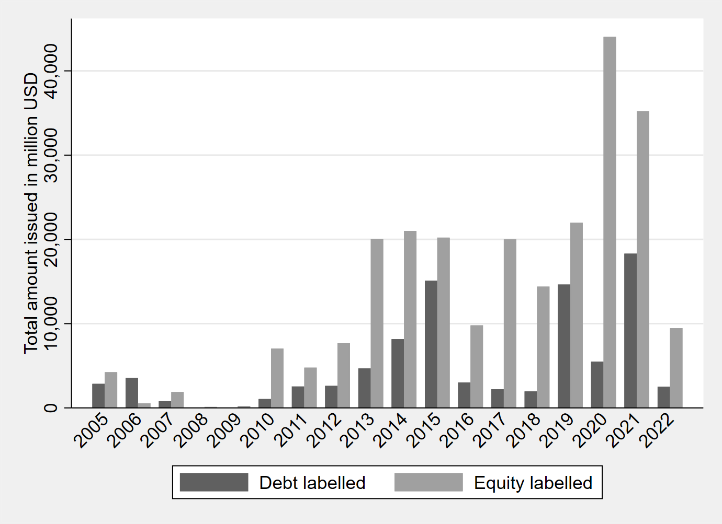
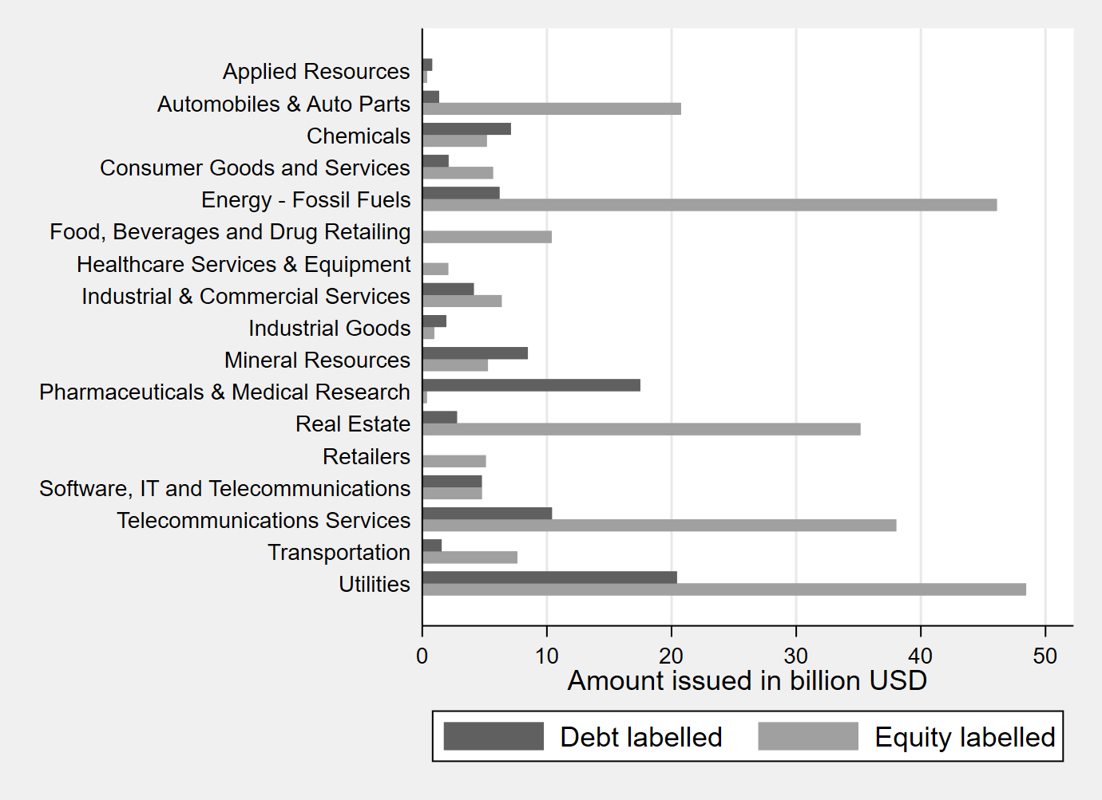
HFIs: CHB market
Volume by year
Volume by industry
~ USD 330bn market
Source: Bornemann and Novotny-Farkas (2024, WP)

Slide 49
2. Classification
Do users of financial statements “look through” the accounting classification of HFIs?

Slide 50






Market perception of HFIs: Introduction
How do capital markets perceive HFIs? As debt, equity, or something in between?
Underlying idea: Analyze the economic substance of HFIs to classify them as either liabilities or equity
Example:
Necessary condition: Users of financial statements are able to “look through” the label and correctly incorporate the underlying features of HFIs
Stock price
Correlation?
Equity
HFI
Systematic
risk

Slide 51
Market perception of HFIs: Evidence I
Some evidence that users are able to “look through” the classification of (hybrid) financial instruments
  Mandatorily Redeemable Preferred Stock (MRPS) does not exhibit a debt-like or equity-like relation with systematic risk or price
  Kimmel and Warfield (1995, TAR); Cheng, Frischmann, and Warfield (2003, RAR)
  Employee stock options (ESOPs) are negatively correlated to common equity risk and expected returns, suggesting that ESOPs are not priced as liabilities
  Barth, Hodder, and Stubben (2013, RAST)
  Cash and share-put warrants are priced as debt or equity in line with their solvency characteristics and independent of their accounting classification as liabilities (SFAS 150)
  Terando, Shaw, and Smith (2007, RQFA)
  In an experiment, experienced finance professionals rely on HFIs’ contractual features when evaluating a firm’s creditworthiness and in their lending decisions
  Clor-Proell, Koonce, and White (2016, JAR)

Slide 52
Market perception of HFIs: Evidence II
A bit of evidence suggesting users price HFIs in line with their classification
  Buy-side analysts price MRPS in line with their accounting classification
  Hopkins (1996, JAR)
  Markets price perpetual corporate hybrid bonds (PCHBs) as debt around their offering but as equity when presented as equity in F/S
  Bornemann and Novotny-Farkas (2024, WP)
    Cumulative abnormal returns around PCHB offerings are comparable to straight debt offerings
    However, the value relevance of PCHBs suggests equity-like pricing when presented in F/S

Slide 53
Market perception of HFIs: Evidence II
However, the market’s perception is context-specific and likely depends on the attributes of…
  … the security
    Once MRPS includes more equity features (esp., conversion features or voting rights), MRPS is priced more equity-like
    Kimmel and Warfield (1995, TAR)
  Finance professionals rely on five key features to rank HFIs along the debt-equity continuum: maturity, priority in liquidation, voting rights, settlement in cash or common stock, dependence on profitability
  Clor-Proell, Koonce, and White (2016, JAR)
  … the firm
    Market perception of MRPS as liabilities or equity depends to some extent on firms’ size
    Cheng, Frischmann, and Warfield (2003, RAR)
    Investors price preferred stock as more equity-like (liabilities-like) when the firm is financially distressed (healthy)
    Linsmeier, Partridge, and Shakespeare (2023, WP)

Slide 54
Classification changes: Evidence
No studies that analyze whether reclassifications of (hybrid) financial instruments provide more useful information to users
Literature supports that firms adjust financing or instruments in response to classification changes
  FAS 150: reclassified MRPS from mezzanine to liabilities around 2003
    Firms redeemed MRPS early before the adoption of FAS 150 to avoid negative effects on debt covenants
    Moser, Newberry, and Puckett (2011, RAST)
  Firms issued fewer MRPS and restructured MRPS after the adoption of FAS 150
  Levi and Segal (2015, EAR); Hanlon (2019, AJM)
  IAS 32: reclassified most preferred shares from equity to liabilities
    Majority of affected firms either buy back or restructure preferred shares in response to IAS 32
    De Jong, Rosellón, and Verwijmeren (2006, AiE)

Slide 55
Classification: Conclusion
Some evidence that users “look through” the classification of HFIs even in low-disclosure settings
(e.g., no information on MRPS’ attributes was disclosed in the analyzed U.S. settings)
A bit of evidence that users price HFIs in line with their classification
The perception of HFIs as debt-like or equity-like is context-specific and depends on
  The features of the instrument
  The economic attributes of the firm
  (The type of user of financial statements)
No evidence that reclassification of (certain) HFIs provides more useful information

Slide 56
2. Presentation and Disclosure
Which features are important to users of financial statements?

Slide 57
Disclosure: Introduction
Contractual features of HFIs are typically public information after their offering
Nevertheless, disclosure of contractual features in the Notes to the Financial Statements can have two effects:
  reduces information asymmetry across different types of users of financial statements
  (“levels the playing field”)
  reduces information processing costs of users of financial statements
  Blankespoor, deHaan, and Marinovic (2020, JAE)

Slide 58
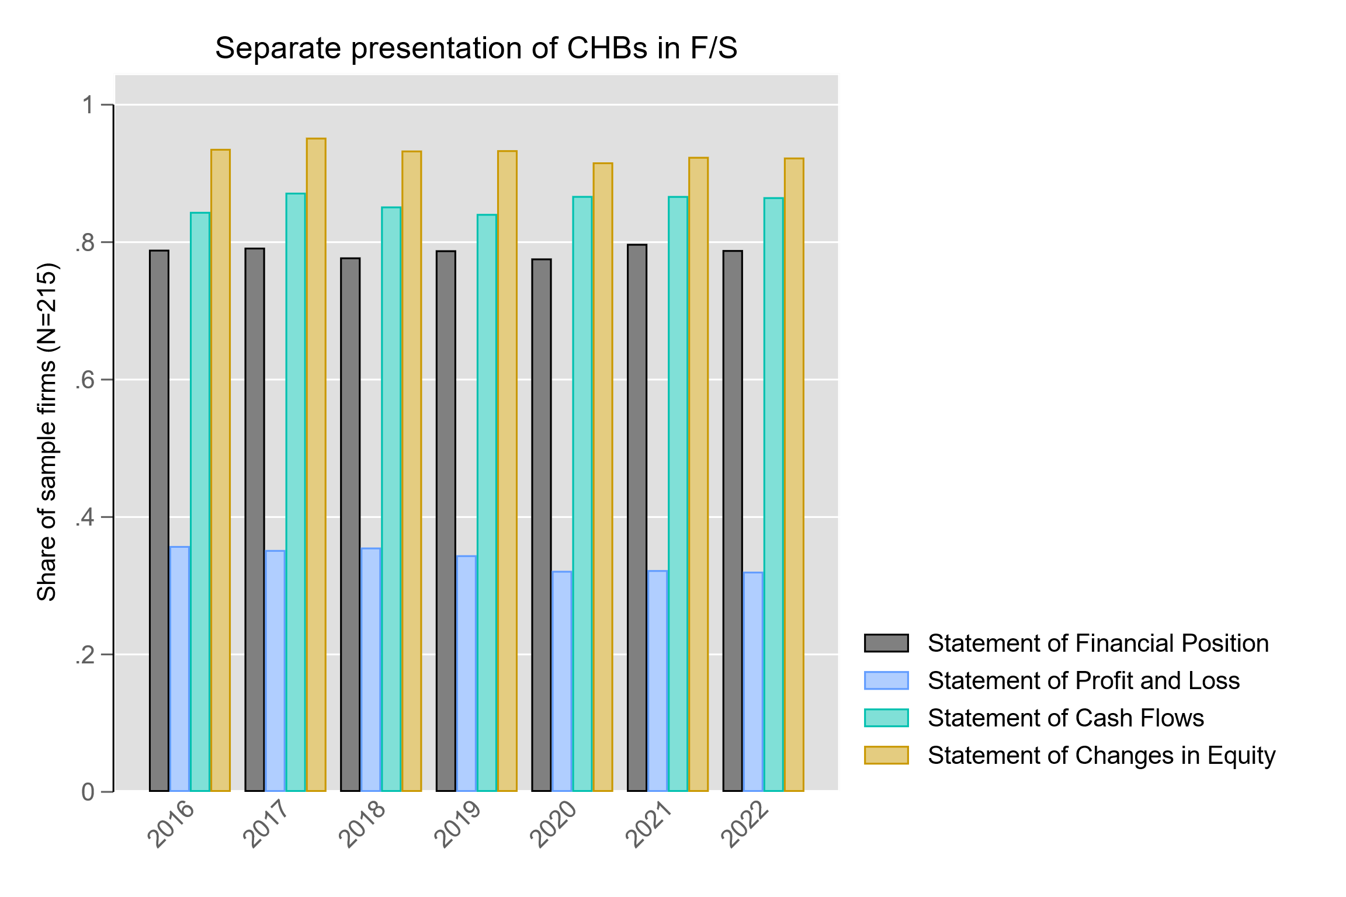
Disclosure: Anecdotal evidence
Transparency on perpetual hybrid bonds varies across firms
Source: Bornemann and Novotny-Farkas (2024, WP)

Slide 59
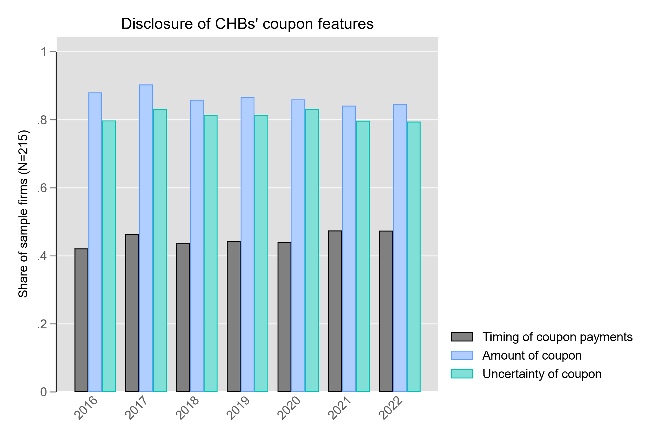
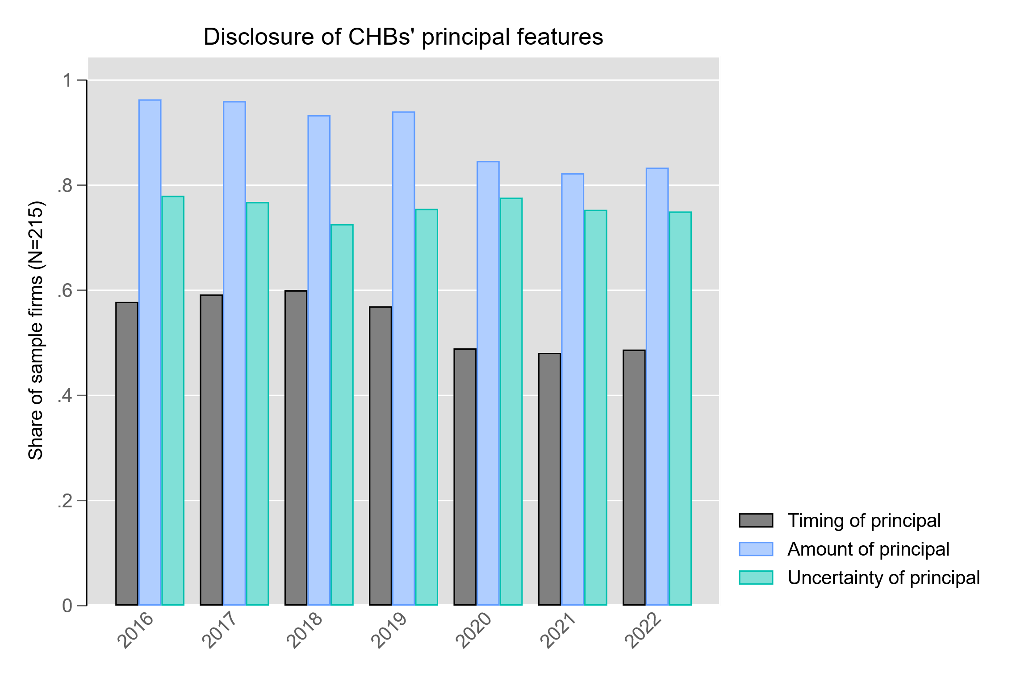
Disclosure: Anecdotal evidence
Transparency on perpetual corporate hybrid bonds (PCHBs) varies across firms
Lacking disclosures on seniority, voting rights, and dilution effects of PCHBs
Source: Bornemann and Novotny-Farkas (2024, WP)

Slide 60
Disclosure: Evidence
Some evidence that HFIs’ features differ in their importance to certain users
(“experienced finance professionals conducting credit-related judgments”)
Clor-Proell, Koonce, and White (2016, JAR)
  Maturity and priority in liquidation matter most in assessing an HFI as equity-like or debt-like
  Voting rights, settlement in cash or common stock, and dependence on profitability matter less
  However, no broad agreement on the relative importance of features
  No evidence that these results generalize to other types of users
Some descriptive evidence that disclosure guidance improves disclosure of HFI features
Marquardt and Wiedman (2007, AH)
  Disclosure of conversion features and impact on diluted EPS was low pre-2004, esp. for firms with high
  Disclosure of conversion features of COCOs improved after disclosure guidance by FASB in 2004
Separate presentation of CHBs in F/S is associated with lower forecast error and dispersion of analysts
Bornemann and Novotny-Farkas (2024, WP)

Slide 61


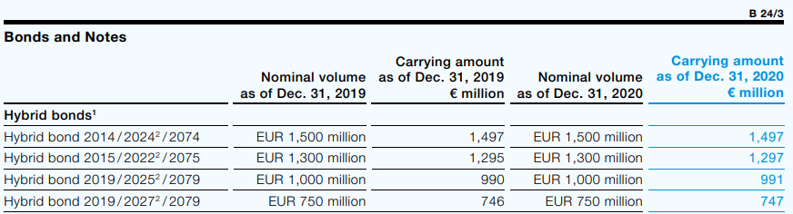
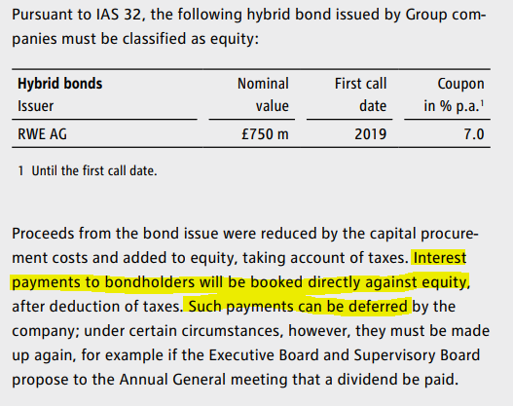
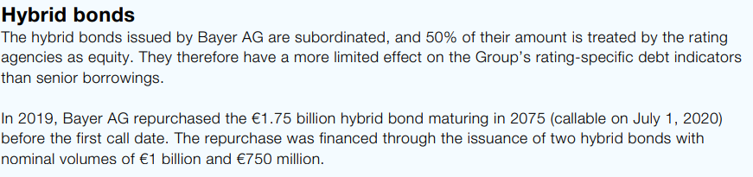
Differences in disclosure for similar instruments
Under IFRS 7, no specific disclosures are required for instruments classified as equity

Slide 62
Disclosure: Conclusion
The existing disclosure requirements (e.g. IFRS 7 and IFRS 9) and the complexity of the features of HFIs are unlikely to provide sufficient information to allow users to reclassify instruments (e.g. from debt to equity)
Fargher, Sidhu, Tarca, and, van Zyl (2019, AF)
However, features are important to allow users to assess the financing of the firm and the characteristics of HFIs
No consensus on which features matter most to characterize HFIs, but users rely on:
  Maturity
  Priority in liquidation
  Voting rights
  Settlement in cash or common stock
  Dependence on profitability

Slide 63
3. Conclusion and Outlook

Slide 64
Conclusion
No consistent evidence that the reclassification of certain types of instruments provides more useful information to users
Some evidence that users do not assess the same type of instrument consistently
Instead, the assessment of HFIs is likely context-specific and relies on the attributes of the instrument and the firm
A dichotomous classification of HFIs does likely not communicate important information relevant to HFIs
Disclosure of underlying features allows users to (more cost-effectively) evaluate them

Slide 65
Caveats and outlook
Existing empirical and experimental evidence is largely limited to
  U.S. settings
  specific types of HFIs (mainly MRPS)
  specific types of users (buy-side analysts, finance professionals making credit-related decisions)
  sample periods before 2000
  equity market effects
Avenues for future research
  Differences in perception of HFIs across different types of users, esp. less experienced users
  Differences in perception of HFIs across debt and equity markets
  Identification of attributes that are important to different users to assess HFIs’ underlying characteristics

