Slide 1


European Accounting Association (EAA) / EFRAG / International Accounting Standards Board Research (IASB) Workshop
Business Combinations—Disclosures, Goodwill and Impairment
30 April 2024

Slide 2
Business Combinations—Disclosures, Goodwill and Impairment
Ann Tarca, IASB Member
Jawaid Dossani, IASB Technical Director
Dehao Fang, IASB Technical Staff
Vikash Kalidas, IASB Technical Staff

Slide 3

Objective of this workshop
Provide an overview of the Exposure Draft–Business Combinations, Goodwill and Impairment
To gather academic input on:
  the effects of pre- and post- acquisition disclosures about business combinations provided voluntarily by companies or pursuant to regulatory environments around the world, including for example the United States;
  incentives and consequences of disclosures–for example, exemptions from requirements to disclose information that might be commercially sensitive; and
  factors affecting pre- and post-acquisition disclosures, such as the nature or size of the business combination, and impact of the reporting environment on disclosures.

Slide 4
Agenda
Background
5–8
Improving disclosures about business combinations
9–15

Slide 5
Background

Slide 6
Summary of the Exposure Draft
Objective
Improve information entities provide about their business combinations at a reasonable cost
Package of proposals
A package of improved disclosure requirements in IFRS 3 Business Combinations
Changes to the impairment test of cash-generating units containing goodwill in IAS 36 Impairment of Assets
Comment period
Comments requested by 15 July 2024
Better information for better decisions
– increases transparency and usefulness of information

Slide 7

Why is the IASB publishing an Exposure Draft?
High value transactions
Acquisitions—referred to as ‘business combinations’ in IFRS Standards— are often large transactions for the entities involved
These transactions play a central role in the global economy. For example, deals announced in 2023 totalled $3.2 trillion¹
Information about acquisition’s performance
Investors receive insufficient information about an acquisition’s performance – investors sometimes use information from impairment test as a proxy to assess an acquisition’s success
Preparers consider information about an acquisition’s performance to be commercially sensitive
Impairment test
Impairment losses on goodwill sometimes recognised too late.
Impairment test complex and costly
¹ Looking Back at M&A in 2023: Who Wins in a Down Year? | Bain & Company

Slide 8
Package of proposals
Proposed changes to IFRS 3
Proposed changes to IAS 36
Disclose information used by key management personnel about performance of strategic business combinations
  Key objectives, targets in year of acquisition
  Performance against key objectives, targets in subsequent periods
Other improvements to existing disclosures, including disclosing quantitative information about expected synergies
Exempt an entity from disclosing some information in specific circumstances
Clarify how an entity allocates goodwill to cash-generating units (CGU)
Require entities to disclose which reportable segment contains a CGU
Simplify value in use calculation

Slide 9
Improving disclosures about business combinations

Slide 10



Key disclosure proposals
Performance of business combinations
Quantitative information about expected synergies
Exemption

Slide 11


Stakeholder feedback leading to proposals
Acquisitions are a large and risky use of capital. Investors need better information to help assess:
the price paid;
why management paid that price; and
subsequently, whether the acquisition is meeting management's expectations
Some investors use impairment losses on goodwill as a signal of an unsuccessful acquisition but sometimes impairment losses are recognised too late
Information about the performance of acqusitions and information about expected synergies could be commercially sensitive and forward-looking.
Companies should not be required to disclose this information in financial statements.
Investors
Preparers

Slide 12


Performance of business combinations
Information to be disclosed
Population of business combinations
Exemption
Key objectives and targets
Performance against key objectives and targets
Strategic business combinations
Applied to some items of commercially sensitive information

Slide 13
Expected synergies
Information to be disclosed
Population of business combinations
Exemption
In year of acquisition only, information aggregated by category about:
Expected synergies
Cost to achieve synergies
Expected timeframe
All ‘material’ business combinations
Applied to some items of commercially sensitive information

Slide 14



Exemption
Principle
An entity may be exempted from disclosing some information if doing so can be expected to prejudice seriously an entity’s objective for a business combination
Application guidance
For example:
disclosing the reason for applying the exemption for each item of information
factors to consider in identifying the appropriate circumstances for applying the exemption
Responds to preparer concerns
In particular, concerns about commercial sensitivity and some concerns about forward-looking information

Slide 15
Summary of key disclosure proposals
Disclosures for material business combinations
Additional disclosures for strategic business combinations
As at acquisition date
Expected synergies
Exemption - YES
Strategic rationale
Exemption - NO
Key objectives and targets
Exemption - YES
After acquisition date
Performance - actuals
Exemption - NO
Performance – statement
Exemption - YES

Slide 16




Follow us online
ifrs.org
@IFRSFoundation
IFRS Foundation
International Accounting Standards Board

Slide 17

Business Combinations—Disclosures, Goodwill and Impairment
EFRAG Presentation
30 April 2024
Didrik Thrane-Nielsen and Ioanna Michailidi

Slide 18
DISCLAIMER
The views expressed in this presentation are those of the presenter, except where indicated otherwise. EFRAG positions, as approved by the EFRAG FRB, are published as comment letters, discussion or position papers, or in any other form considered appropriate in the circumstances

Slide 19
OVERVIEW
TIMELINE
EFRAG’S PRELIMINARY VIEWS ON THE IASB’S PROPOSED DISCLOSURES IN IFRS 3 BUSINESS COMBINATIONS
  Performance of a business combination
  Strategic business combinations
  Expected synergies
  Exemption from disclosing information
  Identifying information to be disclosed

Slide 20
TIMELINE
Consultation period. In Q1 2021, EFRAG issued its FCL
EFRAG DCL consultation period and outreaches
Exposure Draft published
Q2 2021 - Q3 2023
March
2024
Early May
2024
May-June
2024
July 2024
Q1 2020 - Q2 2021
Q1 2020
Discussion Paper published
Redeliberations
EFRAG to publish its Draft Comment Letter
EFRAG to publish its Final Comment Letter

Slide 21
Performance of a business combination
IASB PROPOSALS
Acquisition-date key objectives and targets and whether these are being met
Actual performance and statement of whether actual performance meeting/met key objectives and targets
Information only required for strategic business combinations, and subject to the exemption in specific circumstances (no exemption for actual performance)
EFRAG PRELIMINARY
VIEW
Welcomes the IASB’s proposals for better information on the performance of strategic business combinations as they respond to users' requests
Appreciates the IASB’s efforts in reaching a compromise for preparers and users by requiring the information only for a subset of business combinations, and for exempting an entity from providing the information in specific circumstances
FEEDBACK REQUIRED
Further feedback on potential scenarios where the exemption would not be applicable, and the disclosures would pose serious concerns to the entity
Feedback on whether the information on actual performance would be useful in all cases, and the usefulness of integrated performance information to users
Additional feedback on whether the information related to the performance of a business combination should be provided in the financial statements

Slide 22
Strategic business combinations
IASB PROPOSALS
Identification of a strategic business combination using a closed-list of thresholds
  quantitative thresholds—any one of revenue, operating profit and assets of the acquired business constitutes at least 10% of the acquirer’s corresponding amounts; or
  qualitative thresholds—the acquisition results in a company entering a new major line of business or geographical location
EFRAG PRELIMINARY
VIEW
Supports the proposed thresholds since they are, in most cases, expected to capture the intended population of acquisition and is consistent with thresholds used in other IFRSs
Notes concerns that the thresholds may capture immaterial acquisitions; however notes that the concept of materiality would still apply and recommends the IASB to elaborate on this in the Basis for Conclusions
FEEDBACK REQUIRED
Additional feedback on the potential challenges in applying the proposed thresholds
Seeks additional insight into whether open-list approach would be more appropriate
Feedback on the appropriateness of the 10% measure
Additional feedback on the usefulness of guidance in assessing whether a series of business combinations could be strategic on an aggregated basis

Slide 23
Expected synergies
IASB PROPOSALS
Require the disclosure of expected synergies by category
For each category, disclosure of the estimated cost to achieve the synergies and estimated timeframe
Information subject to the exemption in specific circumstances
EFRAG PRELIMINARY
VIEW
Generally supportive of proposals, and considers that it would enhance the information on expected synergies that users currently receive under IFRS 3
For cases where the disclosure of this information would be prejudicial to the entity, the exemption may be applied
FEEDBACK REQUIRED
Additional feedback on whether the information of expected synergies should be provided in the financial statements
Seeks input on whether to define ‘synergies’ or provide additional guidance on the types of synergies for which quantitative information should be provided

Slide 24
Exemption from disclosing information
IASB PROPOSALS
Exemption to some items of information in specific circumstances
Application guidance to support the identification of the circumstances where the exemption can be applied
EFRAG PRELIMINARY
VIEW
Welcomes the proposed exemption, as it would address some of the concerns expressed by constituents (e.g., on commercial sensitivity)
Suggests including illustrative examples of ‘specific circumstances’ to support entities in its application, as these circumstances could be interpreted differently
FEEDBACK REQUIRED
Seeks additional feedback on whether further application guidance and/or illustrative examples are needed to clarify the meaning of ‘specific circumstances’

Slide 25
Identifying information to be disclosed
IASB PROPOSALS
Provide the proposed disclosures about the performance of a strategic business combination based on information that the entity’s management uses to review and monitor the acquisition
Appropriate level of management is set to be the entity’s Key Management Personnel (KMP)
EFRAG PRELIMINARY
VIEW
Supports proposals and considers that the KMP is the appropriate level
Entities would be familiar with the ‘KMP’ term, as it is defined in IAS 24 and used in other IFRSs (IFRS 10)
FEEDBACK REQUIRED
Seeks additional feedback from constituents on whether KMP is the appropriate level

Slide 26
THANK YOU

Slide 27
The IASB’s Exposure Draft Business Combinations –
Disclosures, Goodwill and Impairment – Academic perspective
EAA–IASB Virtual Research Workshop
30 April 2024
Notes:
A

Slide 28
The IASB‘s Business Combinations Project – Background, Process

Slide 29
The IASB‘s Business Combinations Project – Background, Process
2004, introduction of IFRS 3
2013/14, Post-Implementation Review of IFRS 3 (IASB 2015)
March 2020, Discussion Paper
main preliminary views:
- no re-introduction of amortization
- no substantial changes to impairment testing (headroom approach, etc.)
- improved disclosure requirements
2018, FASB goodwill accounting project
Dec. 2020, FASB tentatively decides to reintroduce amortisation
June 2022, FASB removes goodwill project from agenda
November 2022, IASB votes to retain the impairment-only approach

Slide 30
The IASB‘s Business Combinations Project – Background, Process
2004, introduction of IFRS 3
2013/14, Post-Implementation Review of IFRS 3 (IASB 2015)
March 2020, Discussion Paper
main preliminary views:
- no re-introduction of amortization
- no substantial changes to impairment testing (headroom approach, etc.)
- improved disclosure requirements
2018, FASB goodwill accounting project
Dec. 2020, FASB tentatively decides to reintroduce amortisation
June 2022, FASB removes goodwill project from agenda
November 2022, IASB votes to retain the impairment-only approach

Slide 31
The IASB‘s Business Combinations Project – Background, Process
2004, introduction of IFRS 3
2013/14, Post-Implementation Review of IFRS 3 (IASB 2015)
March 2020, Discussion Paper
main preliminary views:
- no re-introduction of amortization
- no substantial changes to impairment testing (headroom approach, etc.)
- improved disclosure requirements
2018, FASB goodwill accounting project
Dec. 2020, FASB tentatively decides to reintroduce amortisation
June 2022, FASB removes goodwill project from agenda
November 2022, IASB votes to retain the impairment-only approach

Slide 32
The IASB‘s Business Combinations Project – Background, Process
- - interdependency of FASB, IASB decision-making
comparability, convergence – also: timing of events!
- - path dependency
changing an existing standard vs. developing new standard
(see IASB ED Business Combinations, para. BC 232 and 233)

Slide 33
Disclosures – Academic research

Slide 34
Disclosures – Academic research
Different definitions of disclose, disclosure
(1) making any type of information publicly available (also: ESG/CSR)
(2) making financial statements publicly available
(3) providing information in notes to financial statements
Notes:
thus, also in future, the accounting itself, i.e., goodwill impairment, will in most cases not provide insights into M&A performance – leaves crucial role for disclosure

Slide 35
Disclosures – Academic research
Different definitions of disclose, disclosure
(1) making any type of information publicly available (also: ESG/CSR)
(2) making financial statements publicly available
(3) providing information in notes to financial statements
Literature reviews on financial disclosure, (1) and (2)
Verrechia JAE 2001; Healy & Palepu JAE 2001; Botosan ABR 2006; Beyer et al. JAE 2010; Bertomeu & Cheynel Abacus 2016; Leuz & Wysocki JAR 2016; Goldstein & Yang ARFE 2017; Roychowdhury et al. JAE 2019; Blankespoor et al. JAE 2020
Notes:
thus, also in future, the accounting itself, i.e., goodwill impairment, will in most cases not provide insights into M&A performance – leaves crucial role for disclosure

Slide 36
Mandatory disclosures
Mandatory disclosures (in notes to financial statements)
- - Schipper TAR 2007
Notes:
thus, also in future, the accounting itself, i.e., goodwill impairment, will in most cases not provide insights into M&A performance – leaves crucial role for disclosure
the Board’s preliminary view is that it would be helpful to set out the implications of that role as follows:
(a) information in the primary financial statements is more prominent than information in the notes
3.24 in DP 2017
FASB:
The primary purpose of notes to financial statements is to supplement or
further explain the information on the face of financial statements by providing
1Definitions of elements and recognition criteria are in FASB Concepts Statements No. 6,
Elements of Financial Statements, and No. 5, Recognition and Measurement in Financial
Statements of Business Enterprises2
financial information relevant to existing and potential investors, lenders, and other
creditors for making decisions about providing resources to an entity.
Information not
discernable from line items or from readily available sources other than the entity
could significantly affect a user’s decisions. Consequently, notes to financial
statements provide types of relevant information that is not provided on the face of
the financial statements. The resulting disclosures can be categorized as
information about (a) financial statement line items, (b) the reporting entity, and (c)
past events and current conditions and circumstances that have not been
recognized that can affect an entity’s cash flows.
Recognition vs. disclosure
… overview of studies on disclosure, main areas, drivers/determinants, effects
… roles of incentives, enforcement
… (value) relevance of disclosures
Models:
Verrechia 1983
Diamond JoF 1985

Slide 37
Mandatory disclosures
Mandatory disclosures (in notes to financial statements)
- - Schipper TAR 2007
- - since 2013, IASB Disclosure Initiative
- - 2017, Discussion Paper “Principles of Disclosure”
- - 2018, IASB Guidance for developing and drafting disclosure requirements
- - 2021, ED Disclosure requirements in IFRS standards,
A Pilot Approach, IFRS 13 and IAS 19
- - 2023, Project Summary, Targeted Standards-level Review of Disclosures
also see:
- - 2012, EFRAG, Towards a Disclosure Framework for the Notes
- - 2018, FASB Statement of Financial Accounting Concepts No. 8,
Notes to Financial Statements
also see: https://www.sec.gov/corpfin/cfdisclosure
Notes:
thus, also in future, the accounting itself, i.e., goodwill impairment, will in most cases not provide insights into M&A performance – leaves crucial role for disclosure
the Board’s preliminary view is that it would be helpful to set out the implications of that role as follows:
(a) information in the primary financial statements is more prominent than information in the notes
3.24 in DP 2017
FASB:
The primary purpose of notes to financial statements is to supplement or
further explain the information on the face of financial statements by providing
1Definitions of elements and recognition criteria are in FASB Concepts Statements No. 6,
Elements of Financial Statements, and No. 5, Recognition and Measurement in Financial
Statements of Business Enterprises2
financial information relevant to existing and potential investors, lenders, and other
creditors for making decisions about providing resources to an entity.
Information not
discernable from line items or from readily available sources other than the entity
could significantly affect a user’s decisions. Consequently, notes to financial
statements provide types of relevant information that is not provided on the face of
the financial statements. The resulting disclosures can be categorized as
information about (a) financial statement line items, (b) the reporting entity, and (c)
past events and current conditions and circumstances that have not been
recognized that can affect an entity’s cash flows.
Recognition vs. disclosure
… overview of studies on disclosure, main areas, drivers/determinants, effects
… roles of incentives, enforcement
… (value) relevance of disclosures
Models:
Verrechia 1983
Diamond JoF 1985

Slide 38
Disclosures – Lines of research
Determinants
Compliance with mandatory disclosures
Recognition vs. disclosure
Effects of Disclosures

Slide 39
Disclosures – Lines of research
Determinants
refers mainly to voluntary disclosure and compliance
Compliance with mandatory disclosures
- - associated with differences in level of enforcement, governance, firm-level
and managerial incentives
- - literature reviews: Hellman et al. AccEu 2018, Tsalavoutas et al. JIAAT 2020
- - many studies on compliance with M&A and goodwill accounting (see next part)
other areas, e.g., financial instruments, pensions, executive compensation,
employee stock options, CSR/ESG
- - non-compliance not only for IFRS, Europe, Asia, etc., also US companies
e.g., Shalev TAR 2009, Ettredge et al. RAST 2011, Robinson et al. TAR 2011,
Ayers et al. TAR 2015, Caskey et al. RAST 2023
also see literature review, Choudhary et al. Man & Dec Econ 2013

Slide 40
Disclosures – Lines of research
Determinants
Compliance with mandatory disclosures
Recognition vs. disclosure
- - Managerial/preparer perception, reliability
e.g., Wiedman & Wier 1999 JAAF 1999; Choudary JAE 2011; Chlor-Proell &
Maines JAR 2014
- - Value relevance, reliability and information processing costs
e.g., Aboody JAR 1996, Davis-Friday et al. TAR 1999, Espahbodi et al. JAE 2002,
Barth et al. JAR 2003, Ahmed et al. TAR 2006, Jifri & Citron EAR 2009, Yu TAR 2013,
Bratten et al. TAR 2013, Israeli RAST 2015, Müller et al TAR 2015 Michels JAR 2017
- - Experimental studies
e.g., Hirst & Hopkins 1998, Hodge et al. TAR 2004, Hirst et al. TAR 2004,
Gaynor AOS 2011, Chlor-Proell & Maines JAR 2014, Leitter et al. SSRN 2023

Slide 41
Disclosures – Lines of research
Determinants
Compliance with mandatory disclosures
Recognition vs. disclosure
Effects of Disclosure
- - CSR/ESG disclosures
- - SEC risk factors, e.g., Campbell et al. RAST 2014, Hope et al. RAST 2016,
Chiu et al. CAR 2017, Beattie et al. CAR 2018, Cazier et al. TAR 2021
- - Managerial compensation, e.g., Lo JAE 2003, Craighead et al. CAR 2004,
Robinson et al. TAR 2011, Frantz et al. JBFA 2013, Jiang et al JAAF 2018,
Wang et al. JAAF 2020, Gipper JAE 2021

Slide 42





Business Combinations—Disclosures, Goodwill and Impairment Proposed amendments to IFRS 3 and IAS 36
EAA-IASB Visual Workshop, 30 April 2024,
Yannis Tsalavoutas

Slide 43
Presentation structure
Context 1: Exposure Draft Disclosure Requirements in IFRS Standards—A Pilot Approach
Context 2: Making Materiality Judgements PS2 (IAS 1 & 8 amendments).
Brief overview of compliance with IFRS Mandatory disclosures around BC & Goodwill
Comments on specific suggestions in the ED, while reflecting on related literature.
Conclusions
1

Slide 44
Key takeaways in the Project Summary and Feedback Statement regarding Exposure Draft Disclosure
Requirements in IFRS Standards—A Pilot Approach
Aspects of the IFRS Accounting Standards that could be contributing to the disclosure problem
IASB’s response to feedback & way forward
Overall disclosure objectives • provide Accounting Standard-specific context of the overall user information needs to enable an entity to make materiality judgements and apply the requirements about specific disclosure objectives and items of information.
Specific disclosure objectives • describe the detailed information needs of users of financial statements; • use the prescriptive language ‘shall’ to require an entity to comply with those disclosure objectives; and • are accompanied by explanations of the user assessments that rely on the information preparers disclose when applying the specific disclosure objectives.
Items of information that satisfy specific disclosure objectives • describe the information needed to satisfy disclosure objectives in most cases, but additional information may be needed in some cases; and • use the prescriptive language ‘shall’ to require an entity to disclose the information.
Lack of specific disclosure
objectives
Use of prescriptive language
such as ‘shall’ or ‘as a minimum’
Voluminous prescriptive
requirements
PS, 2023, p.4.
PS, 2023, p.12.
3

Slide 45
Key takeaways in the Project Summary and Feedback Statement regarding Exposure Draft Disclosure
Requirements in IFRS Standards—A Pilot Approach
IASB’s response to feedback & way forward
IASB’s proposals in the ED on Business Combinations (IFRS 3)
Overall disclosure objectives • provide Accounting Standard-specific context of the overall user information needs to enable an entity to make materiality judgements and apply the requirements about specific disclosure objectives and items of information.
Specific disclosure objectives • describe the detailed information needs of users of financial statements; • use the prescriptive language ‘shall’ to require an entity to comply with those disclosure objectives; and • are accompanied by explanations of the user assessments that rely on the information preparers disclose when applying the specific disclosure objectives.
Items of information that satisfy specific disclosure objectives • describe the information needed to satisfy disclosure objectives in most cases, but additional information may be needed in some cases; and • use the prescriptive language ‘shall’ to require an entity to disclose the information.
1 new objective
“The prescriptive language “shall” is maintained
A new, pre-defined, type of business combinations is introduced - based on a specific threshold
More disclosure items are introduced
4

Slide 46
Making Materiality Judgements PS2
Para 41: It would not be appropriate for the entity to rely on purely numerical guidelines or to apply a uniform quantitative threshold for materiality (see paragraphs 53–55).
The 10% threshold arguably contradicts these
The justification for a threshold in BC67 arguably contradicts these
IFRS 8 precedes the PS
Para 53: quantitative assessment alone is not always sufficient to conclude that an item of information is not material. The entity should further assess the presence of qualitative factors.
Strategy refers to the future
What if this one – which does not meet B67C c - does not meet the threshold? Isn’t it “strategic”? Or is this captured by para 63 in the ED?
Example F—impact of an entity’s press release on materiality Judgements
An entity undertook a business combination in the reporting period. The acquisition doubled the size of the entity’s operations in one of its main markets.
5
Notes:
Guidance notes provided

Slide 47
Brief overview of compliance with IFRS Mandatory disclosures around BC & Goodwill
Compliance with disclosure requirements relating to Goodwill and goodwill impairment testing is, on average, low, but with significant improvement over time.
The most recent evidence relates to the financial years 2015 for German firms and 2012 for Malaysian firms.
The majority of studies focus on European countries, Australia, and Malaysia.
The evidence highlights significant country differences in compliance levels.
With a few exceptions, the studies examine large firms.
Firm size and being audited by a Big 4 auditor are factors that contribute to higher levels of compliance.
Very limited evidence on the role of governance (exception Bepari & Mollik, 2015).
Only two studies explore market consequences arising from the varying levels of explicitly goodwill related disclosures (Baboukardos& Rimmel, 2014; Mazzi et al., 2017)
6
Notes:
10 mins

Slide 48
Comments on specific suggestions in the ED, while reflecting on related literature.
Mazzi, F., André, P., Dionysiou, D., & Tsalavoutas, I. (2017). Compliance with goodwill-related mandatory disclosure requirements and the cost of equity capital. Accounting and Business Research, 47(3), 268-312.
Tsalavoutas, I., André, P., & Dionysiou, D. (2014). Worldwide application of IFRS 3, IAS 38 and IAS 36, related disclosures, and determinants of non-compliance. ACCA research report, 134.
7
Notes:
10 mins

Slide 49

Comments on specific suggestions in the ED, while reflecting on related literature.
8
Notes:
10 mins

Slide 50
Comments on specific suggestions in the ED, while reflecting on related literature.
Newly introduced requirements
Deal synergies are typically uncertain, difficult to forecast, and realized only over the longer term. Providing detailed synergy forecasts exposes management to legal risk: Investors can sue the management for misleading synergy disclosure and may even ask managers to disclose the basis of their synergy estimates in court (e.g., Hewlett-Packer’s merger with Compaq).
Dasgupta et al., (2024 p. 522)
Food for thought: Should IAS 36 then have additional disclosure requirements for the impairment testing of strategic business combinations?
Bernile and Bauguess (2011) and Dutordoir et al., (2014): only about 20% of all deals are accompanied by a management forecast of synergy, and only 2% actually provide an NPV number.
And, see: Ismail et al, (2019), Ismail & Mavis (2022), Ismail (2011)
9
Notes:
10 mins

Slide 51
Comments on specific suggestions in the ED, while reflecting on related literature.
Food for thought: Is “management” the same as “key management personnel”?
Mazzi, F., André, P., Dionysiou, D., & Tsalavoutas, I. (2017). Compliance with goodwill-related mandatory disclosure requirements and the cost of equity capital. Accounting and Business Research, 47(3), 268-312.
10
Notes:
10 mins

Slide 52
Comments on specific suggestions in the ED, while reflecting on related literature.
Mazzi, F., André, P., Dionysiou, D., & Tsalavoutas, I. (2017). Compliance with goodwill-related mandatory disclosure requirements and the cost of equity capital. Accounting and Business Research, 47(3), 268-312.
11
Notes:
10 mins

Slide 53

Concluding remarks:
Changes in the right direction.
Scope for more suggestions to align IFRS 3 and IAS 36?
Probability of effectiveness of the proposed disclosure requirements, if they go ahead?
Risks for the IASB?

Slide 54

Thank you for attending!

Slide 55
Business Combinations – Goodwill, disclosures and impairment
Virtual Research Workshop
April 30, 2024
Niclas Hellman, Stockholm School of Economics

Slide 56
Are M&As successful?
  On the basis of a review of 93 published studies, King et al. (2004, Strategic Management Journal) conclude (emphasis added):
  ‘We find robust results indicating that, on average and across the most commonly studied variables, acquiring firms' performance does not positively change as a function of their acquisition activity, and is negatively affected to a modest extent.’
  In a more recent review, King et al. (2019, Mergers and Acquisitions: A Research Overview. Routledge) state (emphasis added):
  ‘Still, research consistently examines the effectiveness of M&A using financial or other measures of M&A outcomes. While [methodological] progress has been made through reviews (…) and meta-analysis of prior research (…), observed failure rates of M&A have not improved over the recent decades…’

Slide 57
Three aspects to consider
Corporate strategy
Does our strategy for increased/ maintained growth & profitability require acquisitions?
Financial consequences
Attractive valu-ation?
Share price effect?
Financial state-ment effects?
Integration
Can the synergies be attained in practice at a reasonable cost?

Slide 58
An Acquisition example (1)
Ericsson completed the acquisition of the US-based firm Vonage on 21 July 2022 for about SEK 53 billion (about EUR 5 billion).
At the end of 2022, Ericsson provides the following information in its annual report:
The total goodwill for Ericsson is SEK 84.6 (38.2) billion and is allocated to the operating segments:
-Networks [SEK 28.5 (25.8) billion],
-Cloud Software and Services [SEK 3.6 (3.2) billion],
-Enterprise [SEK 52.5 (9.2) billion] of which Vonage SEK 42.0 billion.
Goodwill from the Vonage acquisition during the year has been allocated to the Vonage CGU within segment Enterprise.

Slide 59
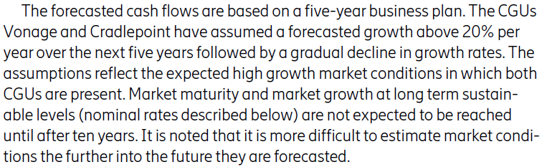
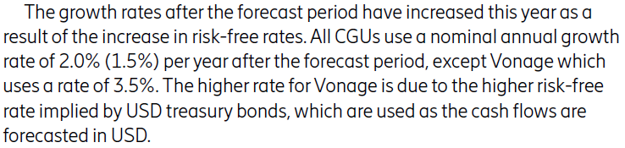




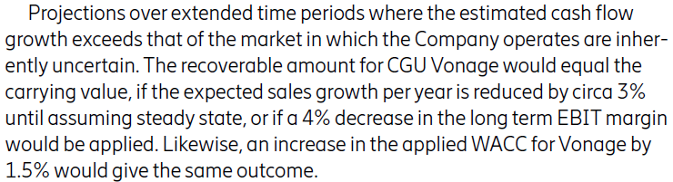
An Acquisition example (2)
Goodwill impairment test
Vonage
(CGU)
Vonage
(acquiree)
Vonage
(acquiree)
The preparer provides adequate disclosures that users can use to evaluate the success of the acquisition.
Acquisition date
(July 2022)
Subsequent period
(31 Dec. 2022)
The acquiree and the CGU are the same.
The impairment test will serve the purpose of evaluating the success of the acquisition.

Slide 60

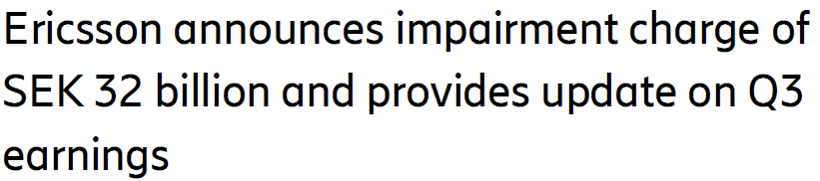
An Acquisition example (3)
Vonage
(CGU)
Vonage
(CGU)
‘The impairment is a consequence of the significant drop in the market capitalization of Vonage’s publicly traded peers, increased interest rates and overall slowdown in Vonage’s core markets.’
Vonage
(acquiree)
Vonage
(acquiree)
Vonage
(acquiree)
Acquisition date
(July 2022)
Subsequent period
(31 Dec. 2022)
Subsequent period
(30 Sep. 2023)
Goodwill impairment test 31 Dec. 2023
There are no reasonably possible changes that would lead to the carrying value not being recoverable for any CGU, except for Vonage. The recoverable amount of CGU Vonage exceeds the carrying amount by SEK 1.1 billion. This CGU was written down to its recoverable amount in Q3 2023. The current head room comes mainly from the amortization of intangible assets since the write-down.
The acquiree and the CGU are the same.
The impairment test will serve the purpose of evaluating the success of the acquisition, but even when the acquiree and the CGU are the same, the design of the impairment test creates headroom.

Slide 61
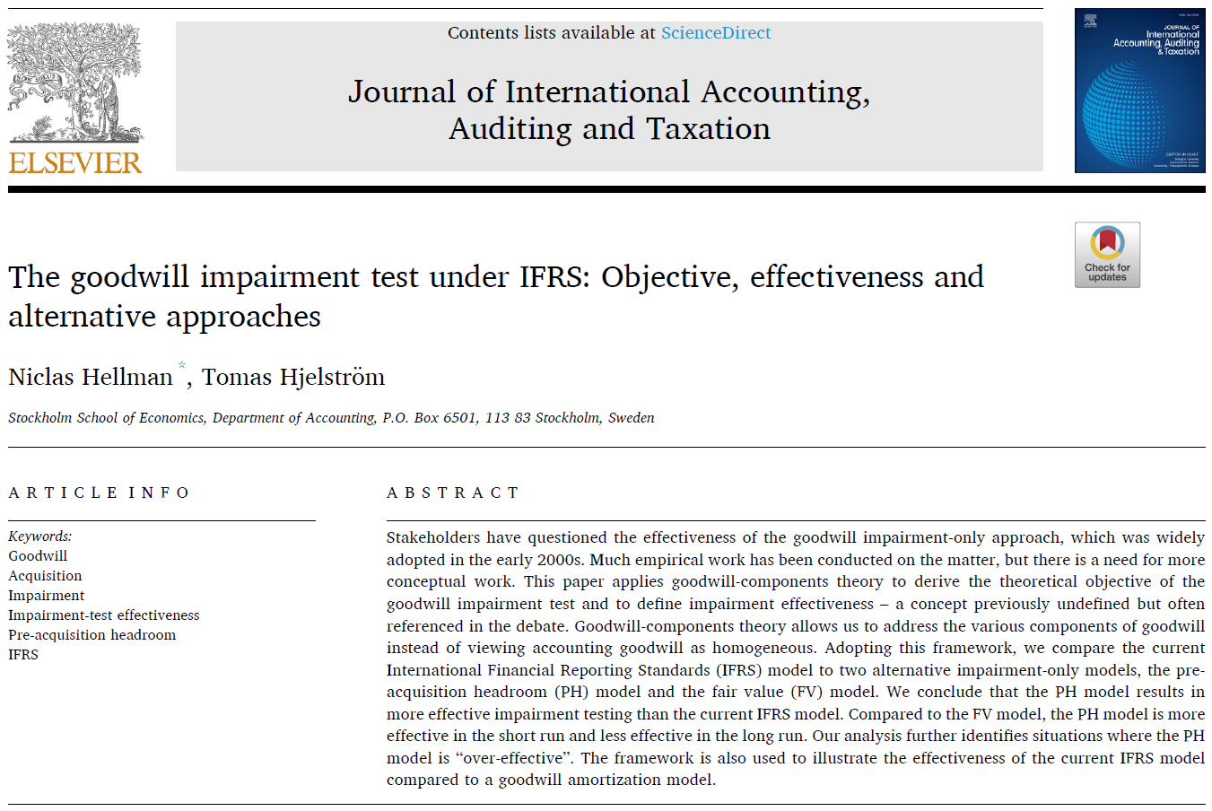


Slide 62
A common situation
Operating segment
Entities may be aggregated so that operating segments become the CGUs (or group of CGUs) subject to impairment tests
CGU
The acquiree is integrated into one or more CGUs with pre-existing internally generated goodwill (pre-acquisition headroom)
Disconnection
Acquiree
Acquiree
Users want to learn about whether the acquisition of the acquiree was successful, but financial information is not provided at the acquiree level.
The valuation of the CGU according to the impairment test is disconnected from the subsequent value of the acquiree (different units, current condition).
Acquisition date
Subsequent period

Slide 63
A management approach
  The suggested solution in the ED to deal with the disconnection between the acquired entity and entity tested for impairment is to ask management to disclose information about business combinations based on the acquiree view rather than the CGU view (i.e. maintaining the link to the goodwill recognized for the acquired entity at the acquisition date).
At the acquisition date, disclosures shall pertain to the strategic rationale and expected synergies for material business combinations and key objectives and targets for strategic business combinations.
  During the post-acquisition period, management shall report on performance (statement and actuals).

Slide 64
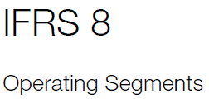
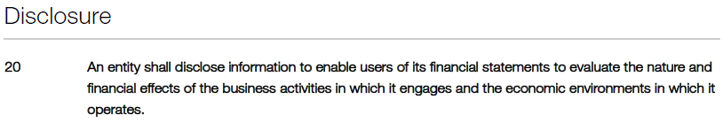
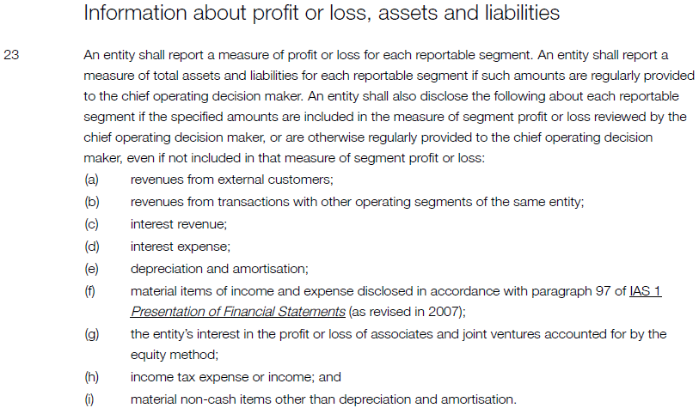
A high-level principle
Some specific requirements
Source: IFRS 8, Operating Segments
management approach applied in IFRS 8

Slide 65
some ifrs 8–related observations
Many users were concerned about the objectivity and reliability of the reported information under the management approach (Aboud & Roberts, 2018; Berger & Hann, 2003; Crawford et al., 2012). Additionally, several issues under this approach are blurry, such as aggregation guidelines, reconciliation, the CODM identification, and the use of non-IFRS measures.
The major observed changes in segmental reporting practices following IFRS 8 are the increase in the disaggregation of geographical information and the reduction in the number of items disclosed (André et al., 2016; Crawford et al., 2012; Leung & Verriest, 2015; Nichols et al., 2013).
Results reported by Aboud and Roberts (2018) indicate that firms with greater proprietary costs provide lower-quality segment disclosure under IFRS 8.
Main source: Aboud, A. (2023) Segmental reporting, accounting enforcement, and analyst dispersion in the European Union. Journal of International Accounting, Auditing and Taxation, 53, 1-10

Slide 66
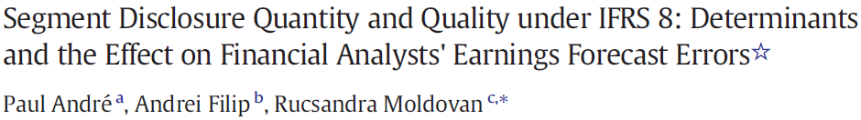
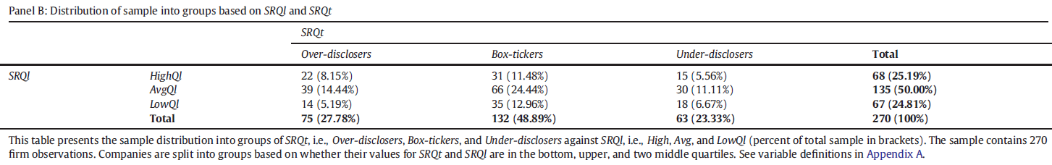
André et al. (2016) find that under IFRS 8, more discretion can be exercised over the quality than the quantity of disclosures and that incentives played an important role in the sense that managers with proprietary concerns tended to solve this by (p. 443, emphasis added): ‘…either deviating from the suggested line-item disclosure in the standard, or, if following standard guidance, by decreasing segment reporting quality.’
These results suggest that when management is given much flexibility in relation to disclosure in combination with low enforceability, there will be high variation in disclosure quantity and quality in practice, to some extent related to the incentive patterns of management.
270 multi-segment European firms applying IFRS 8 that report non-geographical segments

Slide 67
ifrs 8 and some analyst findings (1)
Prior studies suggest that segment-based forecasts outperform consolidated forecasts and that the average forecast error decreased after analysts began using segment information (Cereola et al., 2018; Roberts, 1989).
Segment information is likely to be more beneficial to analysts when business segments are comparable with the industry sectors and are more disaggregated (Berger & Hann, 2003; Heo & Doo, 2018; Hussain, 1997; Kou & Hussain, 2007).
However, using a sample from Australia, He et al. (2016) documented that analysts’ earnings forecasts did not improve significantly after the adoption of the Australian Accounting Standards Board’s AASB 8, suggesting that the benefits associated with the management approach did not materialize when Australia moved to the management approach.
Main source: Aboud, A. (2023) Segmental reporting, accounting enforcement, and analyst dispersion in the European Union. Journal of International Accounting, Auditing and Taxation, 53, 1-10

Slide 68
ifrs 8 and some analyst findings (2)
Cereola et al. (2018) find that geographic sales disclosures by companies located in countries with high and moderate enforcement regimes improve the predictive accuracy of geographic sales.
Aboud and Helfaya (2021) find that common-law countries, higher country-level legal enforcement, and investor protection are positively related to higher quantity of segment disclosure (and disaggregation of geographical information), while both country-level conservatism and closeness between national GAAP and IFRS are negatively related to the quantity of segment disclosure (and disaggregation of geographical information).
Main source: Aboud, A. (2023) Segmental reporting, accounting enforcement, and analyst dispersion in the European Union. Journal of International Accounting, Auditing and Taxation, 53, 1-10

Slide 69
ifrs 8–non-ifrs numbers
Source: Göttsche, M., Küster, S., & Steindl, T. (2021) The usefulness of non-IFRS segment data. Journal of International Accounting, Auditing and Taxation, 43, 1-21
A controversial aspect of IFRS 8 allows firms to define their segment profit (or loss) on a different basis than IFRS measurement and recognition principles, but whether these non-IFRS segment data are useful is in large part unexplored.
Using hand-collected segment data on a sample of European multi-segment firms, we find empirical evidence that non-IFRS segment data lead to less accurate analyst forecasts. Additionally, we find that non-IFRS segment data are associated with higher forecast dispersion, higher uncertainty in analysts’ forecasts, and a lower precision of analysts’ public information set.
Collectively, our findings suggest that non-IFRS segment data impair analysts’ information environment, which casts doubt on their usefulness.
What about new acquiree-centred disclosures on targets and performance – Will they refer to non-IFRS numbers?

Slide 70
Who is management? Who monitors performance?
Operating segment
Chief Operating Decision Maker (IFRS 8)
The CODM identifies a function, not necessarily a manager with a specific title. That function is to allocate resources to and assess the performance of the operating segments of an entity.
CGU
‘Management’ (IAS 36)
Throughout the Conceptual Framework, the term ‘management’ refers to management and the governing board of an entity unless specifically indicated otherwise.
Disconnection
Acquiree
Acquiree
Key Management Personnel (ED proposal, IAS 24)
Those persons having authority and responsibility for planning, directing and controlling the activities of the entity, directly or indirectly, including any director (whether executive or otherwise) of that entity.
Acquisition date
Subsequent period
How will users be able to tell the difference between these categories of management? Does it matter for the disclosures provided?

Slide 71
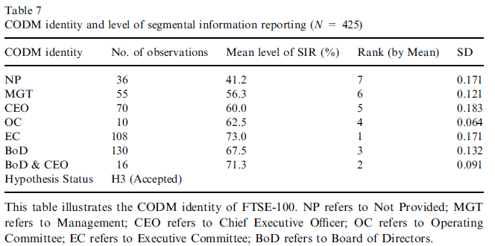
Identity of the codm
Source: Ammar, S. and Mardini, G. H. (2021) Enterprise resource planning enabling segmental information reporting practices of UK-FTSE 100. Accounting and Finance, 61, 1205-1237
Years covered: 2013-2017
The identity of the CODM varies considerably.
The identity of the CODM affects the level of segmental disclosures significantly (the ‘level’ is measured by applying a disclosure index for IFRS 8 comprising 18 mandatory items and 5 voluntary items).
The 32 observations where firms do not disclose the identity of the CODM has the lowest level of segment reporting (41.2%).

Slide 72
Challenges with the ed and the suggested management approach
  Users are likely to make connections between the business combination disclosures related to the acquired entity (acquiree) and the goodwill impairment tests for corresponding CGUs. The acquiree-centred disclosures may become leading indicators for future goodwill impairments. Management may hesitate to provide information about negative acquisition-related performance.
  There is lack of clarity for users (and perhaps also for preparers) as regards the identity and overlap across KMP, CODM and ‘management’.
  There is a risk that the flexibility offered by the management approach may result in a significant group of poor disclosers. Prior research related to IFRS 8 provides some support in this direction.

Slide 73
Thank you!
www.hhs.se

Slide 74
BACK-UP SLIDE

Slide 75
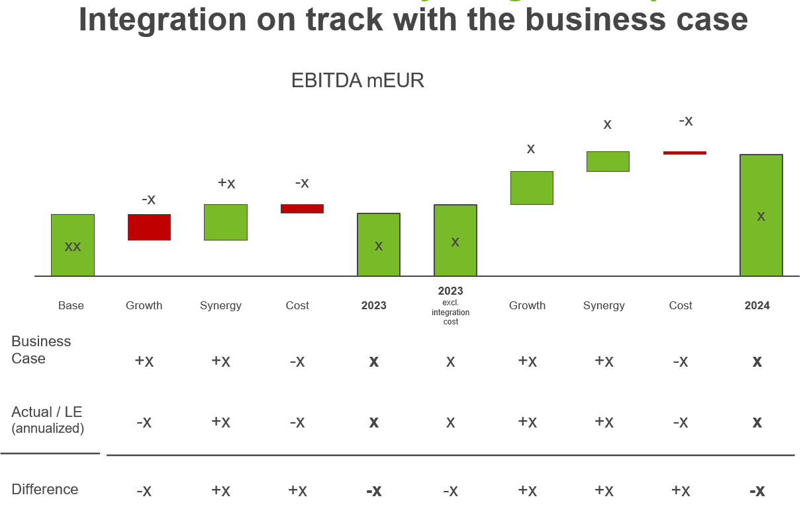
Do companies follow up acquired firms at the acquiree level?
  Stylized example from a listed company’s acquisition of a relatively small acquiree.

