Slide 1
European Accounting Association – European Financial Reporting Advisory Group (EFRAG) – International Accounting Standards Board Research (IASB) Workshop
Statement of Cash Flows and related matters
June 2024

Slide 2
EAA’s Comment Letter Team
Edgar Loew – Frankfurt School of Finance and Management
Kees Camfferman – Vrije Universiteit Amsterdam
Stephani Mason – De Paul University (Chicago)
Henry Jarva – Hanken School of Economics
Andrew Lennard – University of Glasgow.
The group was set up in spring 2024 by the EAA’s Financial Reporting Standards Committee with the intent to contribute to the IASB’s cash flow project with academic input

Slide 3

EFRAG and IASB participants
Rasmus Sommer, EFRAG Senior Technical Manager
Ann Tarca, IASB member
Nick Barlow, IASB Technical Staff
Ana Simpson, IASB Technical Staff

Slide 4

Objective of Research Workshop
As preparation for when the IASB starts work on this pipeline project:
To highlight academic research that would provide evidence to help the IASB answer some of the potential questions that stakeholder feedback raises
To stimulate academic research in areas where there are gaps in the academic literature
Notes:
To also mention that the research might also provide evidence that supports stakeholders’ concerns
For example:
‘missing’ intangibles
financial statements do not reflect economic reality
impedes access to finance
lack of stewardship over unrecognised intangibles
distorts performance metrics
what information investors want

Slide 5
Background
In its April 2022 meeting, the IASB decided to add a project on the Statement of Cash Flows and Related Matters to the research pipeline following the feedback to its Third Agenda Consultation
The matters raised by stakeholders include both presentation issues (such as the classification of cash flows, disaggregation, application of direct method, definition of cash flows etc.) and other issues (such as improved disclosures about non-cash movements, implications to financial institutions, cash flow measures etc.)
As part of the research phase of the project, the IASB will consider whether the project should aim to review IAS 7 Statement of Cash Flows comprehensively or make more targeted improvements
The project is planned to move from the research project pipeline to the research work plan in Q3 in 2024
As part of its research the project team will perform a review of relevant academic literature

Slide 6
Summary of the feedback on the Agenda Consultation
In feedback on the Third Agenda Consultation regarding a project on the Statement of Cash Flows and Related Matters stakeholders identified topics that might be considered in the project. These topics are not presented in any specific order and include:
Cash flow measures and other disclosures (for example, free cash flow)
Effects of non-cash transactions (including disclosure of changes in net debt)
Classification of cash flows and disclosures about operating expenses
Disaggregation of cash flow information
Implications to financial institutions
Application of the direct method
Definition of cash and cash equivalents

Slide 7

Objectives, usages and issues
THE STATEMENT OF CASH FLOWS
24 June 2024

Slide 8
DISCLAIMER
The views expressed in this presentation are those of the presenter, except where indicated otherwise. EFRAG positions, as approved by the EFRAG FRB, are published as comment letters, discussion or position papers, or in any other form considered appropriate in the circumstances
This presentation is based on preliminary input

Slide 9
OVERVIEW
Objectives of the statement of cash flows
Usages of the statement of cash flows
Issues with how the statement of cash flows is currently prepared under IAS 7 Statement of Cash Flows

Slide 10
Objectives

Slide 11
Possible objectives
Clarifying the objectives of the statement of cash flows is important as the objectives as providing more relevant information for one objective might result in less relevant information for another objective.
The benefits of the statement of cash flows presented in the Conceptual Framework and IAS 7 could be categorised as follows:
Evaluating the changes in net assets
Assessing the entity’s financial structure
Assessing the entity’s ability to affect the amounts and timing of cash flows in order to adapt to changing circumstances and opportunities
Assessing the ability of the entity to generate cash and cash equivalents
Comparing entities as it eliminates the effects of using different accounting treatments for the same transactions and events

Slide 12
Usages

Slide 13
Usages (1/2)
Input from input from users and academic literature. Note: EFRAG does not have a representative sample of users!
Academic literature and input from users of financial statements indicate that the statement of cash flows is used (together with other information) for the stated objectives—but the usage of the statement of cash flows depends on the individual user.
The statement of cash flows is used to:
  Understand the business
  Assess management’s stewardship (general performance and cash management)
  Assess accruals (closeness to cash and evaluation of changes)
    Although the statement of cash flow is used by some to assess the ‘quality of earnings’ academic studies indicate that a trading strategy with a long position in low accrual firms and a short position in high accrual firms generates significant abnormal returns in the subsequent years and that high levels of accruals are not reflected in sell-side analysts’ earnings forecasts
  Assess ability to service debt
    But academic literature states that EBIT and EBITDA is often used as an ‘easier’ alternative (but not by all)
The benefits of the statement of cash flows presented in the Conceptual Framework might be categorised as follows:
Evaluating the changes in net assets
Assessing the entity’s financial structure
Assessing the entity’s ability to affect the amounts and timing of cash flows in order to adapt to changing circumstances and opportunities
Assessing the ability of the entity to generate cash and cash equivalents
Comparing entities as it eliminates the effects of using different accounting treatments for the same transactions and events

Slide 14
Usages (2/2)
  Assessing the agility adaptability of the entity
    Not often mentioned by users providing input to EFRAG. Only mentioned in relation to DCF analysis (to assess whether entities would need additional financing in the future)
  Assessing the ability of an entity to generate cash and cash equivalents
    Academic research points in different directions on whether cash flows or earnings figures are best for predicting future cash flows (FASB and IASB: earnings figures are best). Most (not all) academic literature shows that the statement of cash flows includes additional (in addition to the statement of profit or loss) useful information for this
    Input received from EFRAG indicates that many/some users only use the CapEx figures from the statement of cash flows. They estimate cash flows based on the statement of profit or loss. Academic literature indicates that there is additional information in the statements prepared by entities and preparers consider that they can do it better than analysts as they have access to additional information
  Assessing the effects of different accrual accounting practices
    Not a point of focus amongst users providing input to EFRAG

Slide 15
Issues

Slide 16
Issues (1/2)
Included/excluded transactions
  Uncertainty about what is included in ‘cash and cash equivalents’
  What is considered ‘cash and cash equivalents’ is not considered to result in the most relevant information for all objectives
  Excluding certain non-cash transactions does not result in comparable information
  Excluding certain non-cash transactions does not result in the most relevant information for all objectives
Issues with classification
  Diversity in practice in relation to some types of cash flows
  Classification does not result in the most relevant information for certain transactions (e.g. multiple component transactions)
Presentation of cash flows from operating activities
  Academic literature generally finds the direct presentation most useful, but European users prefer the indirect presentation

Slide 17
Issues (2/2)
Insufficient disclosures
  E.g. on restrictions on cash and where the cash is; non-recurring cash flows; the impact of business combinations and reconciliations
Need for more disaggregated information
  E.g. maintenance versus growth CapEx—but some consider that it will not be possible to get additional useful information on this
Definitions
  Free cash flows, working capital, net debt, maintenance vs. growth CapEx
Cohesiveness with other financial statements
  Would generally be preferable, but no appetite for not having depreciations in the operating category in the statement of profit or loss and not having CapEx in cash flows from investing activities

Slide 18
THANK YOU FOR YOUR ATTENTION

Slide 19
Academic research on the Statement of Cash FLows
Online workshop IASB - EFRAG - EAA
24 June 2024
Kees Camfferman, Vrije Universiteit Amsterdam
Henry Java, Hanken School of Economics
Andrew Lennard
Edgar Löw, Frankfurt School of Finance and Management
Stephani Mason, DePaul University, Chicago

Slide 20
Main topics covered today
Presentation of CFO: direct vs indirect
Presentation of free cash flow
Three-way classification
Cash flow statement of banks
Apparently limited literature on:
Cash concept
Non-cash transactions
Disclosure
General disclamer: based on limited/preliminary review of literature

Slide 21
Literature reviews and general reference
Colasse, B., Eglem, J. Y., & Stolowy, H. (2015). La recherche sur les tableaux de flux: panorama, analyse et recherches futures. In: Burlaud A (ed), Comptabilité, Finance et Politique, Mélanges en l’honneur du Professeur Christian Hoarau, 157-171. https://shs.hal.science/halshs-01132706/file/M%C3%A9langes%20Hoarau.pdf#page=185
de Andrés Fazio, S., Urquía Grande, E., & Pérez Estébanez, R. (2022). The “secret life” of the Statement of Cash Flow: A bibliometric analysis. Cuadernos de Gestión 22(1) : 143-159. 211481rp.pdf (ehu.es)
Hales, J., & Orpurt, S. F. (2013). A review of academic research on the reporting of cash flows from operations. Accounting Horizons, 27(3), 539-578. https://doi.org/10.2308/acch-50498
Paolone, F. (2020). Accounting, Cash Flow and Value Relevance. Springer International Publishing.

Slide 22
Presentation of CFO:
Direct method versus indirect method

Slide 23
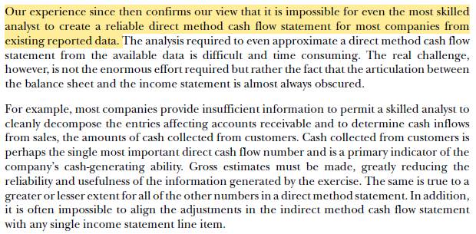
Direct method (DM) vs. indirect method (IM)
CFA Institute (2005, p. 22)

Slide 24
Direct method (DM) vs. indirect method (IM)
Both DM and IM reconcile to the same CFO number.
However, IM does not report operating cash receipts and payments (FASB 1987, para. 111).
Users cannot reliably prepare a DM statement using the data provided in the IM reconciliations (CFA Institute 2005, Orpurt and Zang 2009).
  Cash received from customers
  Cash paid to suppliers and employees
  (net) Interest paid/received, income taxes paid
Many have argued that DM is more consistent with the objective of a statement of cash flows.

Slide 25
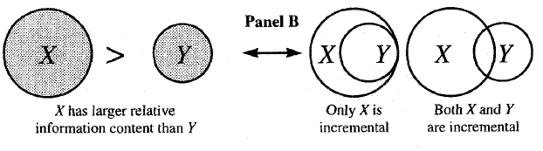
Academic evidence – starting point
There is a strong consensus among academics that earnings is a better predictor of future CFO than CFO (e.g., Dechow et al. (1998, JAE); Barth et al. (2001, TAR); Ball and Nikolaev (2022, JAE)).
Nearly all DM studies follow the “incremental information content” approach (see, Biddle et al. 1995; Gebhardt and Scholz 2014).

Slide 26
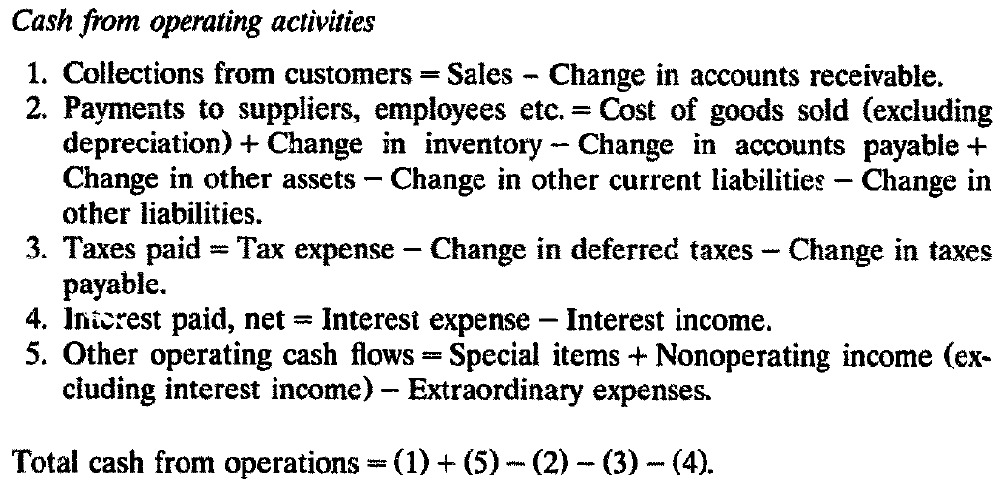
Livnat and Zarowin (1990, JAE): Estimation of cash flow components
Find that individual components of CFO (except tax payments) are differently associated with security returns.

Slide 27
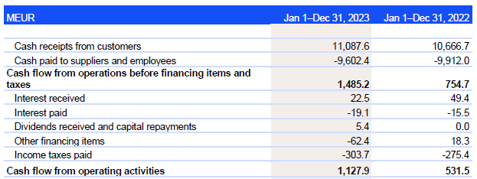
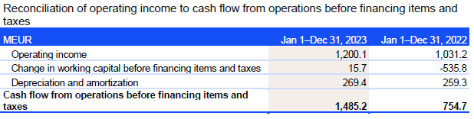
Example of DM: Kone Corporation 2023

Slide 28
Example of DM: Kone Corporation 2023
Sales: 10,952.3 MEUR
Change in accounts receivable (AR): 2,495.1 – 2,668.1 = -173.0
Cash received from customers = Sales - ∆AR = 11,125.3
Kone has a significant amount of advance payments received and deferred revenue (i.e., “contract liabilities”) in its balance sheet. Annual change in this current liability component is 1,915.7 – 1,973.8 = -58.1. Adjusting for this component results in cash received from customers of 11,067.2.
In this case the estimation error is small (about 0.2%).

Slide 29
Krishnan and Largay (2000, JBFA)
U.S. sample over the period 1988-1993 (N=405).
Approximately 2-3 percent of observations include a DM disclosure.
Can investors accurately compute gross cash collections and cash payments?
  Median error for cash collected from customers is less than 1% (~0.75%).
  Median error for cash paid to suppliers and employees is 4.4%.
    The measurement error is greater than zero for all observations.
    The measurement error appears to be material (>3%) for nearly 2/3 of the sample.
Predicting one-year-ahead CFO, gross amounts of cash receipts and cash payments is more value relevant than information about their net amounts.

Slide 30
Orpurt and Zang (2009, TAR)
U.S. sample over the period 1989-2002 (DM sample N=547).
Approximately 2-3 percent of observations include a DM disclosure (decreasing trend -> only 0.48% in 2002).
Estimating DM components (e.g. cash received from customers) is not reliably estimable using income statements and balance sheets or indirect method statements of cash flows.
  Mean value of abs(Sales_Err) is 2.4%.
  Mean value of abs(Supem_Err) is 5.1%.
Estimation (articulation) errors are value relevant (i.e., predict one-year-ahead CFO and EARN).
  However, they have a lower persistence than the main CF components.
  Error components differ in their predictive ability.
Using (future) ERC approach, they provide evidence that DM statements are associated with an increase in the market’s ability to incorporate future earnings information into prices (i.e., better forecasts of future performance).

Slide 31
Australian evidence
Since 1992, Australia has mandated DM reporting under local GAAP.
Since 2007, Australia has allowed firms to choose between DM and IM.
Clinch et al. (2002, RAST)
  Disclosed CFO components (beyond estimates) show incremental predictive power for future CFO (sample period 1992-1997, N=648).
Arthur et a. (2010, A&F)
  Finds that the cash flow components model is superior to an aggregate cash flow model in terms of explanatory power and predictive ability for future earnings (sample period 1992-2005, N=3,672).

Slide 32
Australian evidence (continued)
Clacher et al. (2013)
  Most firms still follow DM (sample period 2000-2010, unique firms N=459).
  DM measures are value relevant for both industrial and extractive firms.
Farshadfar and Monem (2013)
  disaggregating CFO into its components enhances the predictive ability of aggregate operating cash flow in forecasting future cash flows (sample period 1992-2004, unique firms N=349).
Kent and Bu (2020)
  Companies reporting IM incur a significantly higher ex-ante cost of equity but the cost of debt difference is not significant (sample period 2007-2014).

Slide 33
Summary
Cash from customers and cash paid to suppliers/employees cannot be reliably estimated.
  Articulation errors are larger for the latter component.
  The error rates are greater when firm-specific events arise (non-operating activities such as acquisitions, and discontinued operations).
Both equity and debt investors likely favor DM.
  Self-selection issue; one country dominance -> generalizability(?).
Permitting IM is harmful for comparability*.
* Comparability is considered ‘enhancing qualitative characteristics’ in the Conceptual Framework.

Slide 34
References and further reading
Arthur, N., Cheng, M., & Czernkowski, R. (2010). Cash flow disaggregation and the prediction of future earnings. Accounting & Finance, 50(1), 1-30. https://doi.org/10.1111/j.1467-629X.2009.00316.x
Bahnson, P. R., Miller, P. B., & Budge, B. P. (1996). Nonarticulation in cash flow statements and implications for education, research and practice. Accounting Horizons, 10(4), 1.
Ball, R., & Nikolaev, V. V. (2022). On earnings and cash flows as predictors of future cash flows. Journal of Accounting and Economics, 73(1), 101430. https://doi.org/10.1016/j.jacceco.2021.101430
Barth, M. E., Cram, D. P., & Nelson, K. K. (2001). Accruals and the prediction of future cash flows. The Accounting Review, 76(1), 27-58. https://doi.org/10.2308/accr.2001.76.1.27
Biddle, G. C., Seow, G. S., & Siegel, A. F. (1995). Relative versus incremental information content. Contemporary Accounting Research, 12(1), 1-23. https://doi.org/10.1111/j.1911-3846.1995.tb00478.x
Bradbury, M. (2011). Direct or indirect cash flow statements?. Australian Accounting Review, 21(2), 124-130. https://doi.org/10.1111/j.1835-2561.2011.00130.x
CFA Institute. 2005. A Comprehensive Business Reporting Model: Financial Reporting for Investors. Charlottesville, VA: CFA Institute. Available at: https://www.cfainstitute.org/-/media/documents/article/position-paper/comprehensive-business-reporting-model.ashx
Clacher, I., De Ricquebourg, A. D., & Hodgson, A. (2013). The value relevance of direct cash flows under International Financial Reporting Standards. Abacus, 49(3), 367-395. https://doi.org/10.1111/abac.12010
Clinch, G., Sidhu, B., & Sin, S. (2002). The usefulness of direct and indirect cash flow disclosures. Review of Accounting Studies, 7(4), 383-404. https://doi.org/10.1023/A:1020759511460
Dechow, P. M., Kothari, S. P., & Watts, R. L. (1998). The relation between earnings and cash flows. Journal of Accounting and Economics, 25(2), 133-168. https://doi.org/10.1016/S0165-4101(98)00020-2
Ding, Y., Jeanjean, T., & Stolowy, H. (2006, March). The usefulness of disclosing both direct and indirect cash flows: An empirical study. In Workshop Comptabilitie-Audit-Publications.

Slide 35
References and further reading
Farshadfar, S., & Monem, R. (2013). Further evidence on the usefulness of direct method cash flow components for forecasting future cash flows. The International Journal of Accounting, 48(1), 111-133. https://doi.org/10.1016/j.intacc.2012.12.001
Financial Accounting Standards Board (FASB). (1987), Statement of Financial Accounting Standards No. 95, Statement of Cash Flows. https://fasb.org/page/document?pdf=fas95.pdf&title=FAS%2095%20(AS%20ISSUED)
Gebhardt, G., & Scholz, M. (2014). The Costs and Benefits of Requiring an Additional Presentation of Direct Cash Flow Statements–Evidence from Accounting Practice and Empirical Research. http://dx.doi.org/10.2139/ssrn.2747921
Hribar, P., & Collins, D. W. (2002). Errors in estimating accruals: Implications for empirical research. Journal of Accounting Research, 40(1), 105-134. https://doi.org/10.1111/1475-679X.00041
Kent, R. A., & Bu, D. (2020). The importance of cash flow disclosure and cost of capital. Accounting & Finance, 60, 877-908. https://doi.org/10.1111/acfi.12382
Kent, P. F., Kent, R., & Killey, M. (2023). Analysts’ perceptions of cash flow reporting: earnings reliability, confidence and implications for evaluating firm performance. Journal of Accounting Literature. https://doi.org/10.1108/JAL-01-2023-0016
Kone Corporation Annual Report 2023. https://mb.cision.com/Public/18027/3916081/93bad74756a8bad9.pdf
Krishnan, G. V., & Largay III, J. A. (2000). The predictive ability of direct method cash flow information. Journal of Business Finance & Accounting, 27(1‐2), 215-245. https://doi.org/10.1111/1468-5957.00311
Livnat, J., & Zarowin, P. (1990). The incremental information content of cash-flow components. Journal of Accounting and Economics, 13(1), 25-46. https://doi.org/10.1016/0165-4101(90)90066-D
Orpurt, S. F., & Zang, Y. (2009). Do direct cash flow disclosures help predict future operating cash flows and earnings?. The Accounting Review, 84(3), 893-935. https://doi.org/10.2308/accr.2009.84.3.893
Pornupatham, S., Tan, H. T., Vichitsarawong, T., & Yoo, G. S. (2023). The Effect of Cash Flow Presentation Method on Investors’ Forecast of Future Cash Flows. Management Science, 69(3), 1877-1900. https://doi.org/10.1287/mnsc.2022.4406
Sidhu, B. K., & Yu, C. (2021). Direct method operating cash flow disclosures: Determinants and incremental usefulness. Abacus, 57(3), 421-467. https://doi.org/10.1111/abac.12238

Slide 36
Reporting free cash flow

Slide 37
Free cash flow
Free cash flow since 1980s widely used in practice and research
Not specified as subtotal in IFRS / US GAAP
Various perspectives leading to varying definitions:
  ‘objective’ transaction-based measure or ‘normative’ including elements of managerial intent/future expectations (e.g. Jensen, 1986; relative to positive NPV projects)
  Cash flow after capital maintenance or discretionary cash flow (R&D spending? are all finance cash flows discretionary?; e.g. Richardson, 2006)
  Theoretically correct concept versus practical approximation
  Firm perspective or equity-holder perspective?
  Basis for valuation or performance measure?

Slide 38
Voluntary reporting of free cash flow
Adhikari & Duru (2006)
SEC registrants 1994-2004
Disclosures in 10-K/10-Q, mainly MD&A
Upward trend but no more than 5% of registrants
Descriptives on use of different FCF defitions
Some evidence of opportunistic reporting

Slide 39
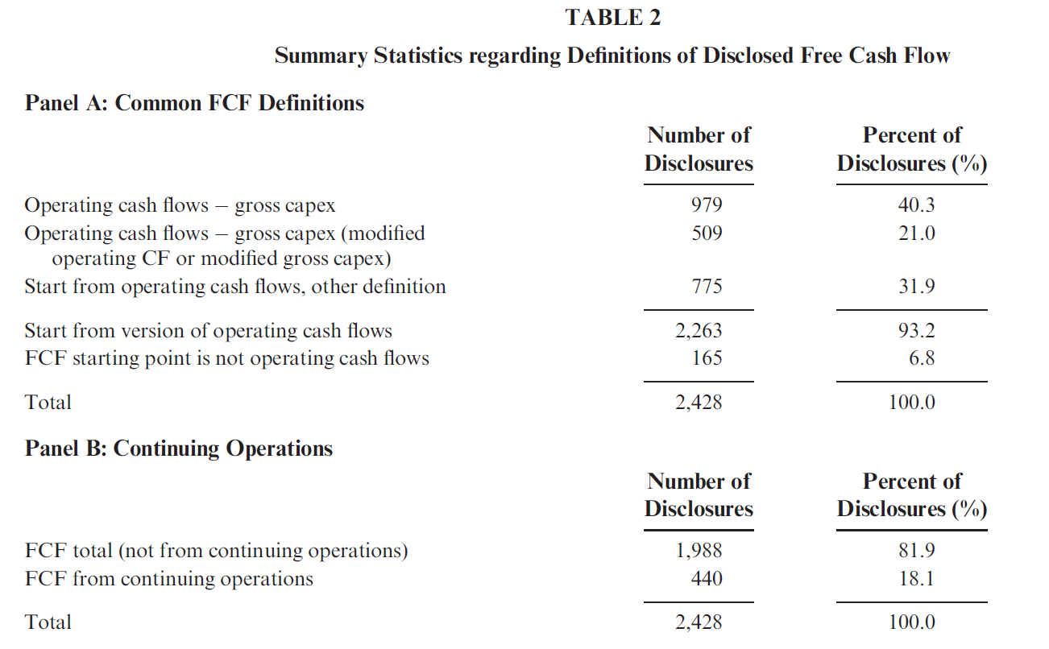
Voluntary reporting of free cash flow
Adame et al (2023)
S&P 1500, 2004-2016
Disclosures in earnings releases
Upward trend, up to 25% of companies
Quite extensive descriptives on use of different FCF definitions and adjustments
Some evidence of opportunistic reporting

Slide 40
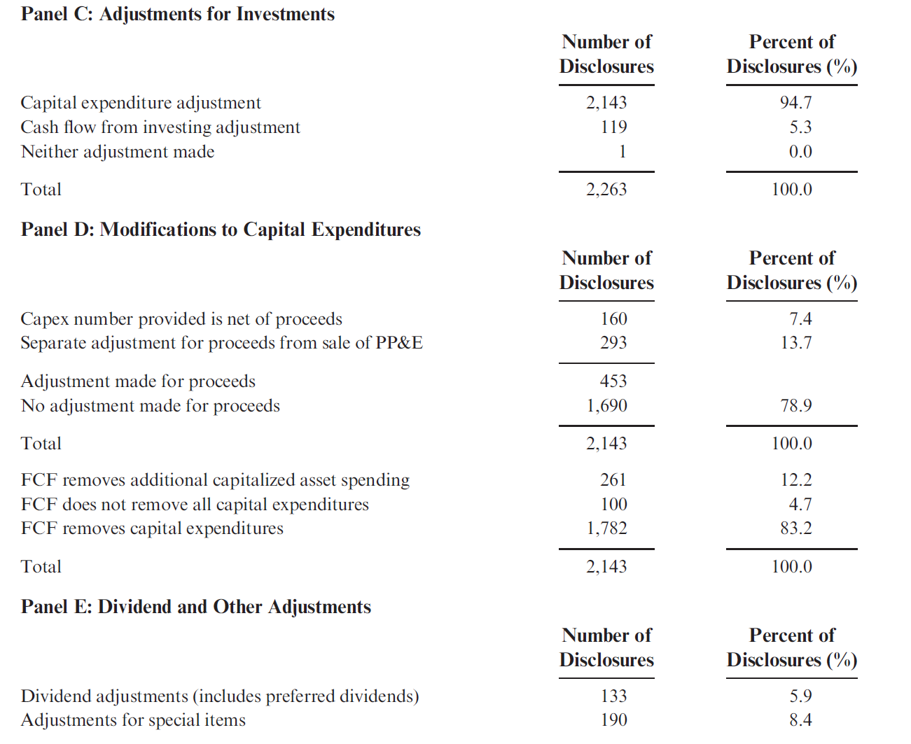
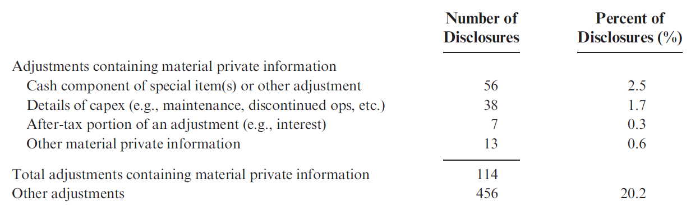

Slide 41
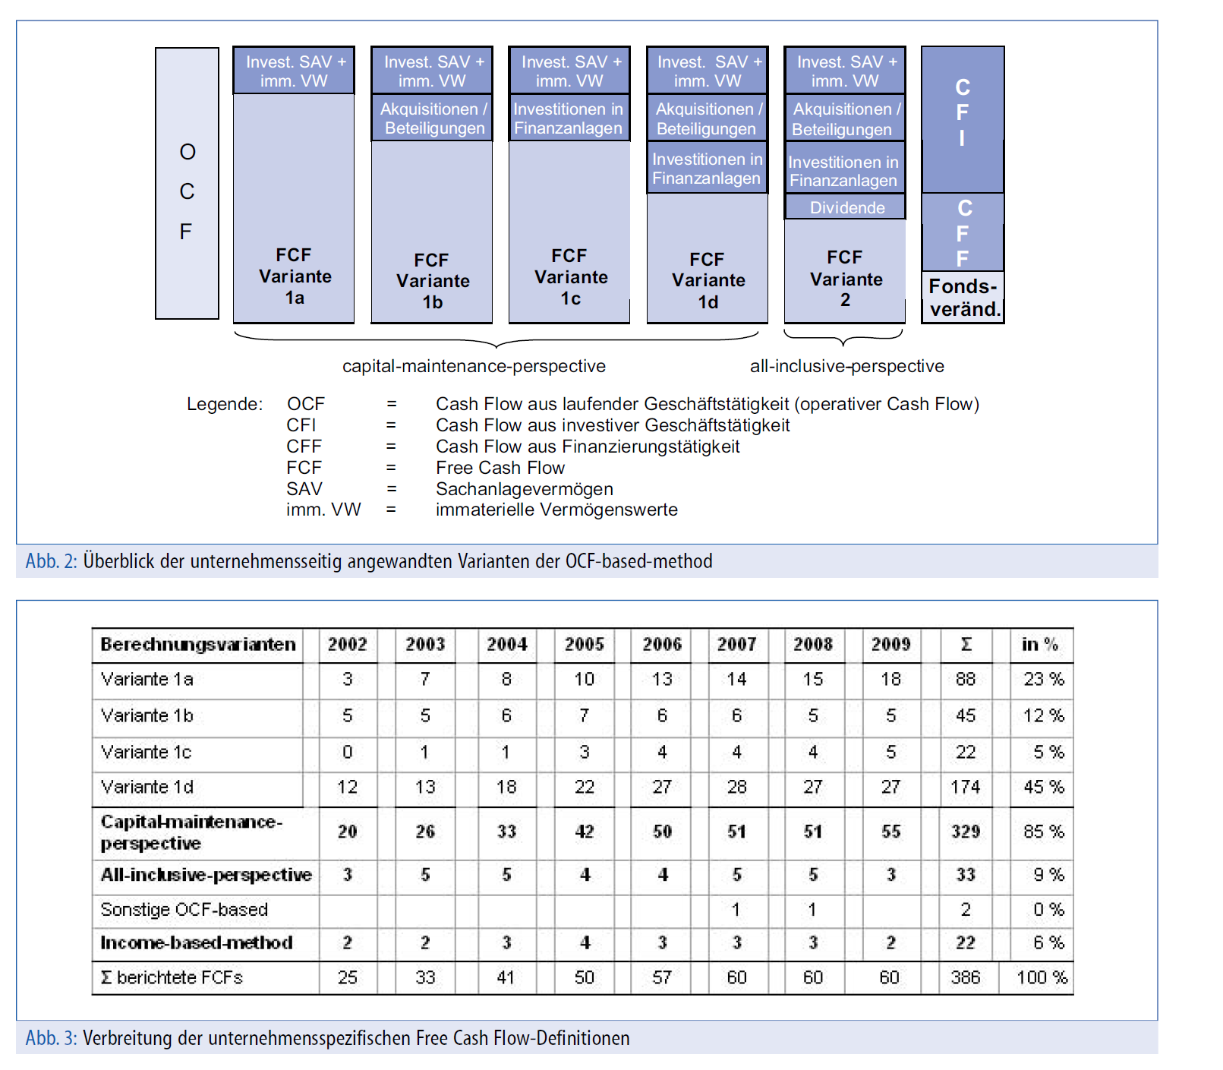
Voluntary reporting of free cash flow
Zirkler & Grunwald-Deliz (2010)
German listed companies, eight-year period in the 2000s
Based on Adhikari & Duru; similar descriptives and tests
FCF disclosure in Geschäftsbericht
Increasing trend up to 53% of companies

Slide 42
Which FCF is value relevant?
Dechow, Richardson & Sloan (2008)
Focus on persistence of cash/non-cash components of earnings
Based on:
  INCOME = ACCRUALS + FCF = ACCRUALS + ΔCASH + DIST_EQ + DIST_D
  FCF = ΔCASH + DIST_EQ + DIST_D
Higher persistence of cash component of earnings (FCF) mainly due to DIST_EQ
Some evidence that investors overestimate persistence of ΔCASH

Slide 43
Which FCF is value relevant?
Awasthi et al (2013)
‘Horse race’ with six FCF-constructs
  FCF0 = - fin + ΔCASH* (CASH* including movements in marketable securities; fin is author-adjusted FIN CF from CFS)
  FCF1 = - fin
  FCF2 = OPS - CAPX (CAPX = net capital expenditure)
  FCF3 = OPS - INV
  FCF4 = OPS - CAPX - DIV
  FCF5 = (EBITDA - DA)(1-t) + DA- CAPX - ΔNWK
Comparison (accuracy, bias, model adequacy) of predicted (FCF-model) with actual market value over different horizons, Compustat firms, 1988-2010
FCF0 performs best overall; FCF2 best ‘back of the envelope’ measure
For similar analyses see a series of industry-by-industry papers by Maksy (2013-2022)

Slide 44
Proposals for presenting FCF
Stein and Hamman (2003):
Proposal for a CFS with a split between discretionary and non-discretionary capital spending
Limited discussion of how the split should be made
Kousenidis (2006):
Attempt to define a practical CFS format that is consistent with FCF as used in the finance literature
Does not discuss different points of view on FCF in finance literature
Yaari et al (2016):
Argues for FCF excluding ‘offset’ from Δ Current liabilities as basis for valuation
Includes empirics on effects of no and partial offsets as against ‘standard’ full offset.
Dichev (2021)
Proposal for modified CFS format with net cash distributed to (received from) equity holders as final section

Slide 45
Reporting free cash flow
‘useful number’: growing practice of reporting FCF numbers + established practice of use in valuation
unsurprising diversity given absence of guidance and absence of consensus about a single ‘right’ definition
‘Discretion’ and ‘relation to investment opportunities’ are significant elements in finance view of FCF: do accounting standard setters want to go there?
At least for academic users: low probability of finding satisfactory single standardized number, but this may also be the case for practitioners.

Slide 46
Three-way classfication in the cash flow statement

Slide 47
Three-way classification
Division in cash flows from operations, investments and financing has been well-established since SFAS 95 (followed by IAS 7 as revised 1992), not fundamentally called into question
Some classification issues may for practical purposes have been resolved in standards but remain in principle problematic, e.g. Nurnberg (1993):
  Operating versus investing (R&D?)
  Operating versus finance (interest, dividends)
  Allocation (or not) of tax cash flows
Amendments in line with IFRS 18 have resolved some of these issues by removing classification options

Slide 48
Classification choice under IAS 7
Specifically for IFRS: discretion allowed by IAS 7 in classifying interest and dividends (paid/received) has given rise to literature on descriptives, determinants and effects of classification choices
Gordon et al (2017) | EU listed firms 2008-2012 | Descriptives, determinants, effects
Kretzman et al (2015) | German listed firms 2005-2012 | Descriptives, determinants
Charitou et al (2018) | UK listed firms, 2006; classification upon initial adoption of IFRS | Descriptives, determinants, effects
Baik et al (2016) | Korean listed firms, 2011-2012; classification upon initial adoption of IFRS | Descriptives, determinants, effects
Backhuijs et al (2016) | EU listed firms, 2015 | Descriptives
De Souza Costa et al (2019) | Brazilian listed firms, 2010-2015 | Descriptives, determinants
Chiang et al (2021) | Taiwanese listed firms, 2013; classification upon initial adoption of IFRS | Descriptives, determinants
Hessian et al (2024) | UK listed firms, 2007-2017 | Descriptives, determinants

Slide 49
Classification choice under IAS 7
When moving to IFRS from prior mandatory classification of interest paid as OCF:
  32% (UK, Charitou et al, 2018), 13% (Korea, Baik et al, 2016), 29% (Taiwan, Chiang et al, 2021) shift to classification as FinCF
More general descriptive findings:
  *percentages of firms where classification is determinable; some studies report signifcant percentages for ‘not clear/other/not applicable’)
(% OCF, ICF, FinCF)* | Gordon et al (2017) | Kretzman et al (2015) | Backhuijs et al (2016) | De Souza Costa et al (2019)
Interest paid | 76, 1, 23 | 70, 1, 29 | 67, 0, 33 | 58, 0, 42
Interest received | 60, 31, 9 | 71, 18, 10 | 65, 30, 5 | 63, 20, 17
Dividends received | 67, 40, 3 | 69, 28, 3 | 64, 36, 0 | 31, 64, 5

Slide 50
Classification choice under IAS 7: determinants
Studies typically report association of OCF-increasing classification with variables suggestive of opportunism, although not always consistently:
Indicative tabulation, selected results; see papers for full details
 | Gordon et al | Kretzmann et al | Charitou et al | Baik et al | De Souza Costa et al | Chiang et al | Hessian et al
Size |  | - |  |  | + | + | -
Equity issue | +
Analyst following | -
Financial distress | + |  |  | + |  |  | +
Losses (lower profitability) | + | + | + |  | -
Debt/leverage | + | + | + | + | + | -
Book to market |  |  |  |  | +
Negative / lower OCF |  |  |  |  | + |  | +
Auditor quality / auditor independence |  | - | - |  |  |  | -
Corporate governance quality |  |  | - |  |  | +/-

Slide 51
Classification choice under IAS 7: effects
OCF-increasing classification may negatively affect market’s ability to predict OCF (Gordon et al)
OCF-increasing classification is associated with lower market value of equity (Charitou et al)
Lower market reaction to cash flow surprises for OCF-increasing classification (Baik et al)

Slide 52
Classification choice under IAS 7 takeaway
Free classification choice for interest and divend seems to have resulted in fairly stable majority/minority practices, although not in line with changes introduced with IFRS 18
Indications of opportunistic classification support removal of options
Research literature has mostly not yet moved on to other classification issues

Slide 53
Classification choice: other
Lee (2012) includes two elements:
Analysis of cash flow manipulation using ‘unexpected’ cash flows
  Using regression-based residuals to determine ‘unexpected’ cash flows. Has inspired some subsequent work (Nagar and Raithata, 2016; Yang and Kim, 2020) but may not be relevant for standard setting
(2) Analysis of cash flow manipulation using hand-collected data on classification of tax benefit on employee stock option expenses (US GAAP, prior to 2000)
  Comparable results for opportunistic OFC-increasing classification
  Rare example of detailed investigation of classification issue other than interest/dividend

Slide 54
References
Adame, K. W., Koski, J. L., Lem, K. W., & McVay, S. E. (2023). Free cash flow disclosure in earnings announcements. Journal of Financial Reporting, 8(2), 1-23. https://doi.org/10.2308/JFR-2020-010
Adhikari, A., & Duru, A. (2006). Voluntary disclosure of free cash flow information. Accounting Horizons, 20(4), 311-332. https://doi.org/10.2308/acch.2006.20.4.311
Awasthi, V. N., Chipalkatti, N., & De Mello e Souza, C. A. (2013). Connecting free cash flow metrics to what matters for investors: Accuracy, bias, and ability to predict value. Journal of Applied Finance (Formerly Financial Practice and Education), 23(2).
Backhuijs J, Vergoossen R, de Vos N (2016) Het kasstroomoverzicht van Europese ondernemingen: classificaties en toelichting. Maandblad Voor Accountancy en Bedrijfseconomie 90(12): 524-540. https://doi.org/10.5117/mab.90.31224
Baik, B., Cho, H., Choi, W., & Lee, K. (2016). Who classifies interest payments as financing activities? An analysis of classification shifting in the statement of cash flows at the adoption of IFRS. Journal of Accounting and Public Policy, 35(4), 331-351. https://doi.org/10.1016/j.jaccpubpol.2015.11.003
Chiang, S., Kleinman, G., & Lee, P. (2021). The effect of auditor industry specialization and board independence on the cash flow reporting classification choices under IFRS: evidence from Taiwan. International Journal of Accounting & Information Management, 29(1), 147-168.
Charitou, A., Karamanou, I., & Kopita, A. (2018). The determinants and valuation effects of classification choice on the statement of cash flows. Accounting and Business Research, 48(6), 613-650. https://doi.org/10.1080/00014788.2017.1407626
Costa, P. D. S., Pinto, A. F., Nunes, F. M., & Lemes, S. (2019). Comparability of accounting choices in the statement of cash flow: Evidence from Brazil. Contaduría y administración, 64(3).
Dechow, P. M., Richardson, S. A., & Sloan, R. G. (2008). The persistence and pricing of the cash component of earnings. Journal of accounting research, 46(3), 537-566.
Dichev, I. D. (2021). Re‐orienting the Statement of Cash Flows Around Cash Flows to Equity Holders. Abacus, 57(3), 407-420.
Kousenidis. D.V. , (2006) "A free cash flow version of the cash flow statement: a note", Managerial Finance, Vol. 32 Issue: 8, pp.645-653
Gordon, E. A., Henry, E., Jorgensen, B. N., & Linthicum, C. L. (2017). Flexibility in cash-flow classification under IFRS: determinants and consequences. Review of Accounting Studies, 22, 839-872. https://doi.org/10.1007/s11142-017-9387-1
Jensen, M. C. (1986). Agency costs of free cash flow, corporate finance, and takeovers. The American economic review, 76(2), 323-329.
Khansalar, E., & Namazi, M. (2017). Cash flow disaggregation and prediction of cash flow. Journal of Applied Accounting Research, 18(4), 464-479.
Kretzmann, C., Teuteberg, T., & Zülch, H. (2015). Comparability of reported cash flows under IFRS: evidence from Germany (p. 906). HHL Leipzig Graduate School of Management.
Lee, L. F. (2012). Incentives to inflate reported cash from operations using classification and timing. The Accounting Review, 87(1), 1-33. https://doi.org/10.2308/accr-10156

Slide 55
Lee, L. F. (2012). Incentives to inflate reported cash from operations using classification and timing. The Accounting Review, 87(1), 1-33. https://doi.org/10.2308/accr-10156
Nagar, N., & Raithatha, M. (2016). Does good corporate governance constrain cash flow manipulation? Evidence from India. Managerial Finance, 42(11), 1034-1053. https://doi.org/10.1108/MF-01-2016-0028
Nurnberg, H. (1993). Inconsistencies and ambiguities in cash flow statements under FASB Statement No. 95. Accounting Horizons, 7(2), 60-75.
Richardson, S. (2006). Over-investment of free cash flow. Review of accounting studies, 11, 159-189.
Steyn, B. W., & Hamman, W. D. (2003). Revamping the cash flow statement. Meditari Accountancy Research, 11(1), 181-198.
Yaari, U., Nikiforov, A., Kahya, E., & Shachmurove, Y. (2016). Finance methodology of free cash flow. Global Finance Journal, 29, 1-11.
Yang, D., & Kim, H. (2020). Managerial overconfidence and manipulation of operating cash flow: Evidence from Korea. Finance Research Letters, 32, 101343. https://doi.org/10.1016/j.frl.2019.101343
Zirkler, B., & Grunwald-Delitz, S. (2010). Free Cash Flows als Element wertorientierter Berichterstattung–Eine Analyse der Geschäftsberichte von Unternehmen des DAX und MDAX. Controlling–Zeitschrift für erfolgsorientierte Unternehmenssteuerung, (10), 544-551

Slide 56
Banks’ cash flow statements

Slide 57
Bank topics (1)
Objectives of CFS and general evidence of usefulness
Objectives criticized by banks because the current cash flow statement doesn’t reflect liquidity management provided by treasury (looking into the mirror instead of into the future cash flows, forecast transactions missing, pipeline transactions missing, time buckets missing)
Two papers might represent the academic research regarding CFS provided by banks with opposite outcomes
  Burke, Q. L., & Wieland, M. M. (2017). Value relevance of banks' cash flows from operations. Advances in accounting, 39, 60-78.
  Their study examines the value relevance of banks' cash flows from operations under US GAAP. Using a sample of banks from 2004 to 2014, they find that banks' cash flows from operations are predictive of future earnings and cash flows (cash flows from operations are positively and significantly associated with share prices).
  Gao, Z., Li, W., & O’Hanlon, J. (2019). The informativeness of US banks’ statements of cash flows. Journal of Accounting Literature, 43(1), 1-18
  Their paper examines the informativeness of CFS of U.S. commercial banks in two settings.
  The first analysis tests the incremental value relevance of banks’ CFS beyond income statements and balance sheets and compares bank’s CFS with those of industrial firms. They find that banks’ CFS have limited incremental value relevance, and are much less value relevant than industrial firms’ CFS.
  The second analysis examines and finds no distress-predictive power of banks’ CFS, especially in the presence of standard distress predictors. These results are consistent with the view that banks’ CFS have limited informativeness.

Slide 58
Bank topics (2)
2. Direct versus indirect method
Not a major point for banks – operationally easier is the indirect method (as long as the cash flow statement is seen as irrelevant, the indirect method works well enough)
3. Cash concept
For banks a very narrow definition of cash and cash equivalents is meaningful due to their business activity.
Demand deposits should not be included in the cash position, as they are not primarily used to meet short-term payment obligations. Moreover, they represent the basis of ongoing business activities and are used, for example, to generate arbitrage profits in money trading (see also GAS 21.A2.6).
Debt securities issued by public authorities and securities eligible for refinancing with central banks are considered cash equivalents (GAS 21.A2.7). Securities held for trading are part of an institution's operating business. They are therefore not classified as cash equivalents (GAS 21.A2.8).
Restricted cash is still presented as cash in some cash flow statements as seen as collateral (however, diversity in practice) – relevant regarding minimum reserve required by central banks (for example, cash deposits at ECB). Equivalent also GAS 21.A2.10 and 11) – Any restrictions on disposal of the financial resources have to be disclosed (only disclosure in the notes not within the presentation of the statement). The minimum reserve to be maintained by credit institutions does not constitute a restriction on disposal according to GAS 21.A2.11 in conjunction with GAS 21.A2.10.

Slide 59
Bank topics (3)
4. Classification and subtotals
Operating cash flow for banks – in Germany defined under the inclusion of assets according to German line items of the profit and loss statement which would lead to a sub-total of operating income. Translated into the language of the IFRS operating income would include net interest income, net fee income, additions to or subtractions of loan loss reserve, net trading income, administrative expenses and net of other operating income/expenses. Hence, the line item within the cash flow statement would represent the cash flow of the respective income parameters. (see GAS 21.A2.14, GAS 21.A2.3).
Hence, interest paid and interest received as well as dividends received belong to the operating cash flow.
The Standard Setter in Germany argues that the cash flow from operating activities is broader for institutions than for corporates. The decisive factor is the fundamental difference between the ongoing business activities of institutions and companies of other industry sectors (GAS 21.A2.15).
Investing cash flow for banks – according to the broad definition of operating cash flow, the investing cash flow for banks in Germany consists of cash inflows and cash outflows of long-term assets (PPE, intangibles and financial investments).
In Germany, financial assets are divided into trading, assets held for liquidity management and long-term financial assets. Therefore, under IFRS it would have to be decided whether long-term and short-term financial assets should be distinguished (criterion remaining holding period of one year) or, maybe, at amortised cost and at fair value through p/l on the one hand (as operating cash flow) and fair value through OCI on the other hand (as investing cash flow) when the criterion should be according to measurement categories or according to business activities in practice like under the German treatment.
Financing cash flow for banks – results from transactions with owners of the institutions and minorities. Furthermore, cash flows from other capital sources are to be included (GAS 21.A2.22). Dividends paid also belong to the financing cash flow (GAS 21.A2.23). In this sense, financing with equity holders should be the main criterion for the categorisation as financing. In contrast, financing with third parties would have to be shown under operating cash flow (GAS 21.A2.25).

Slide 60




Follow us online
ifrs.org
@IFRSFoundation
IFRS Foundation
International Accounting Standards Board
Stay in touch: academics@ifrs.org

